Slide 1
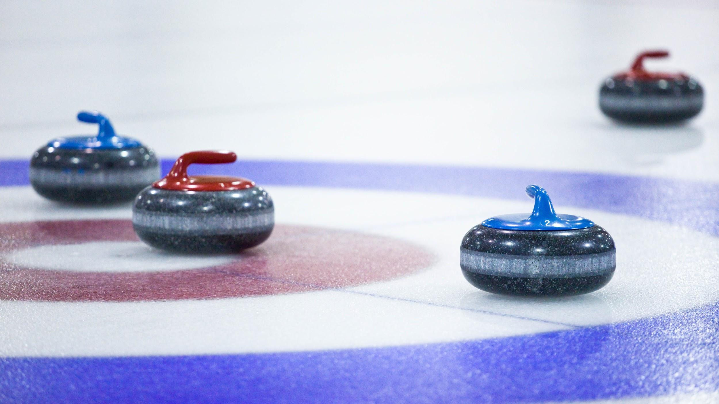
LEVEL 3 : INTERMEDIATE
IMPROVING PLAYING SKILLS

Slide 2
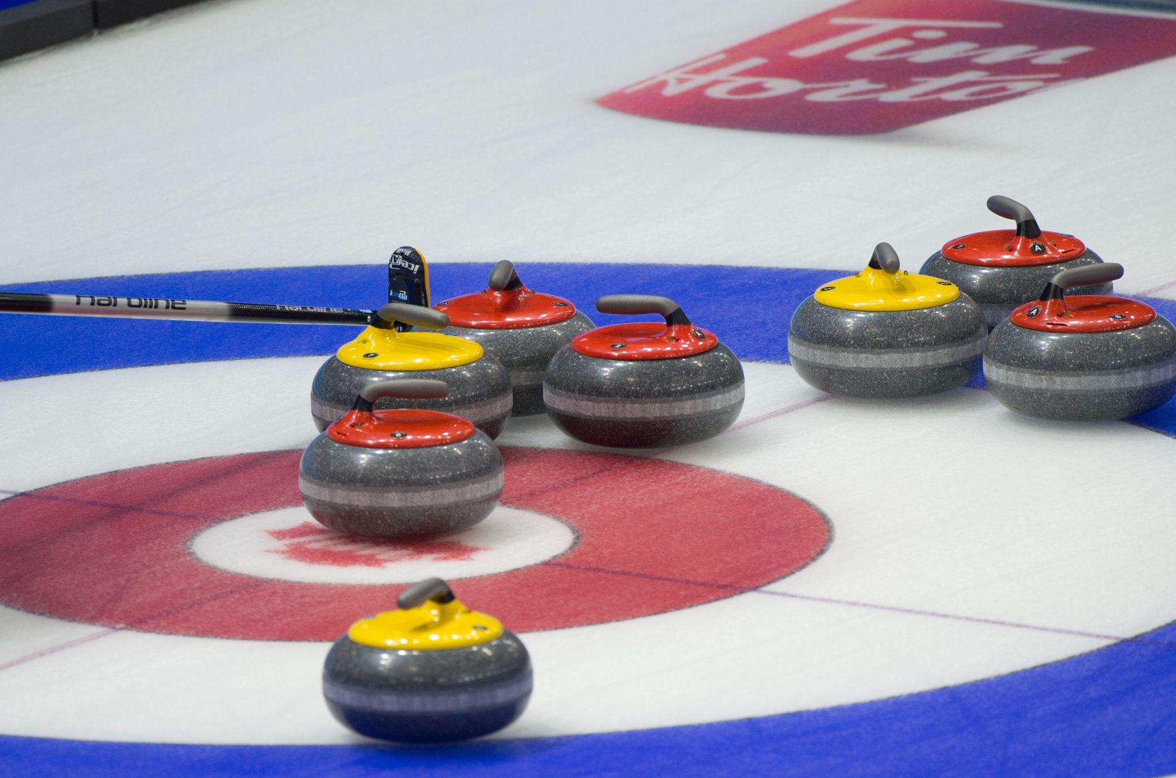
WEEK 1 - INTRODUCTION

Slide 3
Introduction
LEVEL 3 - WEEK 1
→ Introduction of the instructor(s)
→ Introduction of the participants
→ Presentation of the program
🥌 4 levels of 10 sessions each
🥌 Beginner to Intermediate levels
🥌 Sessions of 120 minutes each
🥌 Divided into 3 segments: off ice/on ice/games

Slide 4
Objectives
LEVEL 3 - WEEK 1
Objectives of the program:
🥌 Learning basic curling techniques
🥌 Offering a positive experience
🥌 Offering a safe environment with instructors
🥌 Offering sessions specifically developed for recreational curlers
🥌 Giving an opportunity for all participants to reach an advanced-intermediate level of curling play by the end of Level 4

Slide 5
Themes
LEVEL 3 - WEEK 1
Subjects to be seen in level 3:
→ Reviewing your positioning in the hack
→ Introduction to sliding with a broom
→ Perfecting the steps for the proper slide (draw vs take-outs)
→ Improving your sweeping techniques in the open stance and introduction to the closed sweeping position
→ Reviewing and applying the release zone
→ Introduction to hitting angles and the drag effect
→ Introduction to a shot-making routine
→ Evolving your strategic planning and understanding shot tolerance
→ Improving your communication system and signals
→ Introduction to tournaments (Colts circuit)

Slide 6
Security
LEVEL 3 - WEEK 1
⛑
Review of the risk factors:
Mechanical factors
🥌 Grippers, sliders, shoes, brooms, ice making equipment, stones
Environmental factors
🥌 Cold
🥌 Dehydration
Human factors
🥌 Participants, instructors, officials, coaches

Slide 7
Security
LEVEL 3 - WEEK 1
⛑
Reminder of elements related to safety on the ice:
→ Warm-up
→ Always step on the ice with the gripper foot first
→ Never run or walk backwards on the ice
→ A coach must always have an emergency action plan to minimize risk
→ The instructors organize appropriate activities that fit the participants’ skill level
→ Always have adequate equipment: grippers, clean broom
→ Knowing where the emergency kit and the defibrillator

Slide 8
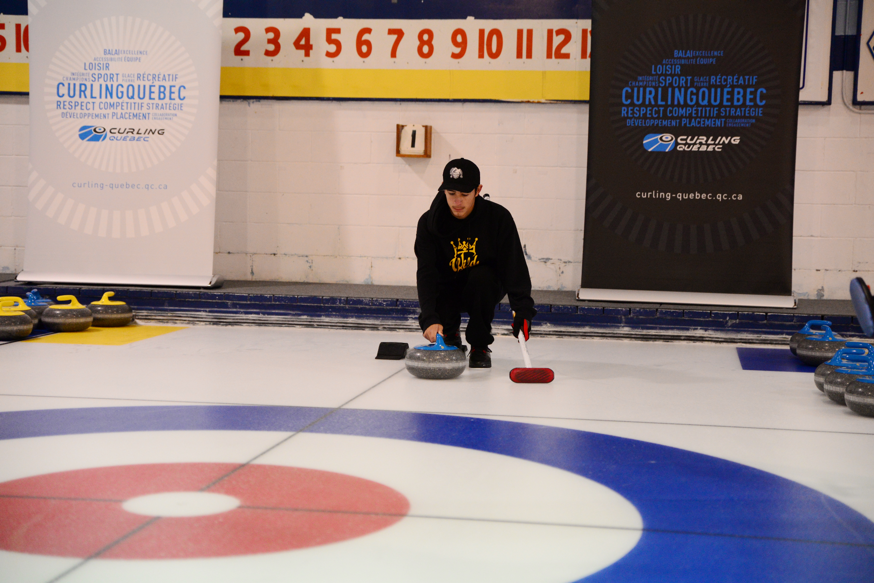
Hack
LEVEL 3 - WEEK 1
Reviewing the steps to a proper slide:
→ The shoulders are parallel to the ice and perpendicular to the line of delivery
→ The hips are perpendicular to the line of delivery (the left and right hip bones act as our eyes, they should aim at the line of delivery)
→ The dominant eye is on the line of delivery (or close to it)*
→ The broom arm is slightly flexed
→ The throwing arm is firm but relaxed, the elbow remains slightly flexed
*Example: The dominant eye for a right hander maybe the left eye. In this case, one must move that eye towards the line of delivery.

Slide 9
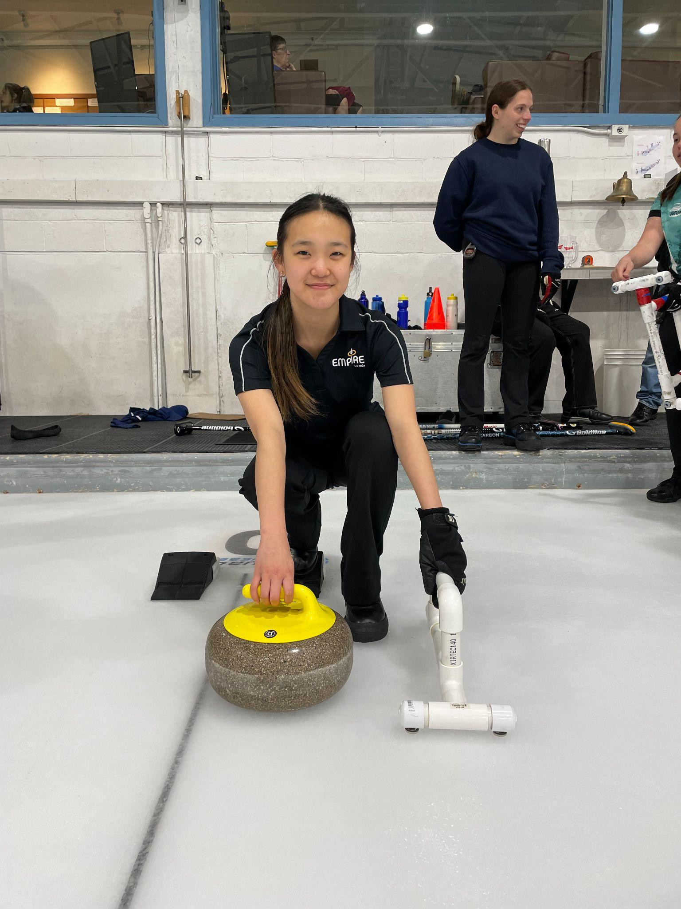
The throw
LEVEL 3 - WEEK 1
Reviewing the steps to throwing the stone:
1. The position in the hack
🥌 Positioning of the foot in the hack and of the sliding foot
🥌 Shoulder and hip positioning
🥌 The supporting arm and the shooting arm
2. The backswing
🥌 Elevated hips
🥌 Slightly back up the sliding foot (no more than heel to toe)
🥌 Body weight equally distributed on both legs
🥌 Pause

Slide 10
The throw
LEVEL 3 - WEEK 1
Steps to throwing a stone (cont’d):
3. Weight transfer and forward swing
🥌 Transfer the upper body weight forward
🥌 At the same time that the rock moves forward on its line of delivery, bring the sliding foot to the center of gravity (under the belly button)
4. Pushing from the hack
🥌 The foot of the hack leg pushes with the strength needed to make the called shot

Slide 11
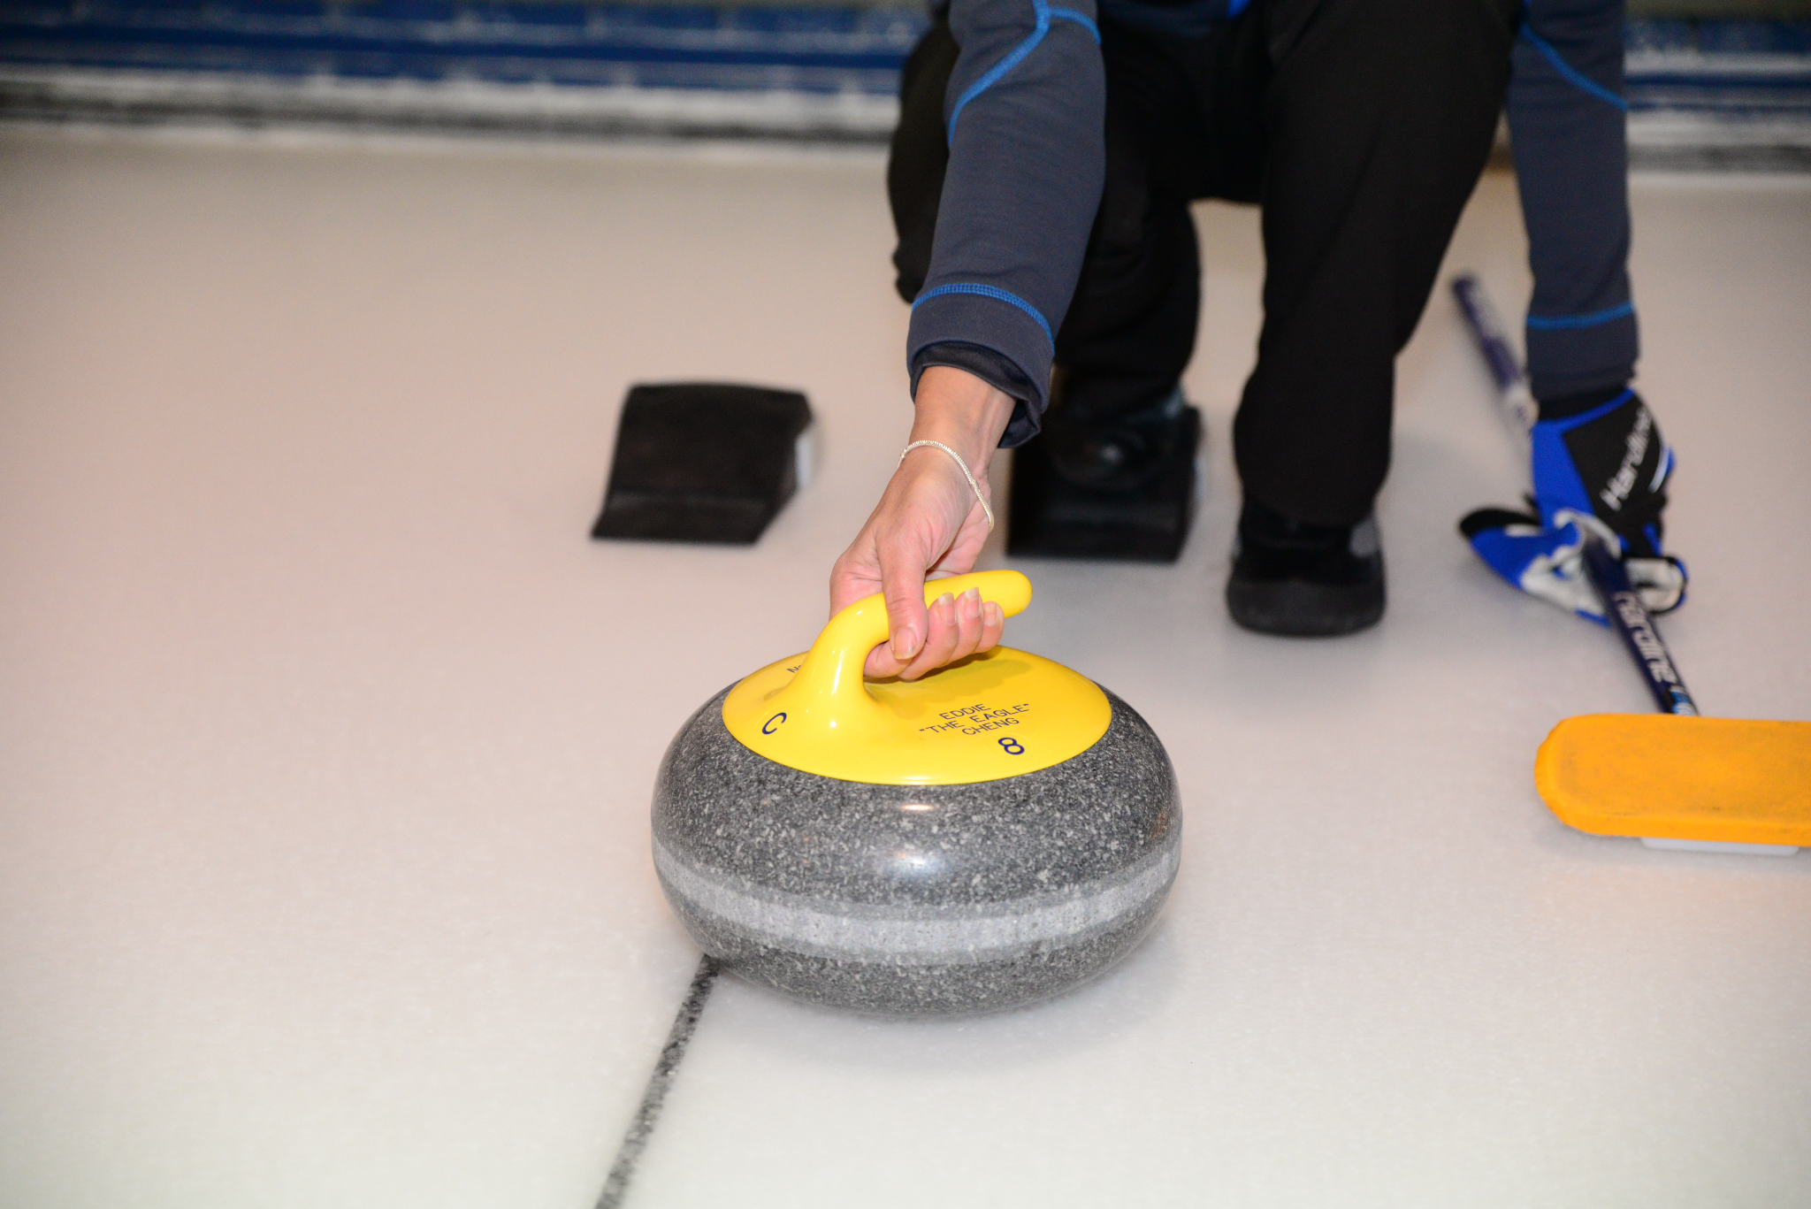
The release
LEVEL 3 - WEEK 1
Review of the release:
→ Place the stone so that the handle points to 12 o’clock
→ Maintain a slightly bent elbow
→ Form a “U” with the fingers that are under the handle
→ Position the thumb on the left side of the handle
→ Put the emphasis on the thumb, the index and the middle finger
→ A “V” is created with the thumb and index finger
→ For a clockwise rotation, position the stone at 10 o’clock (the neck of the handle). The point of the “V” will aim at the right shoulder
→ For a counterclockwise rotation, position the stone at 2 o’clock (the neck of the handle). The point of the “V” will aim at the left shoulder.

Slide 12
Release zone
LEVEL 3 - WEEK 1
Revision of the release zone:
→ The release point is exactly when the stone leaves the hand of the shooter.
→ The rotating motion is done over the length of a broom… the time it takes to say: Tic Tac Toe.
→ Release the rock at 12 o’clock (for both a clockwise and counterclockwise rotation).
→ Each player of the team should release the stone in a similar spot.
→ The more consistent the release, the more consistent the shots will be, and it will be easier for the sweepers to judge.

Slide 13
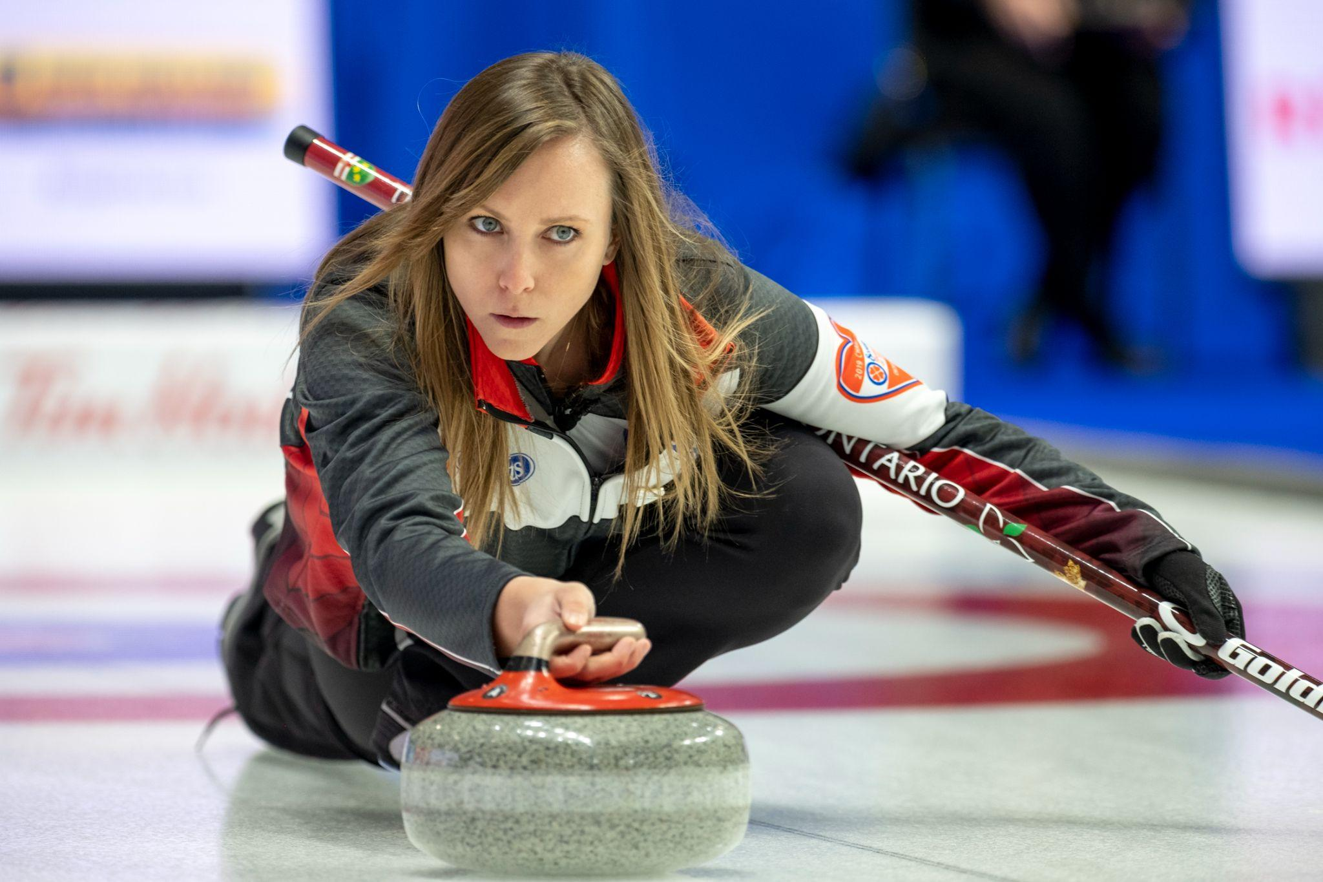
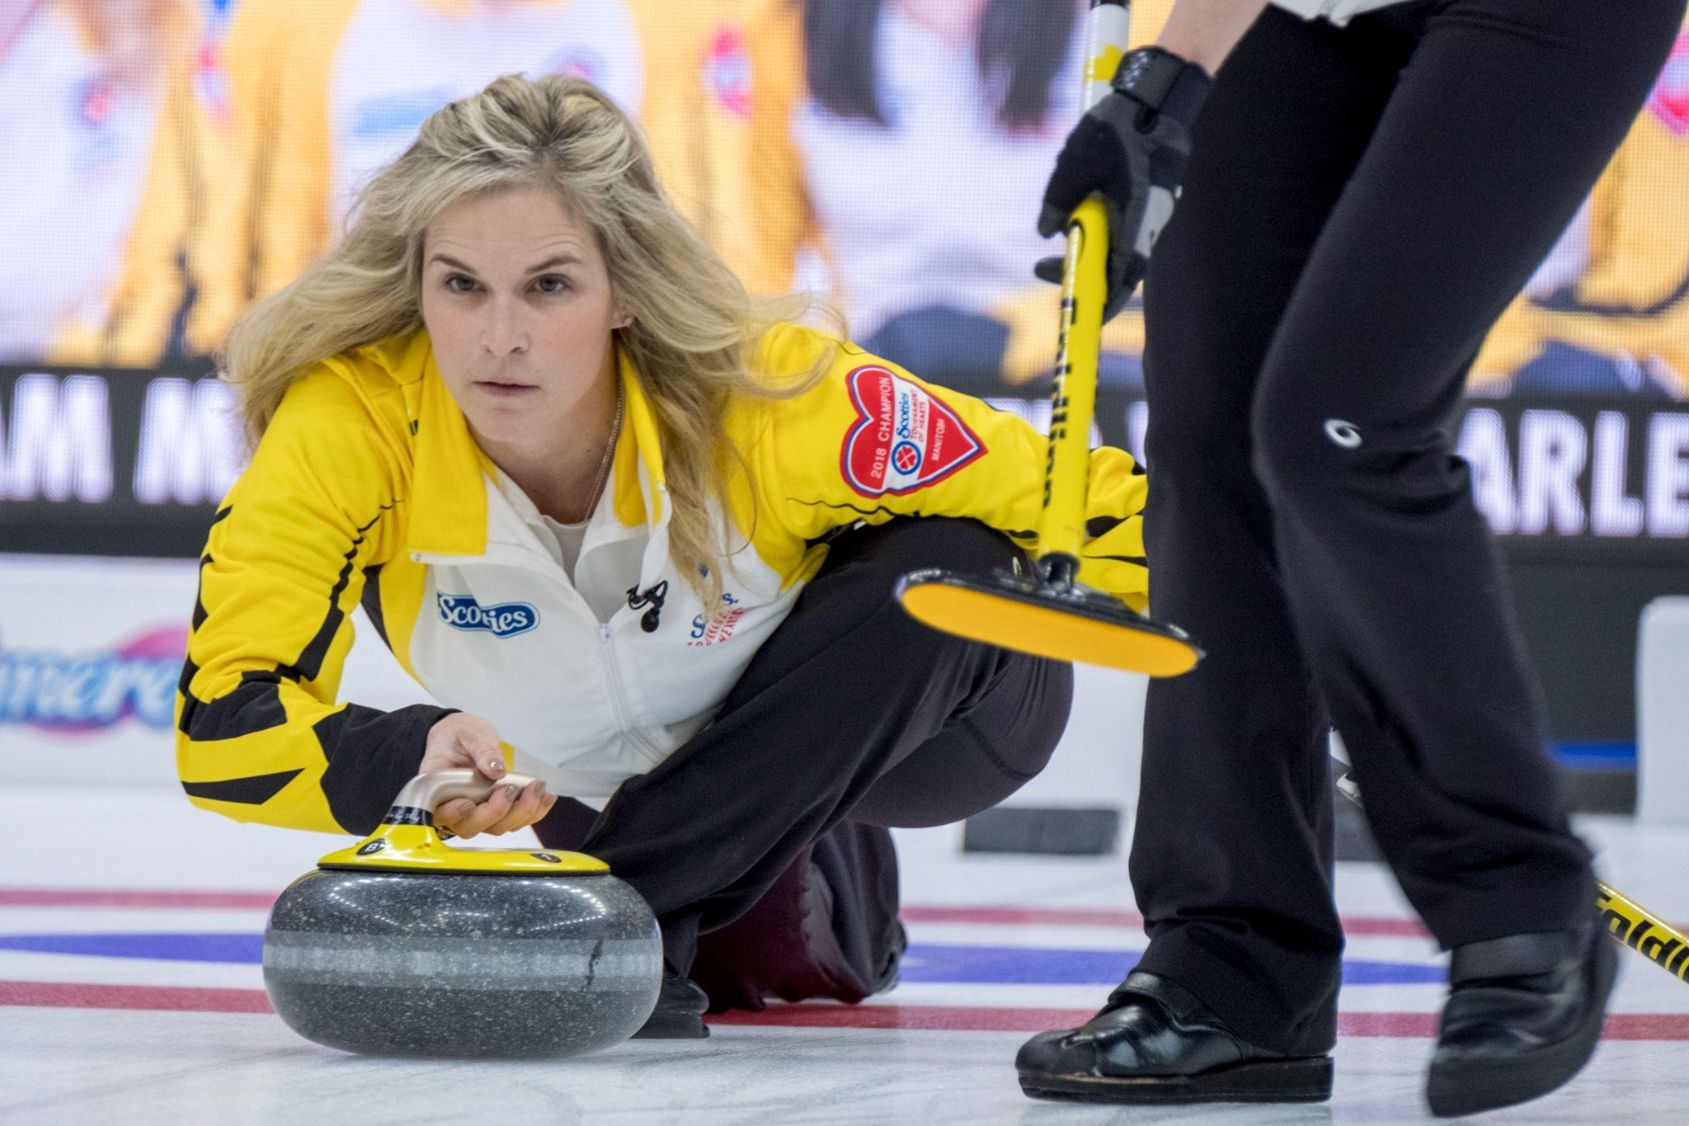
The release - Pictures
LEVEL 3 - WEEK 1
Both players are right handed! Can you tell which one has a dominant left eye?

Slide 14
Coach’s advice
LEVEL 3 - WEEK 1
→ It is important for each participant to master the basics of throwing a stone in order to increase their success rate.
→ The more we are aware of our body positioning and movements, the better we will control the fine details.
→ Even for high performance athletes, it is important to come back to basics when working on technical points.
Practice = Awareness = Adjustments = Consistency

Slide 15
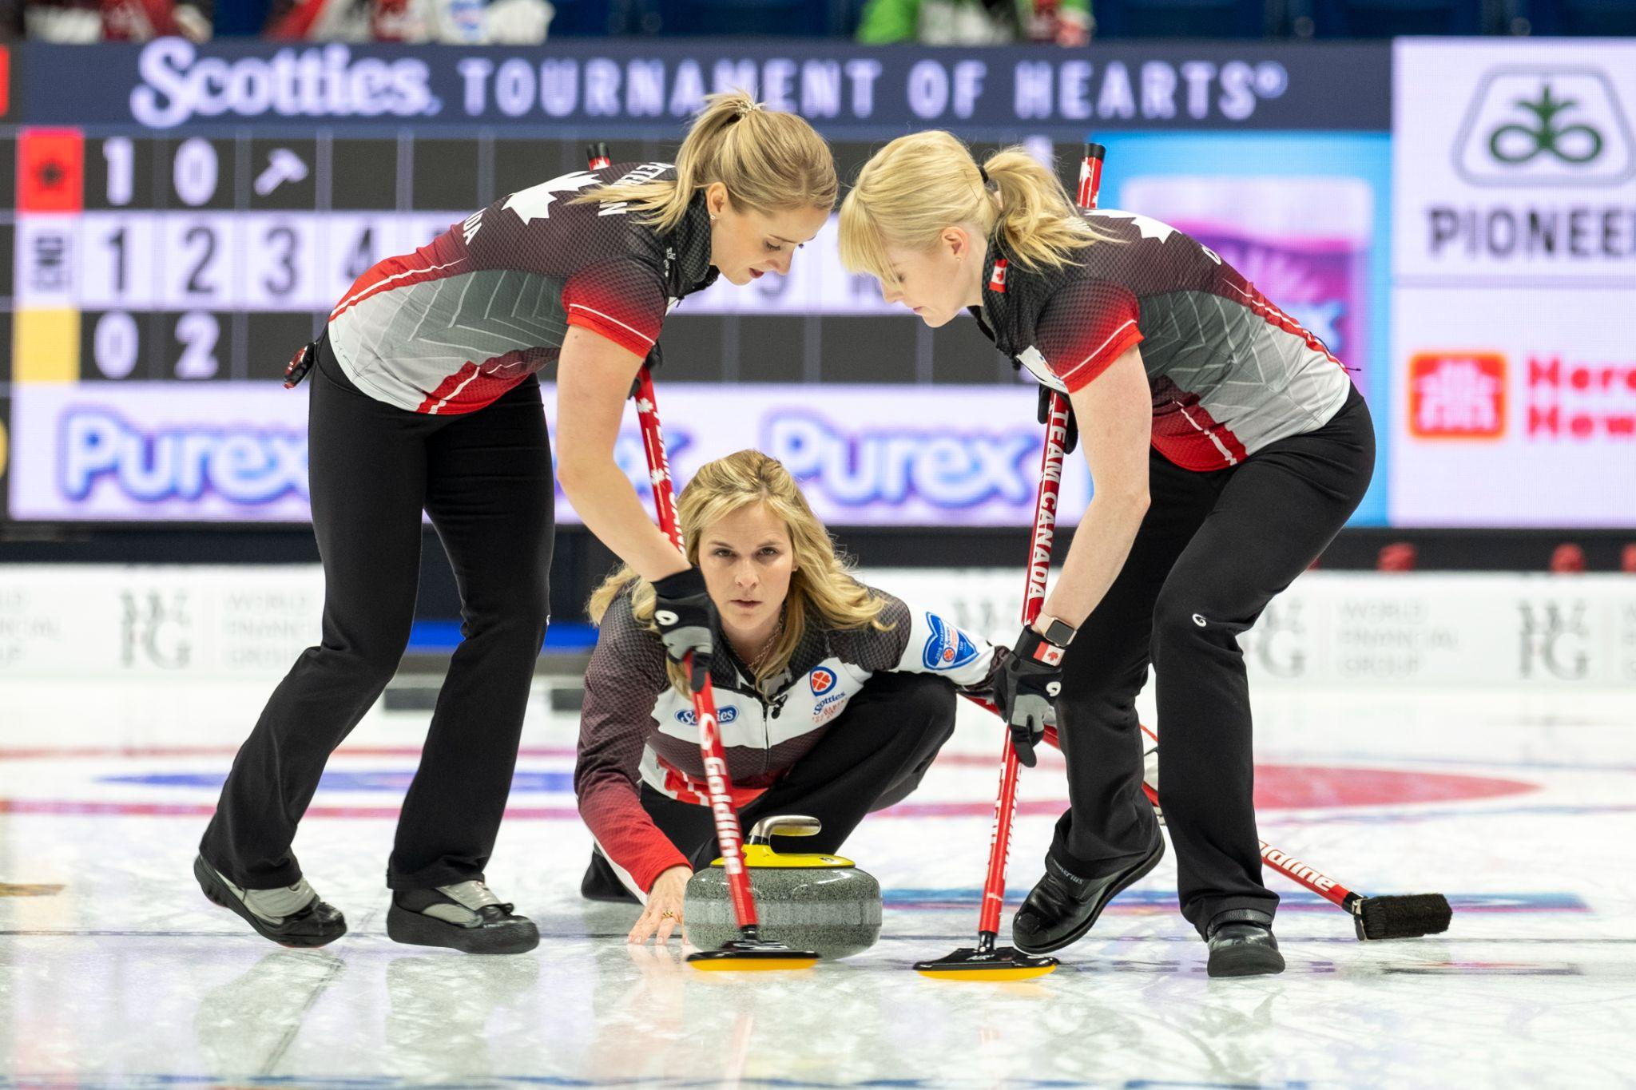
WEEK 2 - SWEEPING

Slide 16
Sweeping
LEVEL 3 - WEEK 2
Review the 4 key points for efficient sweeping:
1. The hand position on the broom
🥌 The lower hand is about one foot away from the broom head
2. The head position
🥌 The eyes are over the rock
3. A straight back
🥌 By keeping the back straight we lower the risk of injuries
4. Footwork
🥌 Side to side movement and on tiptoes
🧹

Slide 17
Sweeping - Review
LEVEL 3 - WEEK 2
🧹
Review of the factors that influence the trajectory of the rock while sweeping:
→ Ice temperature
→ Outside weather
→ Sweepers’ efficiency
→ Ice surface (eg. Pebble size)
→ Garbage, dirt, dust
→ Length of the game (eg. A team that is tight on time will play more take outs)

Slide 18
Sweeping - Qualities to develop
LEVEL 3 - WEEK 2
Qualities to develop to become a good sweeper:
→ Be a great communicator (roles of the lead and second)
→ Improve your physician endurance (interval cardiovascular exercise is prioritized when training in a gym)*
→ Increase the speed of the sweeping motion
→ Increase the pressure put on the broom head
*Will be discussed in Level 4
🧹

Slide 19
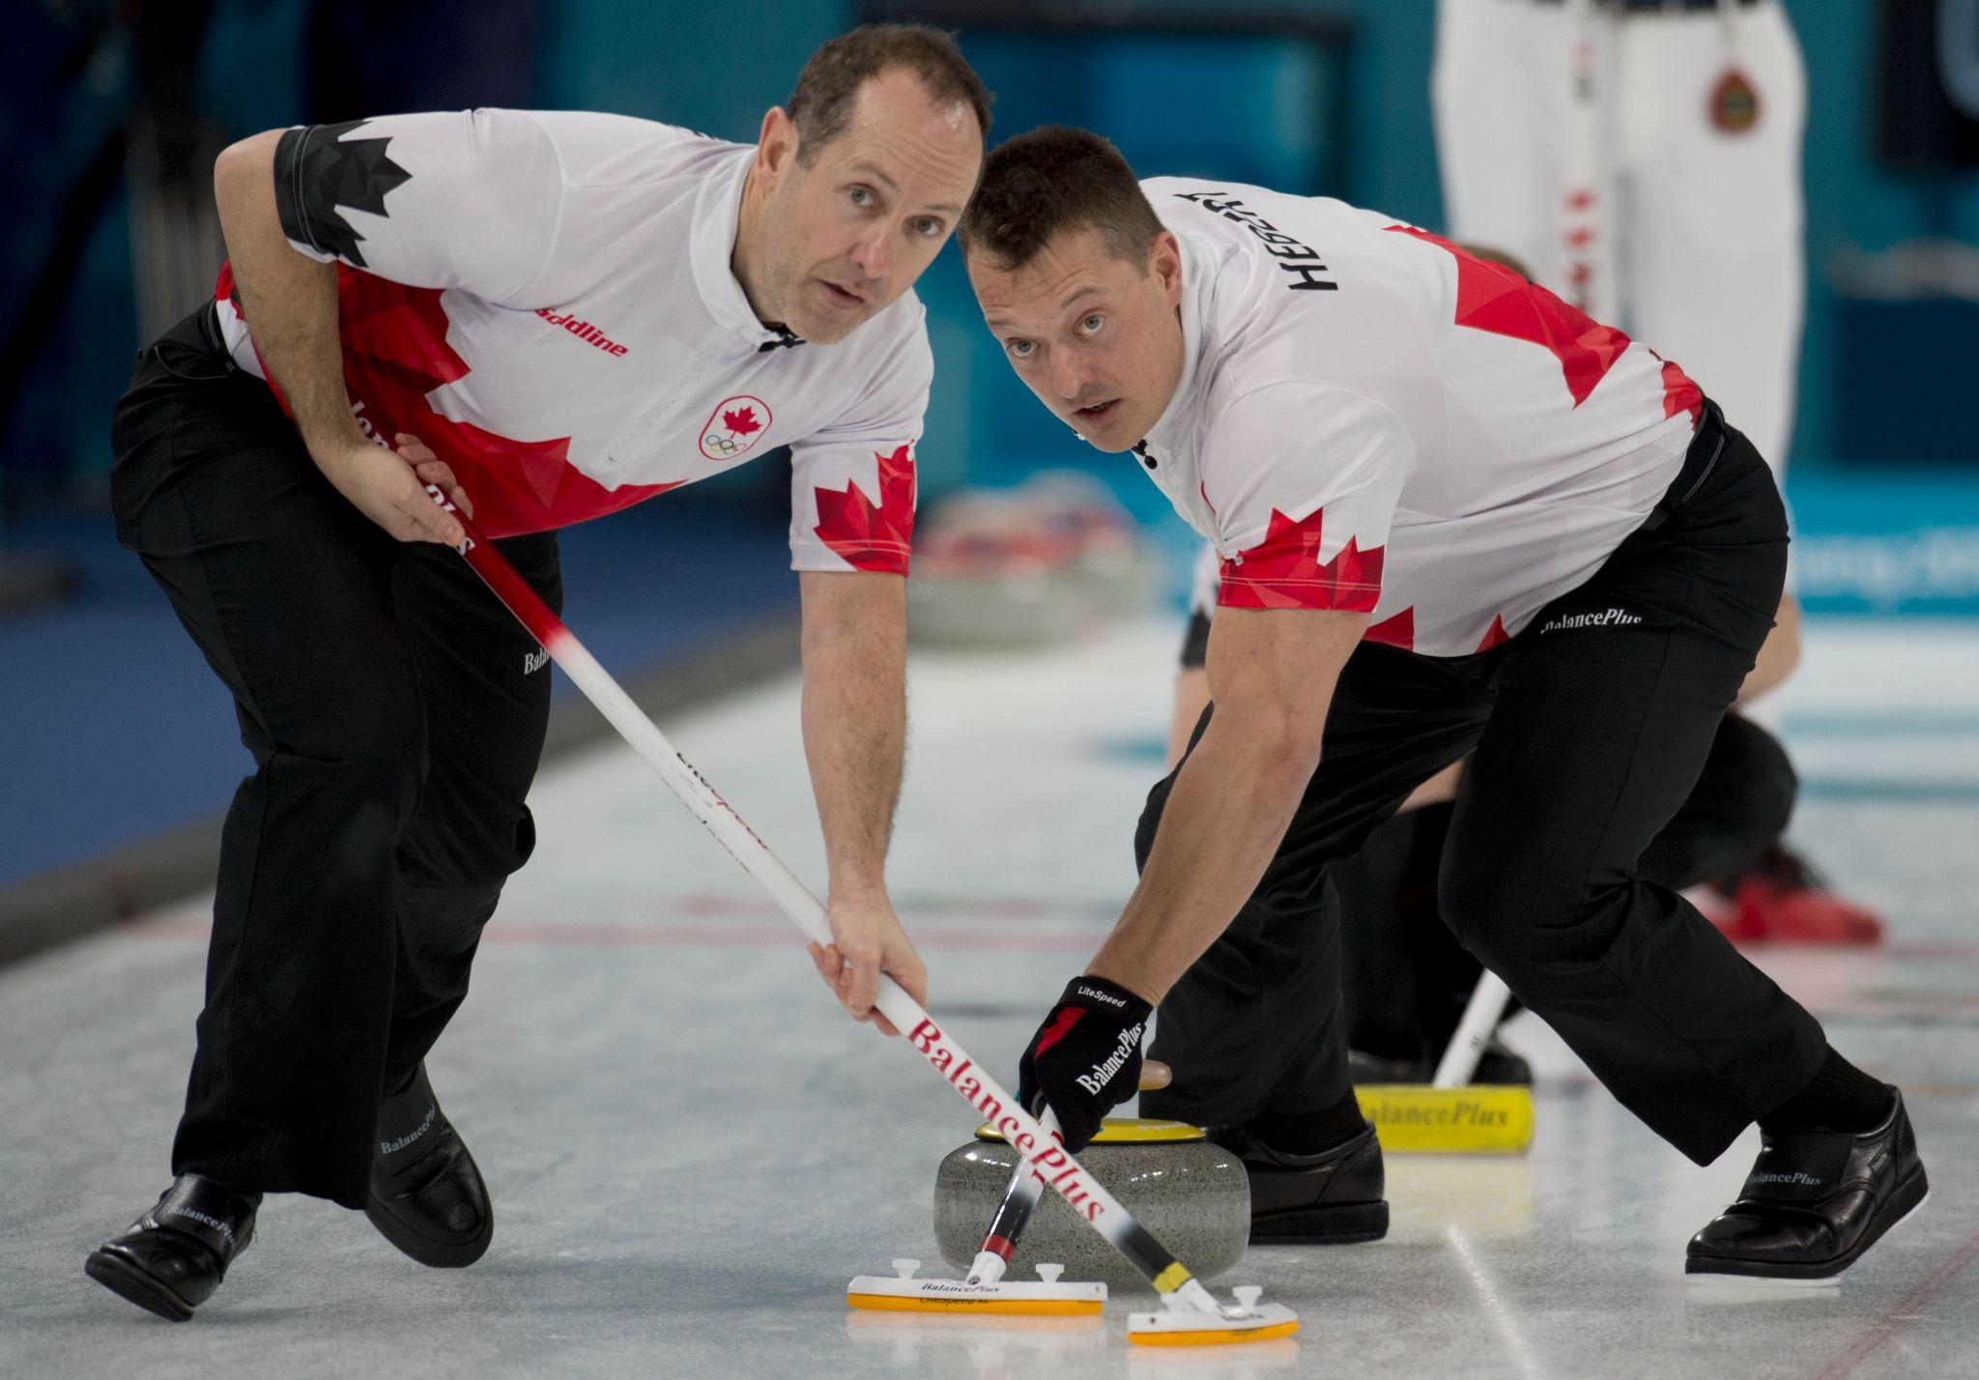
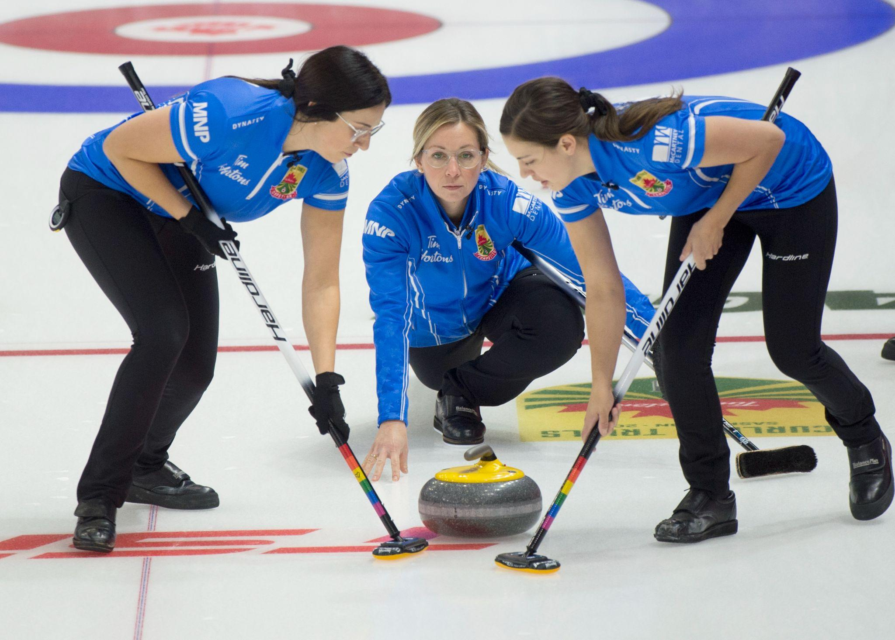
Sweeping - Open position
LEVEL 3 - WEEK 2
Review of sweeping in the open position:
→ The body faces the skip
→ The palm of the lower hand faces the skip
→ The palm of the higher hand faces the sweeper
→ The feet stride back and forth

Slide 20
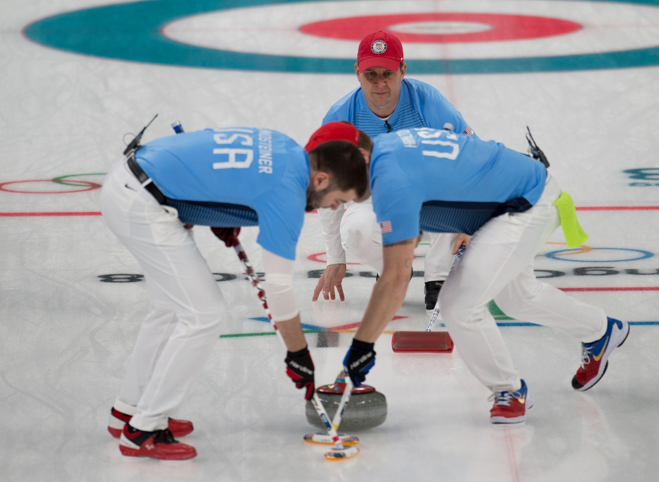
Sweeping - Closed position
LEVEL 3 - WEEK 2
Sweeping in the closed position:
→ The body faces the shooter
→ The palm of the lower hand faces the shooter
→ The palm of the higher hand faces the skip
→ Side to side foot motion
→ Movement on the tiptoes

Slide 21
Sweeping - Closed position
LEVEL 3 - WEEK 2
Did you know…
For the closed sweeping position:
→ The sweeper’s feet should be at a 90 degree angle to the stone’s trajectory
→ The sweeper stands on the balls of their feet, and one foot crosses over the other other creating a half moon effect
→ The broom head is squarely under the chest
→ The closed sweeping position is slightly more efficient than the open position

Slide 22
Coach’s advice
LEVEL 3 - WEEK 2
→ Sweeping in the open position is safer, but the closed position is more efficient
→ The closed position puts more pressure on the head of the broom
→ It takes years to master the four key points for proper brushing
Practice = Increase your capacity = Efficiency

Slide 23
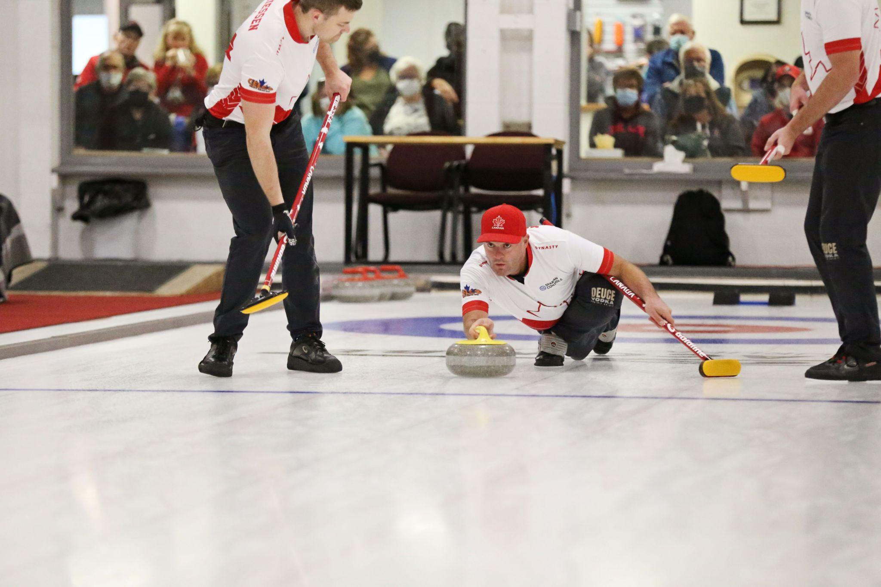
WEEK 3 - WEIGHT CONTROL

Slide 24
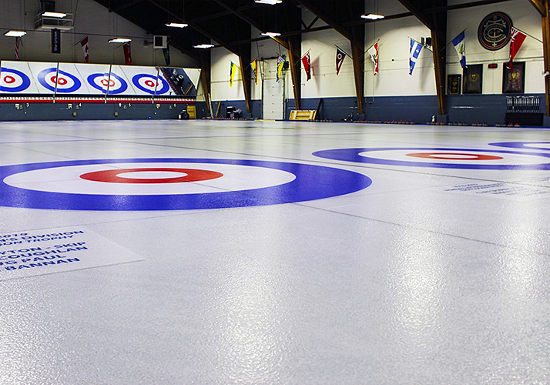
Weight control
LEVEL 3 - WEEK 3
Reminder of the three types of shots:
1. Guard
🥌 The rock stops between the hog line and the house
🥌 It protects other rocks sitting in the house
2. Draw
🥌 A stone that stops in the house
🥌 Any rock that touches the house can count as a point
3. Take-out
🥌 Action of moving the opposition’s rock from the play area by hitting it with another rock

Slide 25
Weight control
LEVEL 3 - WEEK 3
Types of shots and their subcategories:
1. Guard
🥌 Center guard
🥌 Corner guard
🥌 Long, mid or short guard
2. Draw
🥌 Draw in the house
🥌 Come around draw
🥌 Freeze
🥌 Tap back
3. Take-out
🥌 Open take-out
🥌 Hit & roll take-out
🥌 Raise take-out
🥌 Double or triple take-out
🥌 Back line, bumper, control, regular, heavy and peel take-outs
🥌 Tick shot, moving a guard in the free guard zone without taking it out of play

Slide 26
Take-outs
LEVEL 3 - WEEK 3
🥌
🥌
When should we use take-outs?
→ When we want to play a defensive game with less rocks in play
→ When we want to protect a lead
→ When we want to maintain a low scoring game
The strength of a take out depends on the desired result
→ Do we want to keep our rock in play?
→ Do we want to remove the opponent’s rock from play?
→ Do we want to roll somewhere in the house?
→ How many rock do we need to remove?

Slide 27
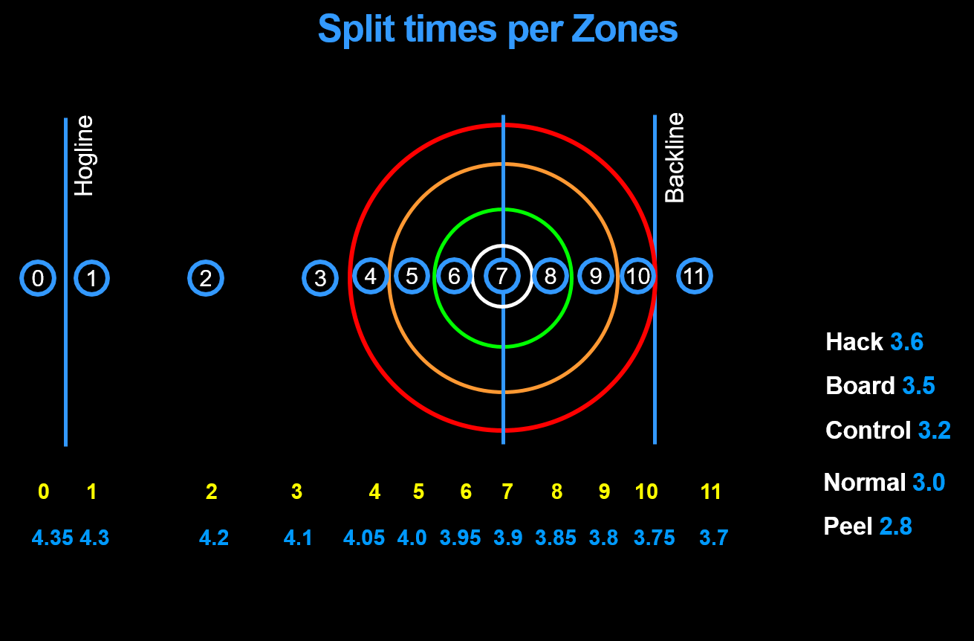
Take-outs - 11 zones
LEVEL 3 - WEEK 3
🥌
🥌
The 11 zones for guards and draws:

Slide 28
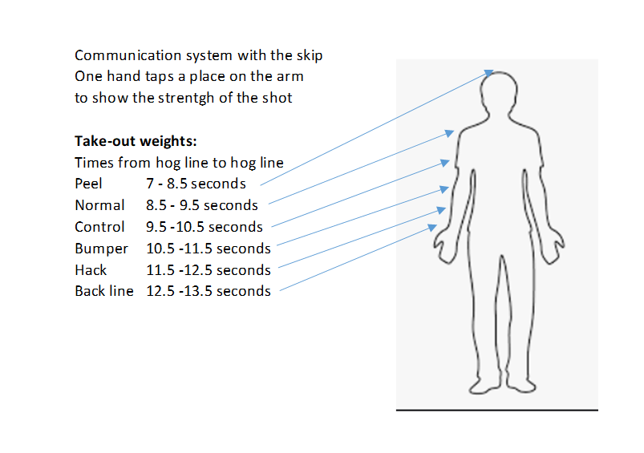
Take-outs - Reminder of the signals
LEVEL 3 - WEEK 3
Reminder of the signals for different weights:
→ Back line
→ Hack
→ Bumper
→ Control
→ Normal
→ Heavy normal
→ Peel
*From hog line to hog line in corresponding seconds

Slide 29
The stopwatch
LEVEL 3 - WEEK 3
⏱
→ The different types of shots are categorized by the weights needed to attain their objective
→ Having weight control is a critical skill that you need to develop after learning and mastering the basic technical skills of shot making
→ Having the skills of being right on the line of delivery is very important, however having good weight control can compensate for imperfect line

Slide 30
The stopwatch - Use
LEVEL 3 - WEEK 3
⏱
Why use a stop watch?
→ The stopwatch helps in judging the relative speed of the rock and also help us to react to the changing ice speed throughout a game
→ The stopwatch also helps us to the speed of the ice from one club to another, or simply from one day to another

Slide 31
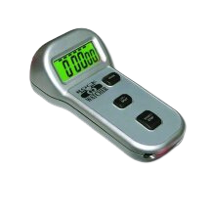
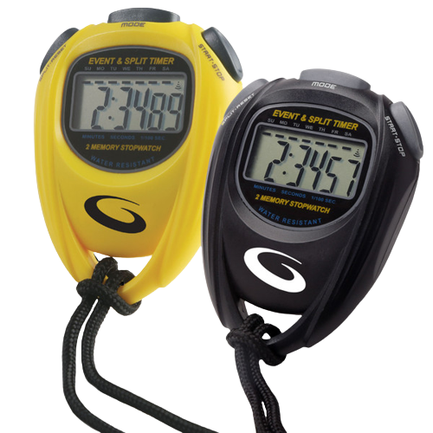
The stopwatch - Types of measurement
LEVEL 3 - WEEK 3
The different types of measurement:
1. From backline to hogline
🥌 Recommended for the sweepers, it’s a speedy measure
2. From hog to hog
🥌 Recommended for the skip, this is the precise measure for all types of shots, and the shooter tendencies, eg. Push or pull the rock
3. De la ligne arrière à la ligne de balayage
🥌 Less used but can give a quick general reference during the game

Slide 32
The stopwatch
LEVEL 3 - WEEK 3
⏱
WARNING!!
The measured time depends on ice conditions and release technique of the shooter!
On two identical shots with the time measured, the result can be different.

Slide 33
Coach’s advice
LEVEL 3 - WEEK 3
→ The stopwatch is a useful tool to use during practices and games.
→ For the sweepers, the quick measure of time will be a reference to call out the zones for guards or draws.
→ For the skip, the time taken between the hog lines will be a precise measure of the shot’s speed versus the objective of the requested shot. The skip shares this information to the sweepers.
→ Warning: The stopwatch does not replace the eyes and intuition. With experience, the eye becomes a great judge of speed, so use it.

Slide 34
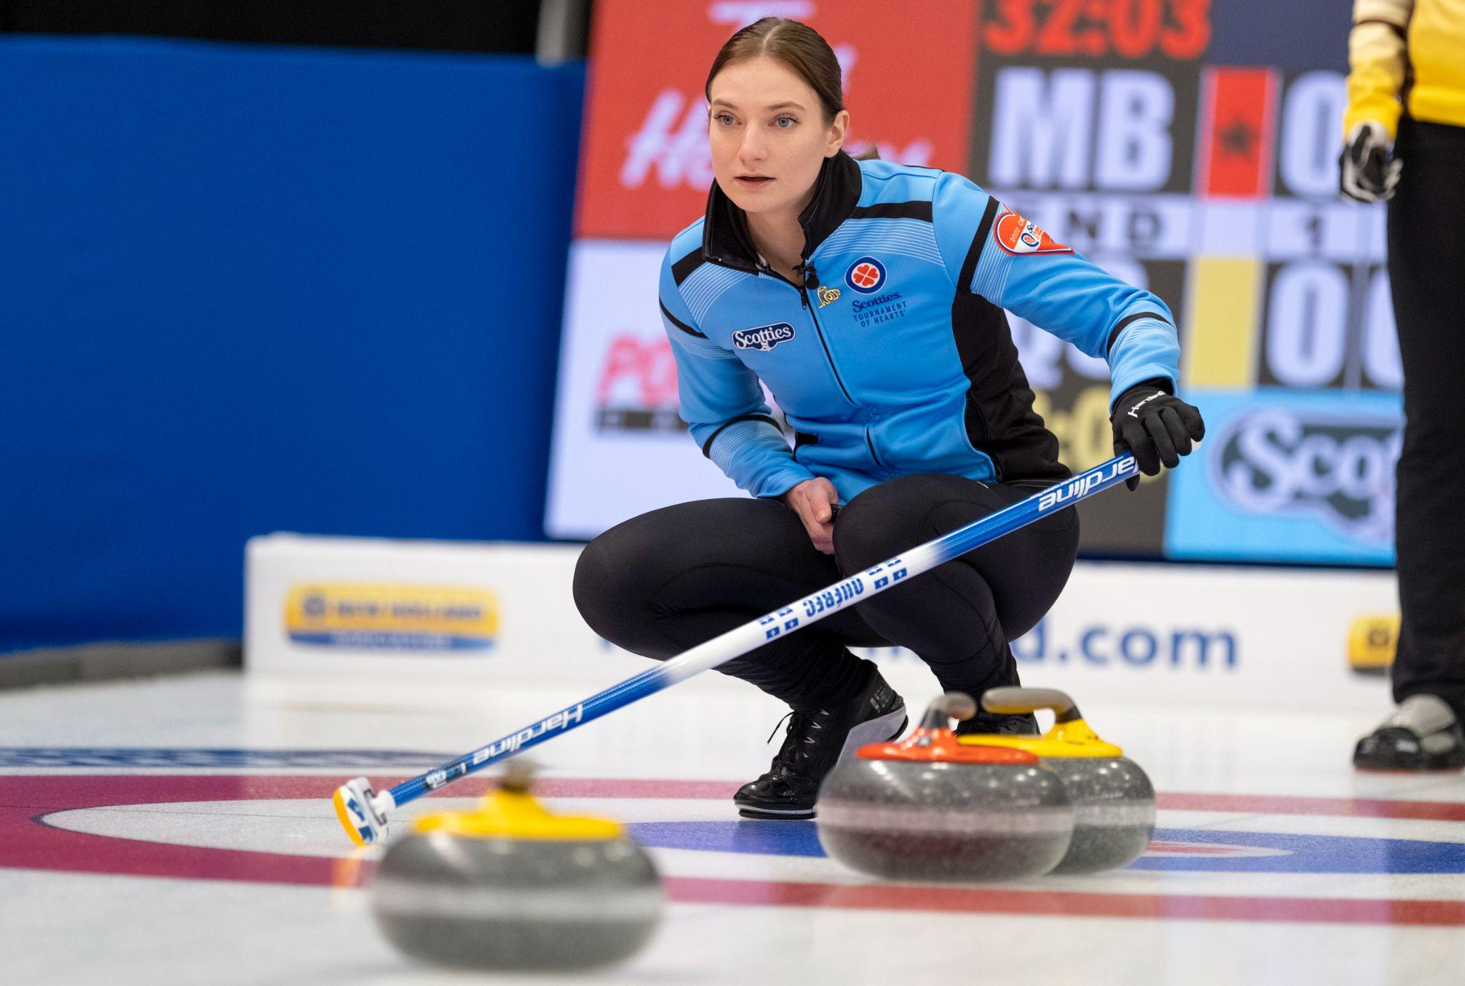
WEEK 4 - THE TAKE-OUTS

Slide 35
Take-outs - Review
LEVEL 3 - WEEK 4
🥌
🥌
Review of the different types of take-outs:
→ Back of the house take-out
→ ‘’Tick shot’’ - Move a guard in the protected Free Guard
→ Zone without getting it out of play
→ Nose take-out
→ Hit and Roll take-out
→ Raise take-out (simple, double, triple)
→ Double, triple take-out

Slide 36
Take-outs - Scenarios
LEVEL 3 - WEEK 4
🥌
🥌
With the following scenarios, what kind of takeout weight should we favour and why?
First end, last rock. Our team wants to blank the end and there is only one opponent’s rock in the house.
Last rock of the end, tie game and the opponents have 5 rocks in the house while we have none. Our skip decided to do a take-out.
Last rock of the end, tie game. The opposition has a rock on the button half hidden by a guard.

Slide 37
Take-outs - Scenarios
LEVEL 3 - WEEK 4
🥌
🥌
Answers:
We should opt for a regular take-out or up weight to take out the rock and that our own rock maintains enough momentum to roll out of the house to blank the end.
Considering the number of rocks in the house by the opposing team, we want to minimize the risk. We would choose control or bumper weight in order to control the trajectory and to stay in the house after striking the stone.
In this example, it is preferred top use back line or hack weight in order to properly control the rock’s trajectory. We do not need to push the rock out of the house to score the point.

Slide 38
Take-outs - Technical adjustments
LEVEL 3 - WEEK 4
🥌
🥌
Technical adjustments to be made for take-outs:
→ The backswing will go further back while still maintaining the hips parallel to the ice. This movement will provide better forward propulsion (increased weight transfer).
→ After the break, transfer the upper body weight forward while delaying the forward movement of the sliding foot.
→ Start the pushing movement of the rock before bringing the sliding foot behind it.
→ Increase the pushing strength of the leg in the hack.

Slide 39
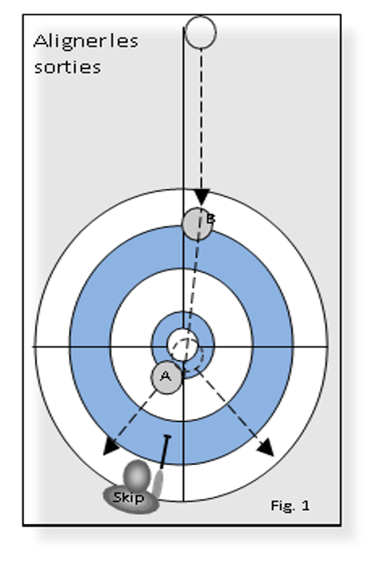
Angles - Aligning the take-outs
LEVEL 3 - WEEK 4
Aligning
Take-outs
Aligning the take-outs:
→ Whenever we want to do a take-out, we always begin the alignment with the last rock to be hit (figure 1).
→ The skip begins on the side of rock ‘’A’’ and traces a virtual line towards the center of rock ‘’B” towards the outer edge. That is the spot where the thrown rock needs to make contact.
→ Remember that if you want to remove rock ‘’A’’, then the starting point is no longer the center of ‘’A’’ but rather the outer edge of the rock.

Slide 40
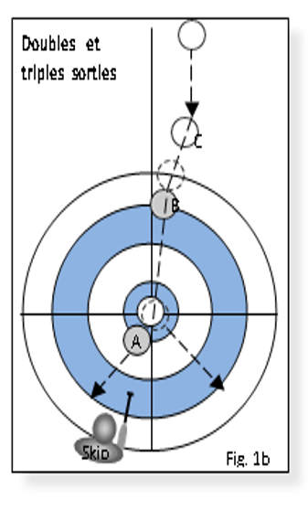
Angles - Doubles and triples take-outs
LEVEL 3 - WEEK 4
Double &
Triple Take-outs
Double and triple take-outs:
→ When you align a triple take-out (figure 1B), apply the same method.
→ Begin at the edge of rock ‘’A’’ toward the center of rock ‘’B’’ towards the outer edge.
→ From that point aim at the center of rock ‘’C’’.
→ The outer edge of rock ‘’C’’ will be the point of contact of the thrown rock.

Slide 41
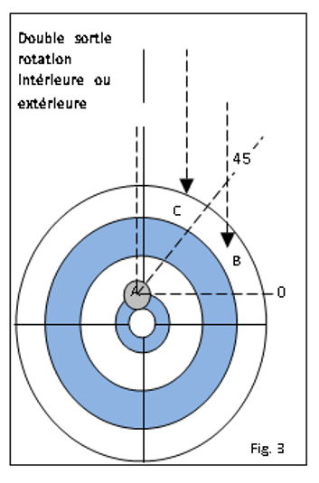
Double take-outs with pronounced angles or flat angles
LEVEL 3 - WEEK 4
Double take-out internal or external rotation
Double take-outs with pronounced angles or flat angles (hit inside or outside):
→ This type of shot aims to make a double take-out while the thrown rock remains in play.
→ At first, you have to divide the top quarter circle into 45 degree sections.
→ If the first rock is in between 0 and 45 degrees (stone B), one must hit it inside. This is called a flat angle.
→ If the first rock is between 45 and 90 degrees (stone C), one must hit it outside. This is called a pronounced angle.

Slide 42
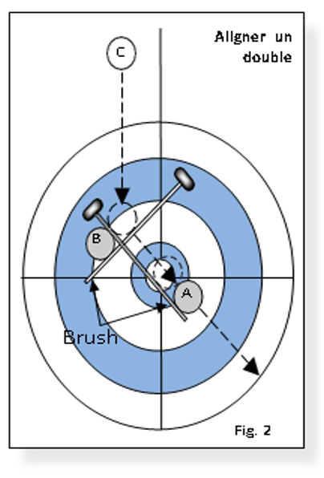
Alignment for flat angle double take-out
LEVEL 3 - WEEK 4
Align a
double
Alignment for flat angle double take-out:
→ Using brooms is an excellent way to align flat angle double take outs during practices.
→ Of course you cannot do this during a game.
→ That’s when you must visualize imaginary lines to fond the contact point.

Slide 43
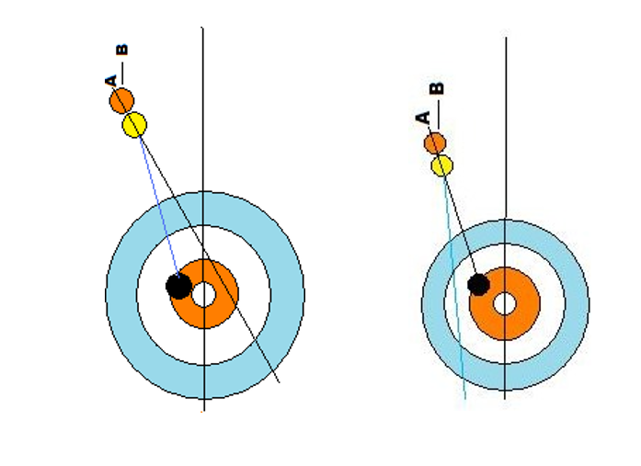
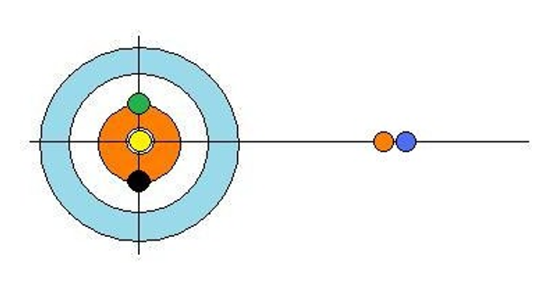
The drag effect
LEVEL 3 - WEEK 4
→ One must figure out where to hit the second rock.
→ This works only if the two rocks are within 2 inches from one another.
🥌
🥌

Slide 44
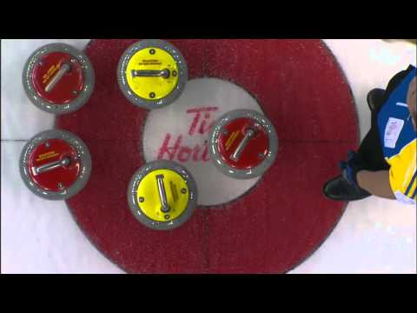
Videos comparaison
LEVEL 3 - WEEK 4
Draw
Take-outs

Slide 45
Coach’s advice
LEVEL 3 - WEEK 4
→ In order to make the different types of take-outs, it is critical to master the steps to throw a rock while balanced.
→ For all the types of take-outs where there is more than one rock to remove, it is important to just visualize where to hit the FIRST rock.
→ To increase your hitting percentage it is important to know the proper hitting angle and use the right weight.
→ Making take-outs does not always require a lot of weight. The finesse game will help control each end.

Slide 46
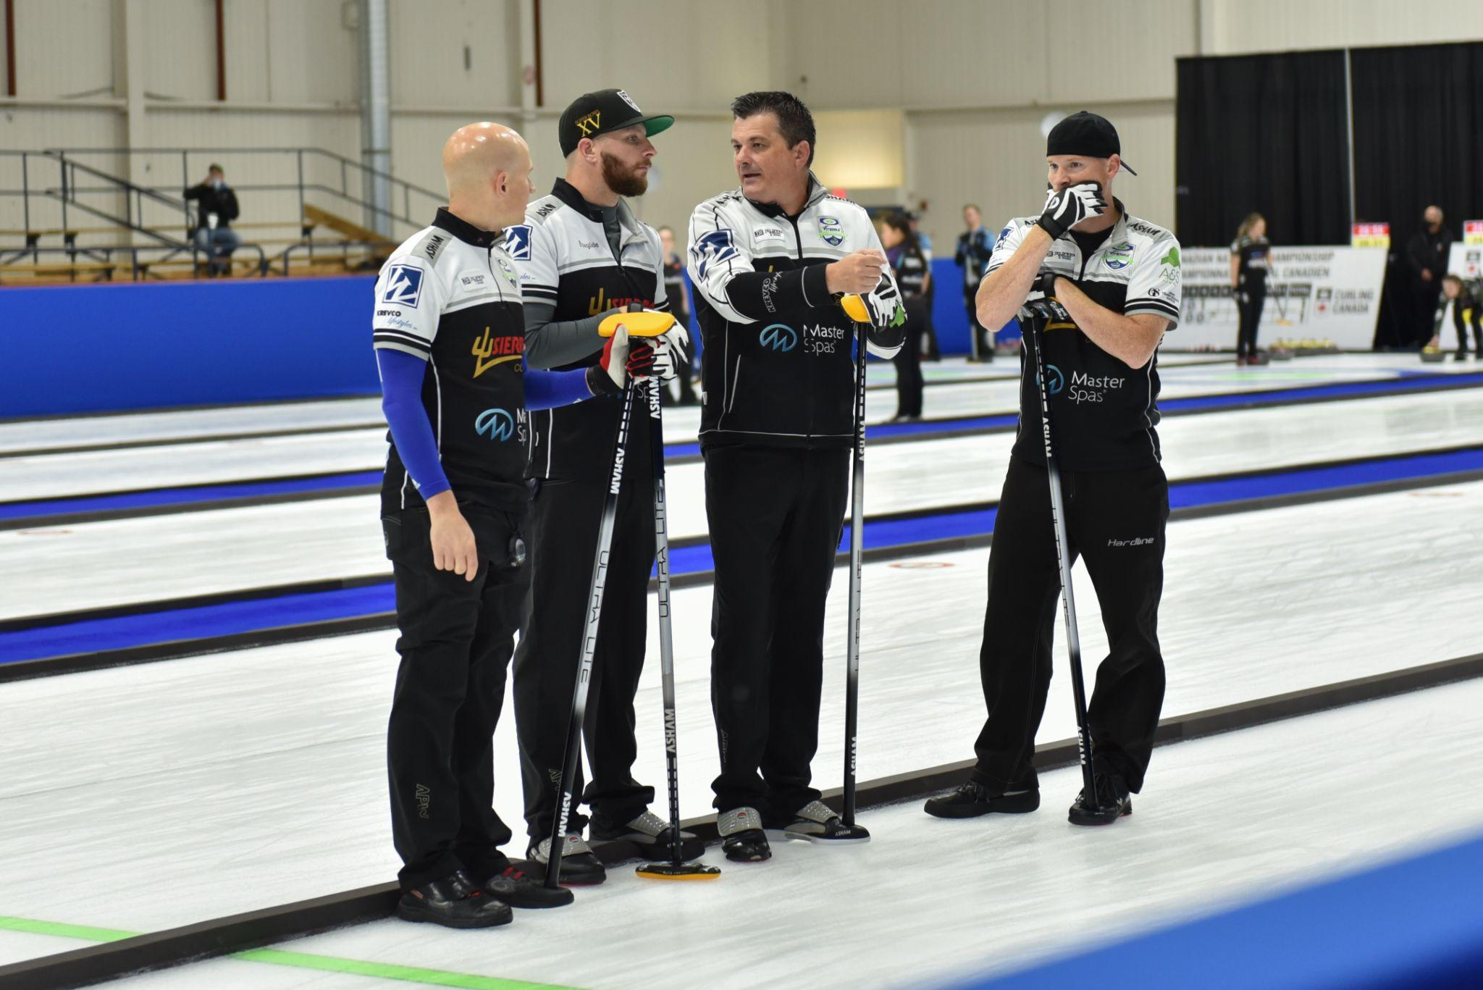
WEEK 5 - ROLE OF THE PLAYERS

Slide 47
Role of the players - Lead
LEVEL 3 - WEEK 5
Reminder !!
Lead:
→ Key player to start the end
→ Is excellent with guards and draws
→ Studies the play and ice condition (speed, opponents)
→ Judges the rocks’ speed and communicates it to the team
→ Cleans the zone around the hack
→ Prepares the third and skip’s stones
→ Should not be in the house

Slide 48
Role of the players - Second
LEVEL 3 - WEEK 5
Reminder !!
Second:
→ Is excellent with all types of shots
→ Studies the play and ice condition (speed, opponents)
→ Judges the rocks’ speed and communicates it to the team
→ Helps in putting away the stones after each end
→ Cleans the ice around the line of delivery for the next shot from the back line to the hog line.
→ May go to the edge of the active house if the Skip and the Third ask for advice.
→ Should not be in the house during an end

Slide 49
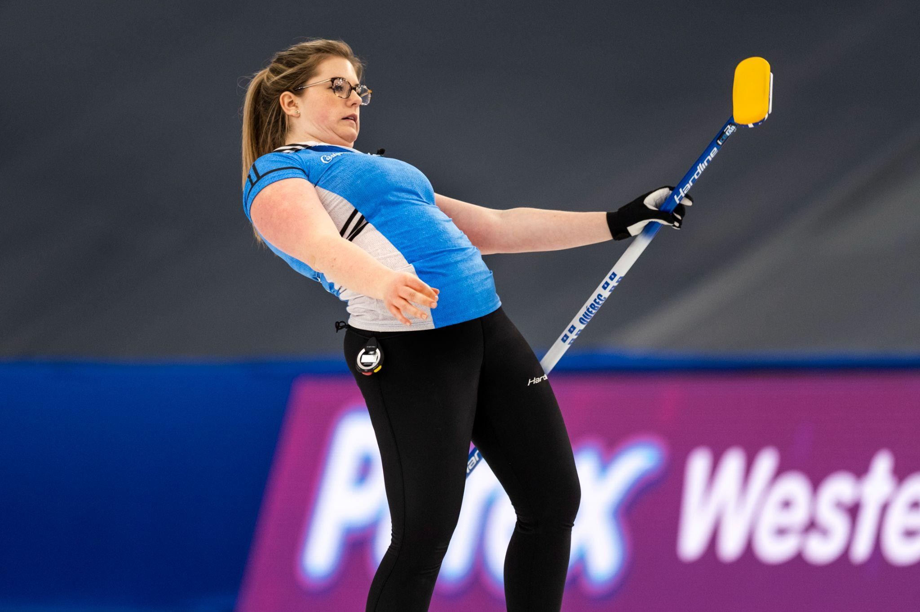
Role of the players - Vice-skip
LEVEL 3 - WEEK 5
Reminder !!
Third (vice-skip):
→ Is excellent with all types of shots
→ Is the link between the Skip and the front end
→ Reinforce the Skip’s decisions
→ Manages the game time
→ Read the ice and is alert to changing ice conditions
→ Replace the Skip in the House when the latter throws their stones
→ Communicates with teammates clearly and efficiently
→ Does the measuring and puts up the score

Slide 50
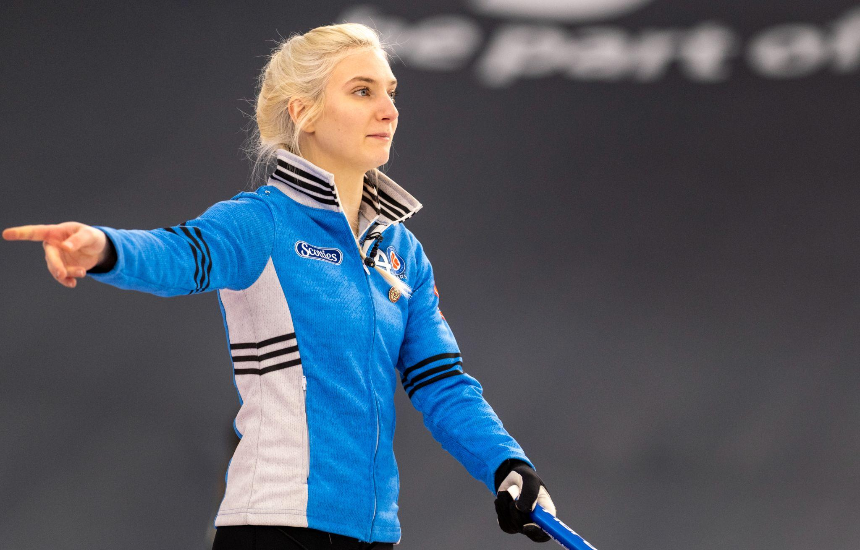
Role of the players - Skip
LEVEL 3 - WEEK 5
Reminder !!
Captain (Skip):
→ Is the ‘’leader’’ of the team
→ Sets the strategy
→ Communicates clearly and efficiently each shot to play
→ Communicates with teammates during the game (ice conditions, strategy, feedback on shots, etc.)
→ Ice reading
→ Adjusts the strategy according to the strengths and weaknesses of the team and the opponents
→ Excels with draws and shots under pressure

Slide 51
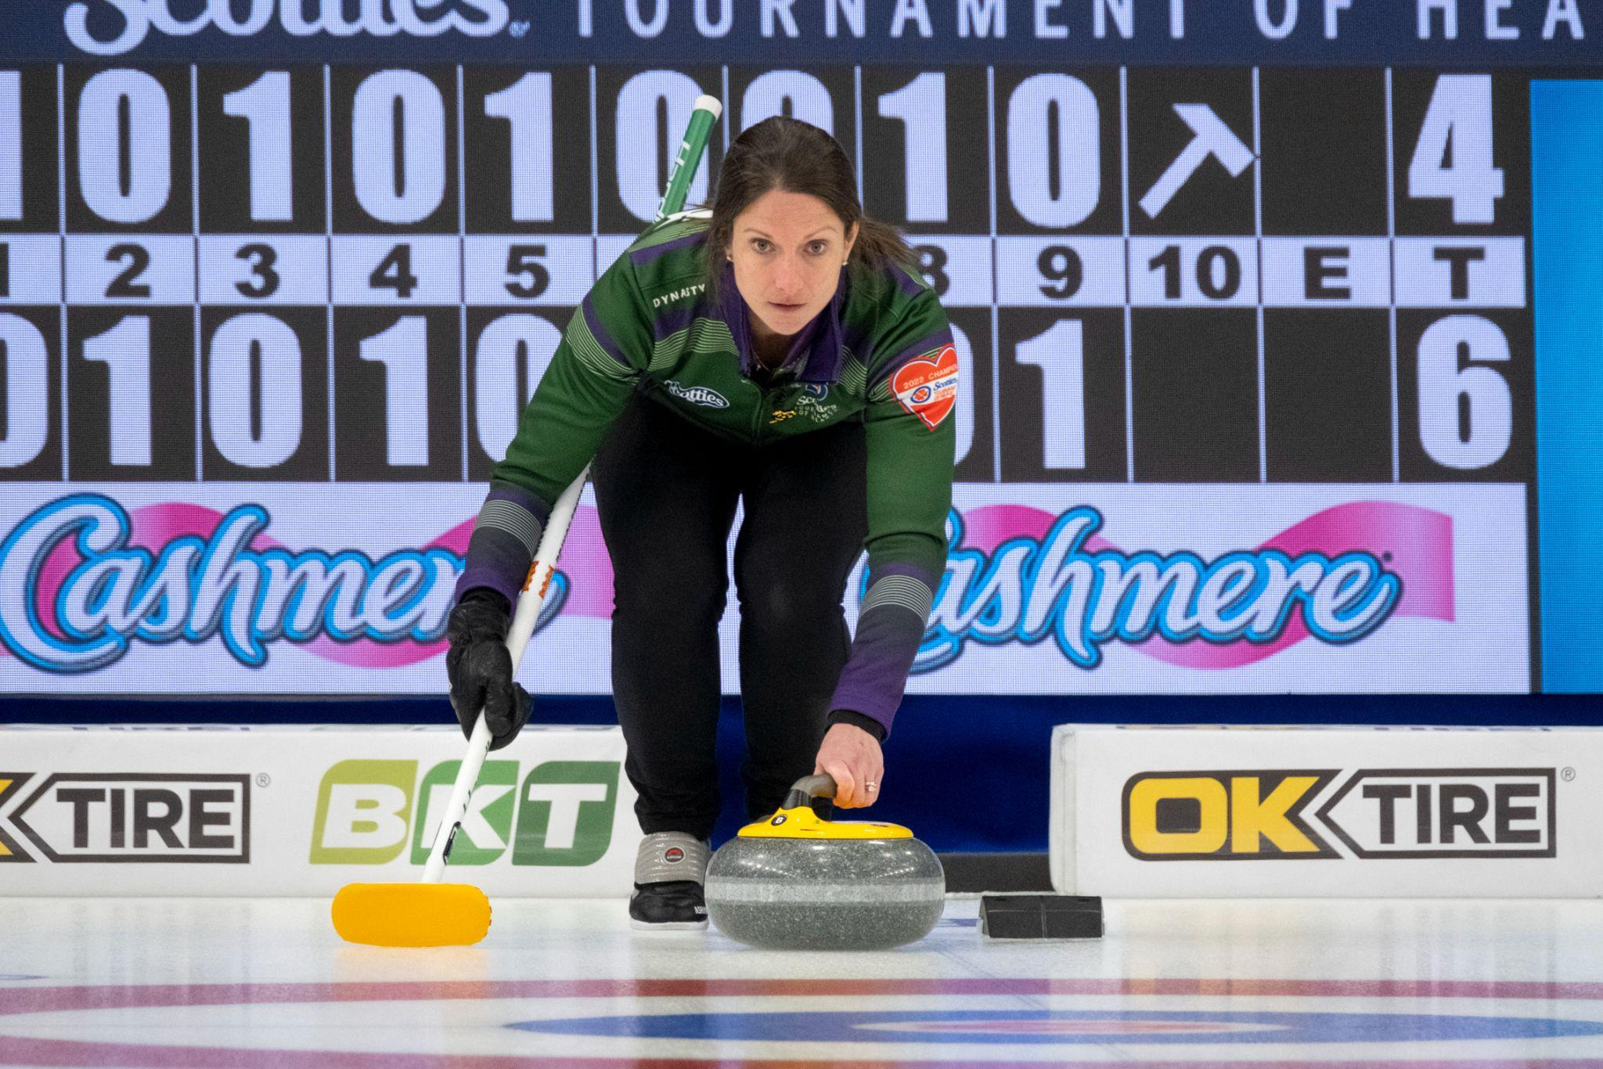
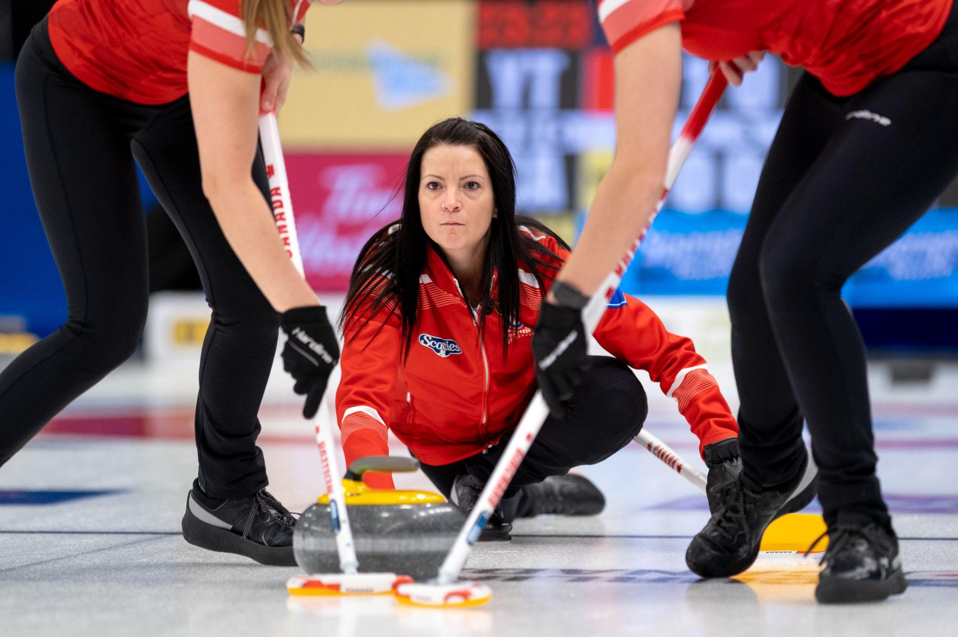
The shot routine
LEVEL 3 - WEEK 5
What is a routine?
What is the purpose of a routine?
Should all players have a routine?

Slide 52
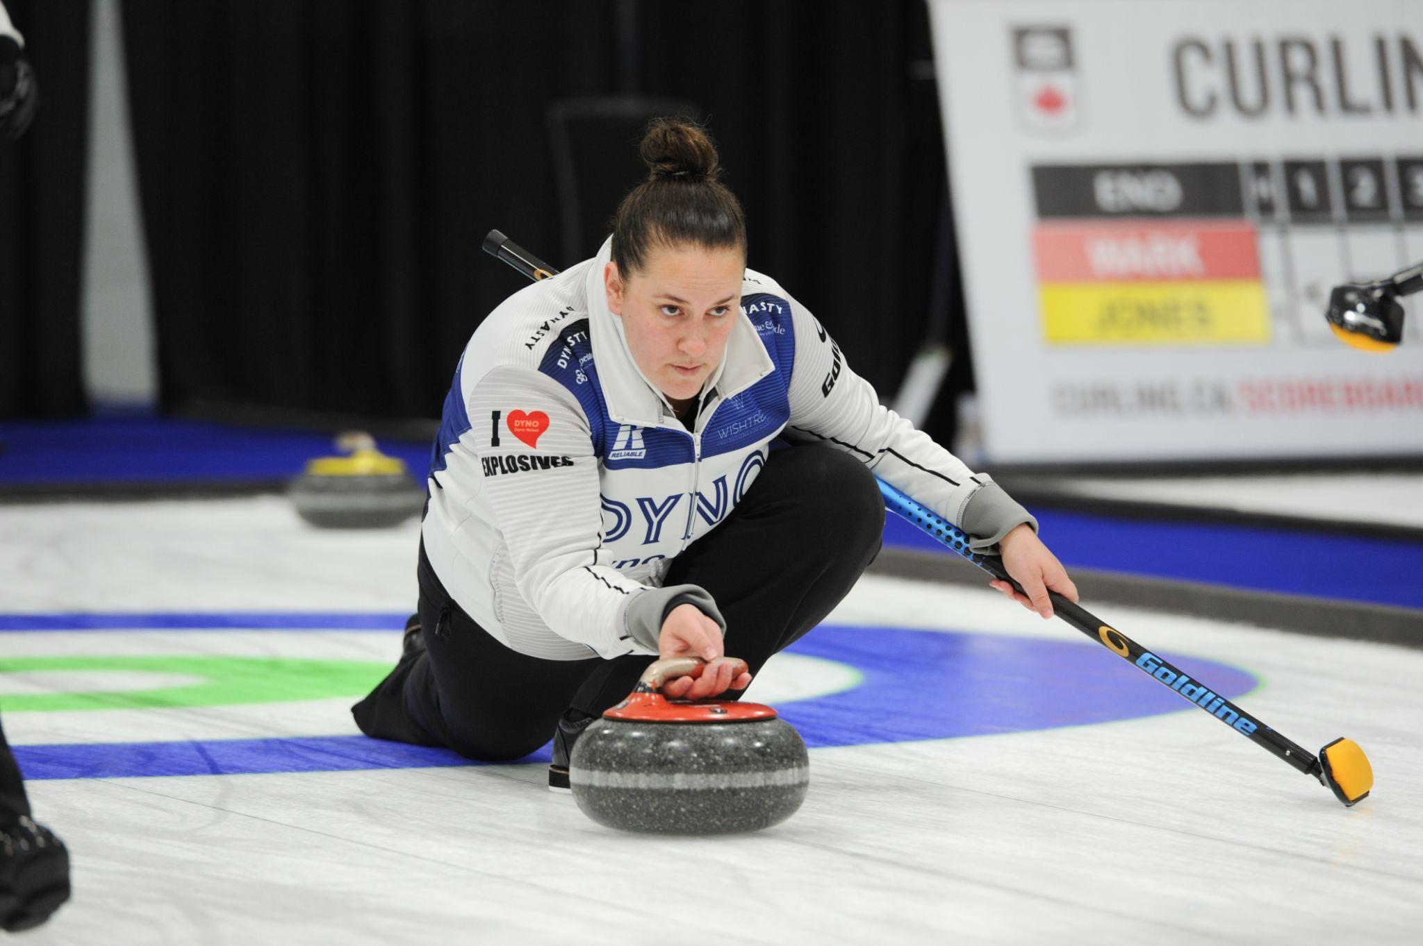
The shot routine - Definition
LEVEL 3 - WEEK 5
Routine definition:
Mechanical habit, unvarying movement that results in repeating actions regularly followed.
Goals:
→ A framework to reach our objectives
→ Brings a sense of confidence
→ Part of mental preparation
→ It helps you repeat the same preparation for each shot

Slide 53
The shot routine - Examples
LEVEL 3 - WEEK 5
Every players should have a shot routine!
Examples of repetitive habits in the hack by athletes:
Jennifer Jones – Rubs her right thigh
Kevin Koe – Cleans behind the rock with his broom then passes under his left leg
Rachel Homan – Before sliding, she lightly tilts her head to bring her dominant eye on the line of delivery and visualize the shot

Slide 54
Coach’s advice
LEVEL 3 - WEEK 5
→ Having a routine helps you get into your bubble and removes distractions.
→ Your routine will bring you to a zone of comfort, well being and confidence.
→ Your routine will evolve with time. You will add movements and remove others.
→ We must be conscious of our body and what makes us comfortable.
Routine = Comfort = Confidence

Slide 55
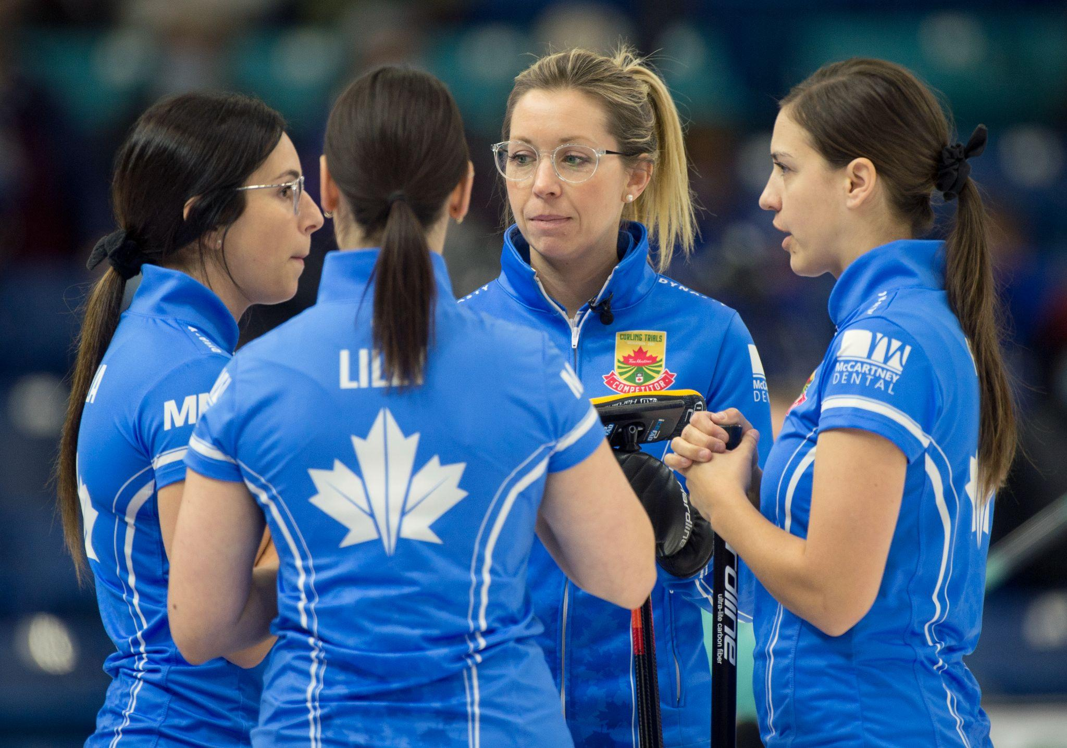
WEEK 6 - STRATEGY

Slide 56
Strategy - Influential factors
LEVEL 3 - WEEK 6
Review of the factors that can influence your choice of strategy:
→ Do you have the hammer or not?
→ Are we at the beginning, midway or at the end of the game?
→ Which player is throwing?
→ What are the strengths or weaknesses of our team, the opponents?
→ What is the current score?
→ What is our objective (take 2, blank, give up 1 point…)?
→ How many ends are left?
→ What are the ice conditions now?

Slide 57
Strategy - With the hammer
LEVEL 3 - WEEK 6
🔨
Different types of strategy WITH the hammer:
Pursuing strategy: A more offensive strategy, we want to maximize the number of rocks in play. The primary objective to score 2 points or more.
Probing strategy: A more conservative strategy, the team is using a mix between offensive and defensive. The primary objective is to score 2 points or to blank the end.
Protecting strategy: A more defensive strategy, the team wants to minimize the number of rocks in play. The primary objective is to blank the end.

Slide 58
Strategy - With the hammer
LEVEL 3 - WEEK 6
🔨
With the hammer
Pursuing
Probing
Protecting
Primary objective
Score 2 points or more
Secondary objective
- Score 1 point
Primary objective
Score 2 points or blank the end
Secondary objective
- Score 2 points or score 1 point
Primary objective
Blank end
Secondary objective
- Score 1 point

Slide 59
Strategy - Without the hammer
LEVEL 3 - WEEK 6
🔨
🚫
Different types of strategy WITHOUT the hammer:
Pursuing: A more offensive strategy, we want to maximize the number of rocks in play. The primary objective is to steal 1 or more points.
Probing: A more conservative strategy, the team is using a mix between offensive and defensive. The primary objective is to force the opposition to take 1 point or to steal 1 point.
Protecting: A more defensive strategy, the team wants to minimize the number of rocks in play. The primary objective is to force the opposition to take 1 point.

Slide 60
Strategy - Without the hammer
LEVEL 3 - WEEK 6
🔨
🚫
Without the hammer
Pursuing
Probing
Protecting
Primary objective
Steal 1 point or more
Secondary objective
- The opposing team scores only 1 point
Primary objective
The opposing team scores 1 point or steal 1 point
Secondary objective
- Steal 1 point or the opposing team scores 1 point
Primary objective
The opposing team scores only 1 point
Secondary objective
- Blank end

Slide 61
Strategy - Scenarios
LEVEL 3 - WEEK 6
Scenarios:
Team A: Start of the game – 1st end, your team does not have the hammer, what is your plan with a probing strategy?
Team B: Mid-game – 4th end, your team is losing by 2 points, you have the hammer, what is your plan with a pursuing strategy?
Team C: End of the game – last end, you are winning by 1 point, you do not have the hammer, what is your plan with a protecting strategy?

Slide 62
Strategy - Possible answers
LEVEL 3 - WEEK 6
Réponses possibles :
Team A: The tactic for the end could be to begin with a center guard with the idea to steal 1 point. If during the end you start to have too many rocks in play, then your probing strategy changes to a more defensive one to hopefully just give up 1 point.
Team B: The traffic for this end is to be offensive and to take at least 2 points. The objective will be to have as many rocks in play as possible.
Team C: The tactic for this end is to maintain a very defensive game to limit the opponent to only 1 point and to get the hammer for the extra end.

Slide 63
Coach’s advice
LEVEL 3 - WEEK 6
→ It is important to know the different types of strategies in order to have a specific plan at any moment of the game considering the score. We call this managing the score board.
→ Communicating this plan with all members of the team is crucial.
→ Each player must know the game plan and the tolerance of each shot in order to obtain the objectives.
→ Do not forget that your strategy can change throughout a game even during an end.
→ Games conditions and who we play against are also factors that may change your strategy. One must be able to adapt to any game conditions.

Slide 64
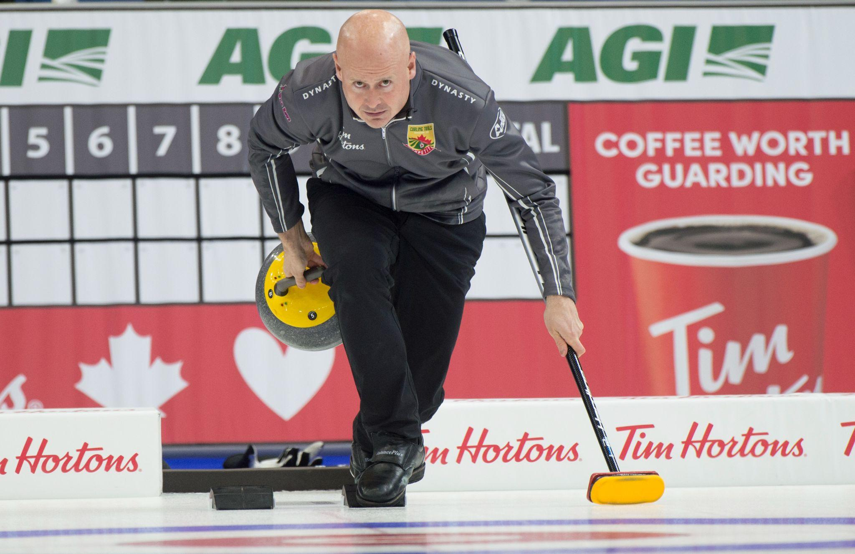
WEEK 7 - THE ROUTINE

Slide 65
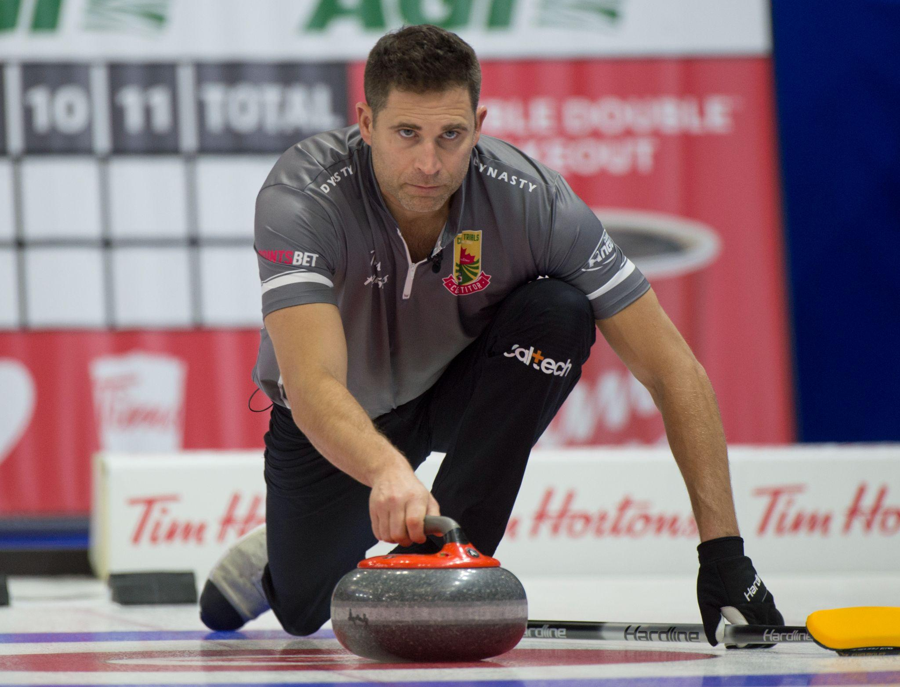
The routine
LEVEL 3 - WEEK 7
Review of the routine and its benefits:
Routine definition:
Mechanical habit, unvarying movement that results in repeating actions regularly followed.
Goals:
🥌 A framework to reach our objectives
🥌 Brings a sense of confidence
🥌 Part of mental preparation
🥌 It allows you to repeat the same preparation for each shot

Slide 66
Athlete throwing routine
LEVEL 3 - WEEK 7
Athlete throwing routine – Testimony of a vice captain:
→ My routine begins as soon as the opponent’s rocks has been released. I move toward the hack while watching the trajectory of the thrown rock. I already think of what shot I might have to make.
→ Option 1: I bring my rock to the hack while still watching the other shot and its trajectory. I get to a squatting position, I lift my rock with my right hand, I clean under the rock with my left hand (I wear a mitt), I clean the ice also with my left hand and slowly lower the rock back on the ice.
→ Option 2: If I am talking with the skip while the opponents rock is thrown, I like it when one of the sweepers brings my rock to the hack in order to save time.
→ When the rock is cleaned, I put my broom on the ice and then get up, always keeping my right foot on the high part of the hack.

Slide 67
Athlete throwing routine
LEVEL 3 - WEEK 7
Athlete throwing routine – Testimony of a vice captain (cont’d):
→ I confirm the shot the skip asked for by making a sign with my right hand and I visualize the shot.
→ I lower myself to a half-squat position, I grab my broom and put the handle on my hip, I lower my head, visualize the shot, rub my right hip with my right hand to warm it up, I breath in and lift up my head exhaling and slightly move my head to the right (dominant left eye!!!).
→ I breathe in another time, and begin my weight transfer while thinking about maintaining equal weight on both legs.
→ Finally, pushing from the block while exhaling.
→ The routine can take between 25 to 45 seconds depending on the skip’s decision making time.

Slide 68
Athlete throwing routine
LEVEL 3 - WEEK 7
Athlete throwing routine – Testimony of a vice captain (cont’d):
→ My release generally finishes with positive motion (a little elbow extension) and I provide information to the sweepers either of my push and/or my release.
→ Once the stone is released, I remain squatting, my right hand on top of my broom’s head and look at the rock’s trajectory.
→ If I anticipate the rock’s movement before the skip, I call on the sweepers for line.
→ Once the rock stops, I quickly clean the ice where I was squatting and move to the side and watch the other team’s shot or I go join the skip.
→ Finally, I like to talk with at least one of the sweepers about details on the ice speed.

Slide 69
Broken routine
LEVEL 3 - WEEK 7
What to do if your routine is broken or your attention is not here?
Answer: Start your routine from the beginning one in the hack!
“Your routine will evolve with time. Find a procedure that will bring you into a comfort zone. You have to feel good and confident”
Amélie Blais
Canadian Mixed 2020 champion

Slide 70
Draw to the button
LEVEL 3 - WEEK 7
Team draw to the button:
→ Each player throws on rock, one after another from the lead to the skip.
→ The objective is to get a close as possible to the button.
→ The distance can be measured in three different ways:
🥌 With a measuring tape – From the center of the button to the closest edge from the center of the rock
🥌 With a laser (more precise measure) – The laser is installed at the center of the house and calculates the distance of the rock at its closest point
🥌 Triangulation (when a rock touches part of the button, we then cannot use the two other methods)

Slide 71
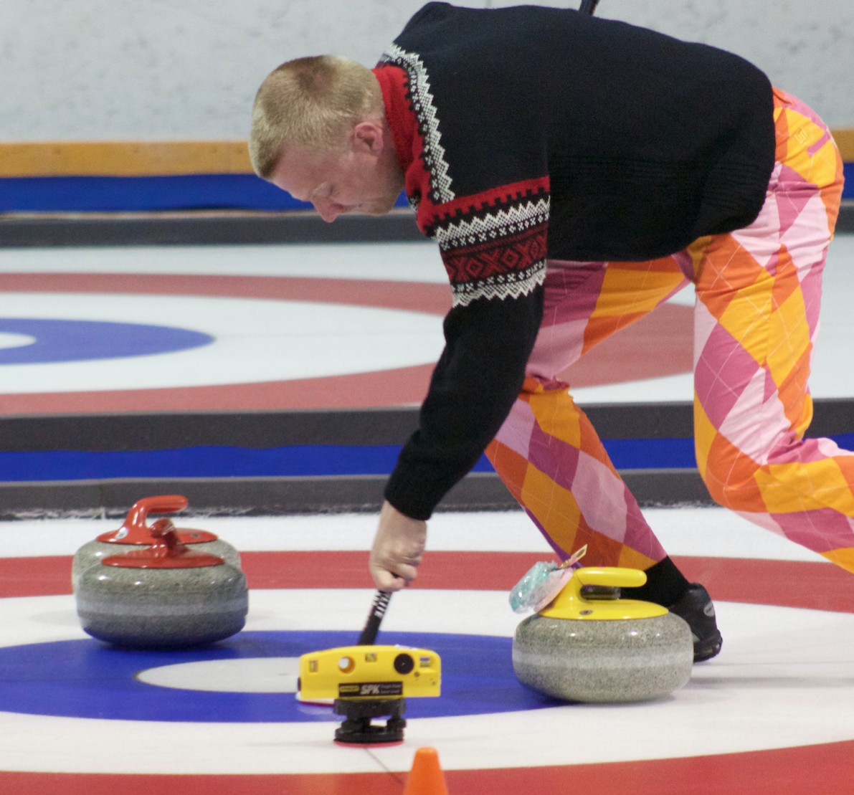
Draw to the button - Triangulation
LEVEL 3 - WEEK 7
Triangulation:
The laser is installed at two specific points on the outside of the four foot circle in order to take two measures and triangulates the distance from the center of the house and the center of the stone.
Laser:
→ The results of the four shots are added to give a grand total for each team.
→ The team with the lowest result gains the advantage of the hammer for the first end.
*For some tournaments, they will take the top 3 shots and remove the worst shot in the calculation.

Slide 72
Draw to the button - One player
LEVEL 3 - WEEK 7
Draw to the button by just one player per team:
→ One player per team is chosen to make the draw.
→ Often, it will be the skip or the lead to make the shot in order to rapidly find the speed of the ice and gain confidence.
→ The best result between both teams gains the hammer to begin the game.

Slide 73
Draw to the button - 2 players
LEVEL 3 - WEEK 7
Draw to the button by two players per team:
→ Two players per team are chosen to make the draw.
→ Often, it will be the skip and the lead that will make the shot in order to rapidly find the speed of the ice for the draws and to gain the advantage at the beginning of the game. However, during a Championship, each player of the team will have to do one or two draws to the button depending on how many games will be played in the preliminary round.
→ The best result between both team determines the hammer advantage for the first end.

Slide 74
Coach’s advice
LEVEL 3 - WEEK 7
→ Having a shot routine you get into the comfort zone.
→ The better you feel and more confident you are, the better your focus will be on the objective : throw the right weight and be on the broom.
→ During your practices, do practice draws to the button. It will help you get comfortable during different ice conditions and to rapidly find your draw weight.
→ The entire warm up done by the teams you see on TV is entirely done in order to win the hammer advantage for the first end.
Practice = Confidence = Comfort zone = Concentration

Slide 75
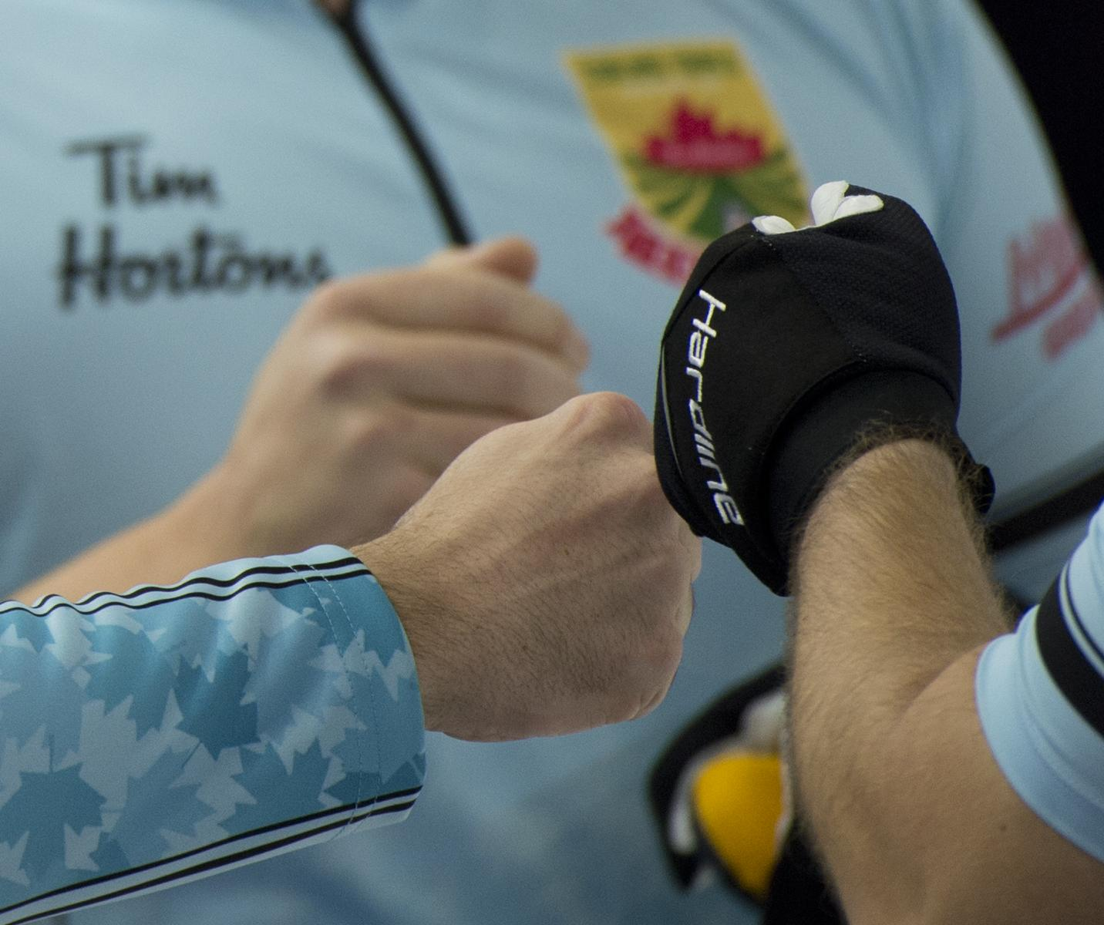
WEEK 8 - INTRODUCTION TO TOURNAMENTS

Slide 76
Ethics during a tournament
LEVEL 3 - WEEK 8
Curling ethics during a tournament:
→ Arrive at least 30 minutes before the scheduled practice time
→ Be ready for when your team needs to get on the ice for the pre-game practice
→ Always be respectful of the opponents:
🥌 Shake hands before and after the game
🥌 Show good sportsmanship at all times (you are all there to learn)
🥌 Respect the active and inactive positions during the game
🥌 Be positive with your teammates and opponents

Slide 77
Ethics during a tournament
LEVEL 3 - WEEK 8
Curling ethics during a tournament (cont’d):
→ Sit with the opponents after the game to exchange
→ Know your game times depending on your win or losses
→ At the end of the tournament, it is thoughtful to thank the organizers and the umpires/officials
Remember when you start doing competitions, there will be ups and downs. Do not forget that we learn more in losses than in victory.

Slide 78
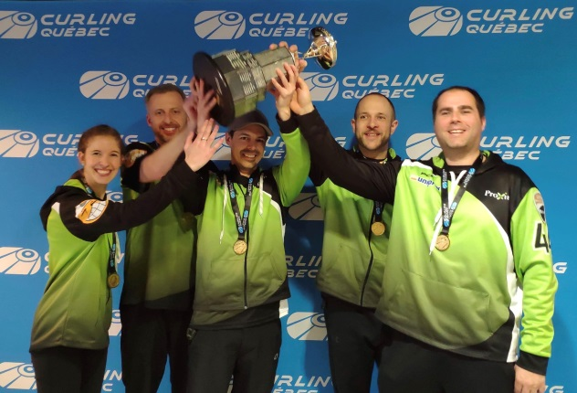
The Colts circuit
LEVEL 3 - WEEK 8
The Colts circuit is a circuit reserved for players that have less than 5 years experience in curling.
This circuit offers and excellent opportunity for new curlers to visit new Clubs and play against teams of the same caliber.

Slide 79
The Colts circuit - Advantages and benefits
LEVEL 3 - WEEK 8
Advantages and benefits in playing in tournaments:
→ To meet new people playing the same sport as you.
→ To put into practice the techniques you have learned during the Ascension Program.
→ To learn to manage stressful situations.
→ To play against new teams in different Clubs (new playing conditions).
→ To develop physical aptitudes, techniques and strategies.
→ To develop the communication within your own team.
→ To develop yourself as a player and human being.
→ To have fun playing!

Slide 80
The Colts circuit - Tournament’s unfolding
LEVEL 3 - WEEK 8
The tournament’s unfolding:
→ Each team receives the timetable and the rules for the bonspiel before it takes place.
→ The tournament usually begins Friday night and last until Sunday afternoon.
→ A minimum of 3 games are guaranteed.
→ Money purses are given out according to your ranking in the classes A, B et C and points are gained depending on your results with Curling Québec.
→ Guaranteed fun at each tournament and a chance to qualify for the Provincial Championship.

Slide 81
The Colts circuit - Advantages in having a Coach
LEVEL 3 - WEEK 8
Advantages in having a Coach:
→ The coach is present to guide you during the tournament. It can be the person in charge of the team’s schedule and to have first hand knowledge of the rules.
→ The coach is also the person that will motivate you to surpass yourself and is there to support you with techniques and strategy
→ The coach will help you develop your strategic plan, improve your routine during a tournament (examples : the right moment to eat, hydratation, sleep, etc.)
→ The coach is there to help you live a positive enriching experience.

Slide 82
Coach’s advice
LEVEL 3 - WEEK 8
→ We recommend that all participants try the Colts circuit.
→ The tournaments are a great way to learn more about curling while meeting new teams and getting to know different ice conditions.
→ Rapidly adapting to the conditions is an important asset when playing in tournaments.
→ Having a coach will make a difference for the Colt’s team to have a positive and enjoyable experience.
New challenge = Adaptation = Enjoyment

Slide 83
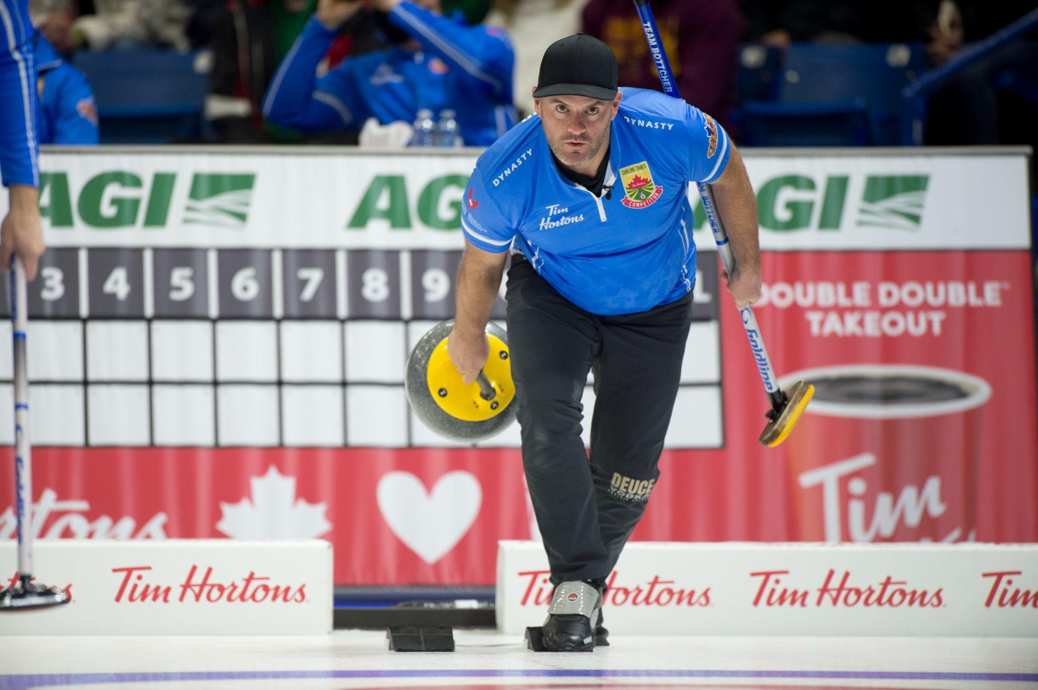
WEEK 9 - REVIEW

Slide 84
Review - Level 3 review
LEVEL 3 - WEEK 9
Review of level 3 – What you have learned:
→ Revisiting your position in the hack
→ Sliding with a broom
→ Perfecting your slides (draws vs take-outs)
→ Improving your sweeping technique in the open and closed positions
→ Revisiting and applying the release zone
→ Hitting angles and the drag effect
→ The throwing routine
→ Evolution of strategic plans and the tolerance level for each shot
→ Improving your communication and sign sustems
→ Introduction to tournaments (Colts’ Circuit)

Slide 85
Coach’s advice
LEVEL 3 - WEEK 9
→ Your game technique is more advance.
→ You have developed your technical and tactical skills when playing.
→ Participating in the Colts tournaments will help you better understand the world of curling.
→ Having a coach can be a great solution to transfer knowledge and help out in your development.
→ Do not forget that participating will help you to improve in the long run.
→ Have fun and do not hesitate to take on challenges!

Slide 86
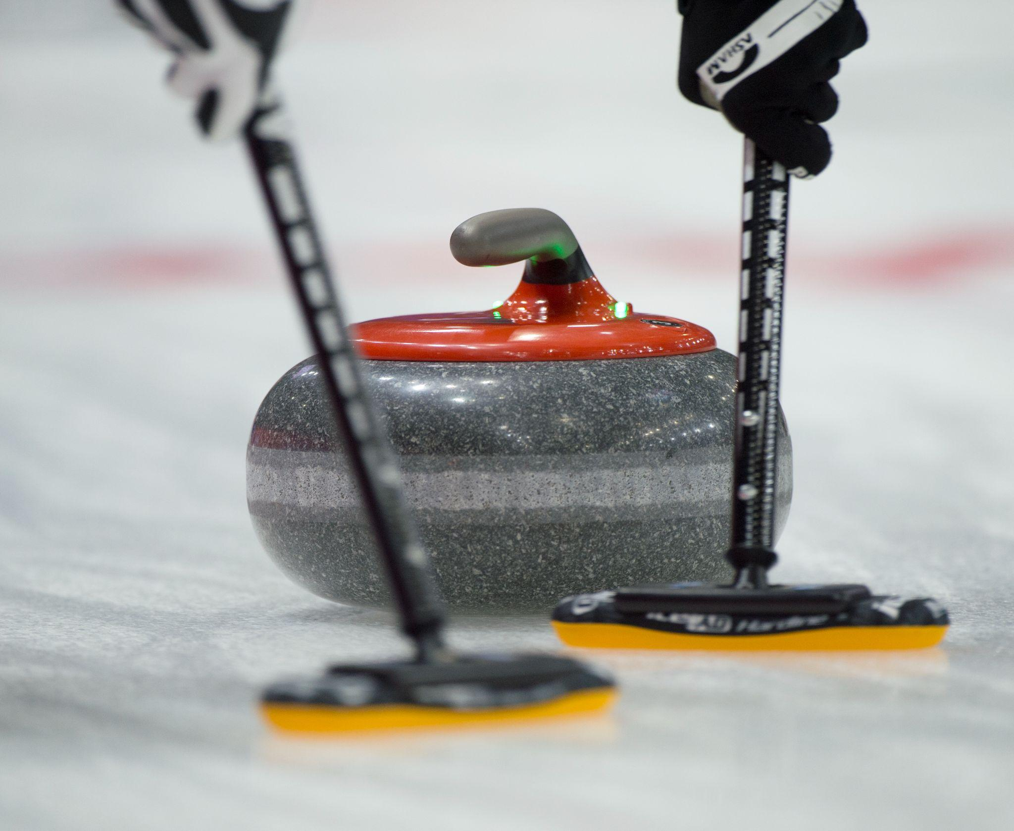
WEEK 10 - LEVEL 3 COMPLETED

Slide 87
Level 3 - What you have learned
LEVEL 3 - WEEK 10
Congratulations in completing the third training level of the ASCENSION PROGRAM!
Join us for the fourth and last level in order to improve your techniques and learn different aspects of curling!

Slide 88
Level 3 - What level 4 has in store for you
LEVEL 3 - WEEK 10
What level 4 will bring you:
→ Improve your balance and throwing technique
→ Better release control
→ Develop your throwing routine
→ Improve your open and closed sweeping technique
→ Understanding directional sweeping
→ Improve stopwatch use
→ Improve your weight consistency
→ Improve your understanding and application of the different types of strategies
→ Introduction to mental preparation, nutrition and physical training
→ More ice time to practice the different techniques and strategies
→ Longer games
→ Guaranteed fun in learning the techniques related to the sport of curling

