Slide 1
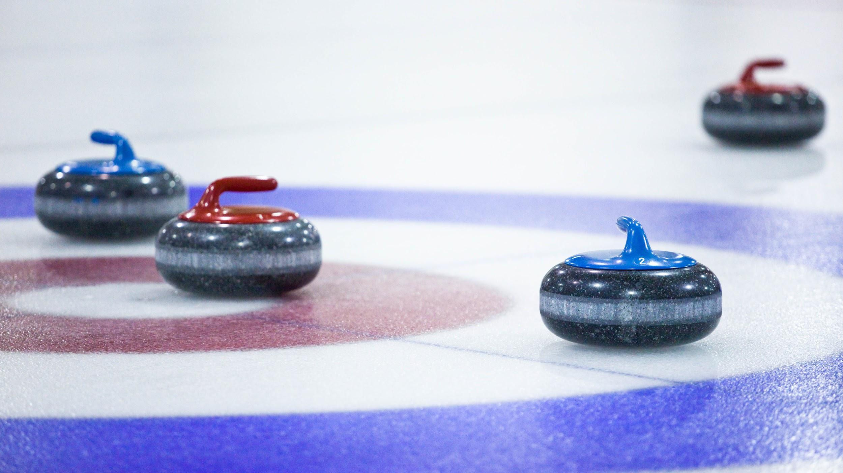
LEVEL 1: BEGINNER
INTRODUCTION TO THE SPORT OF CURLING

Slide 2
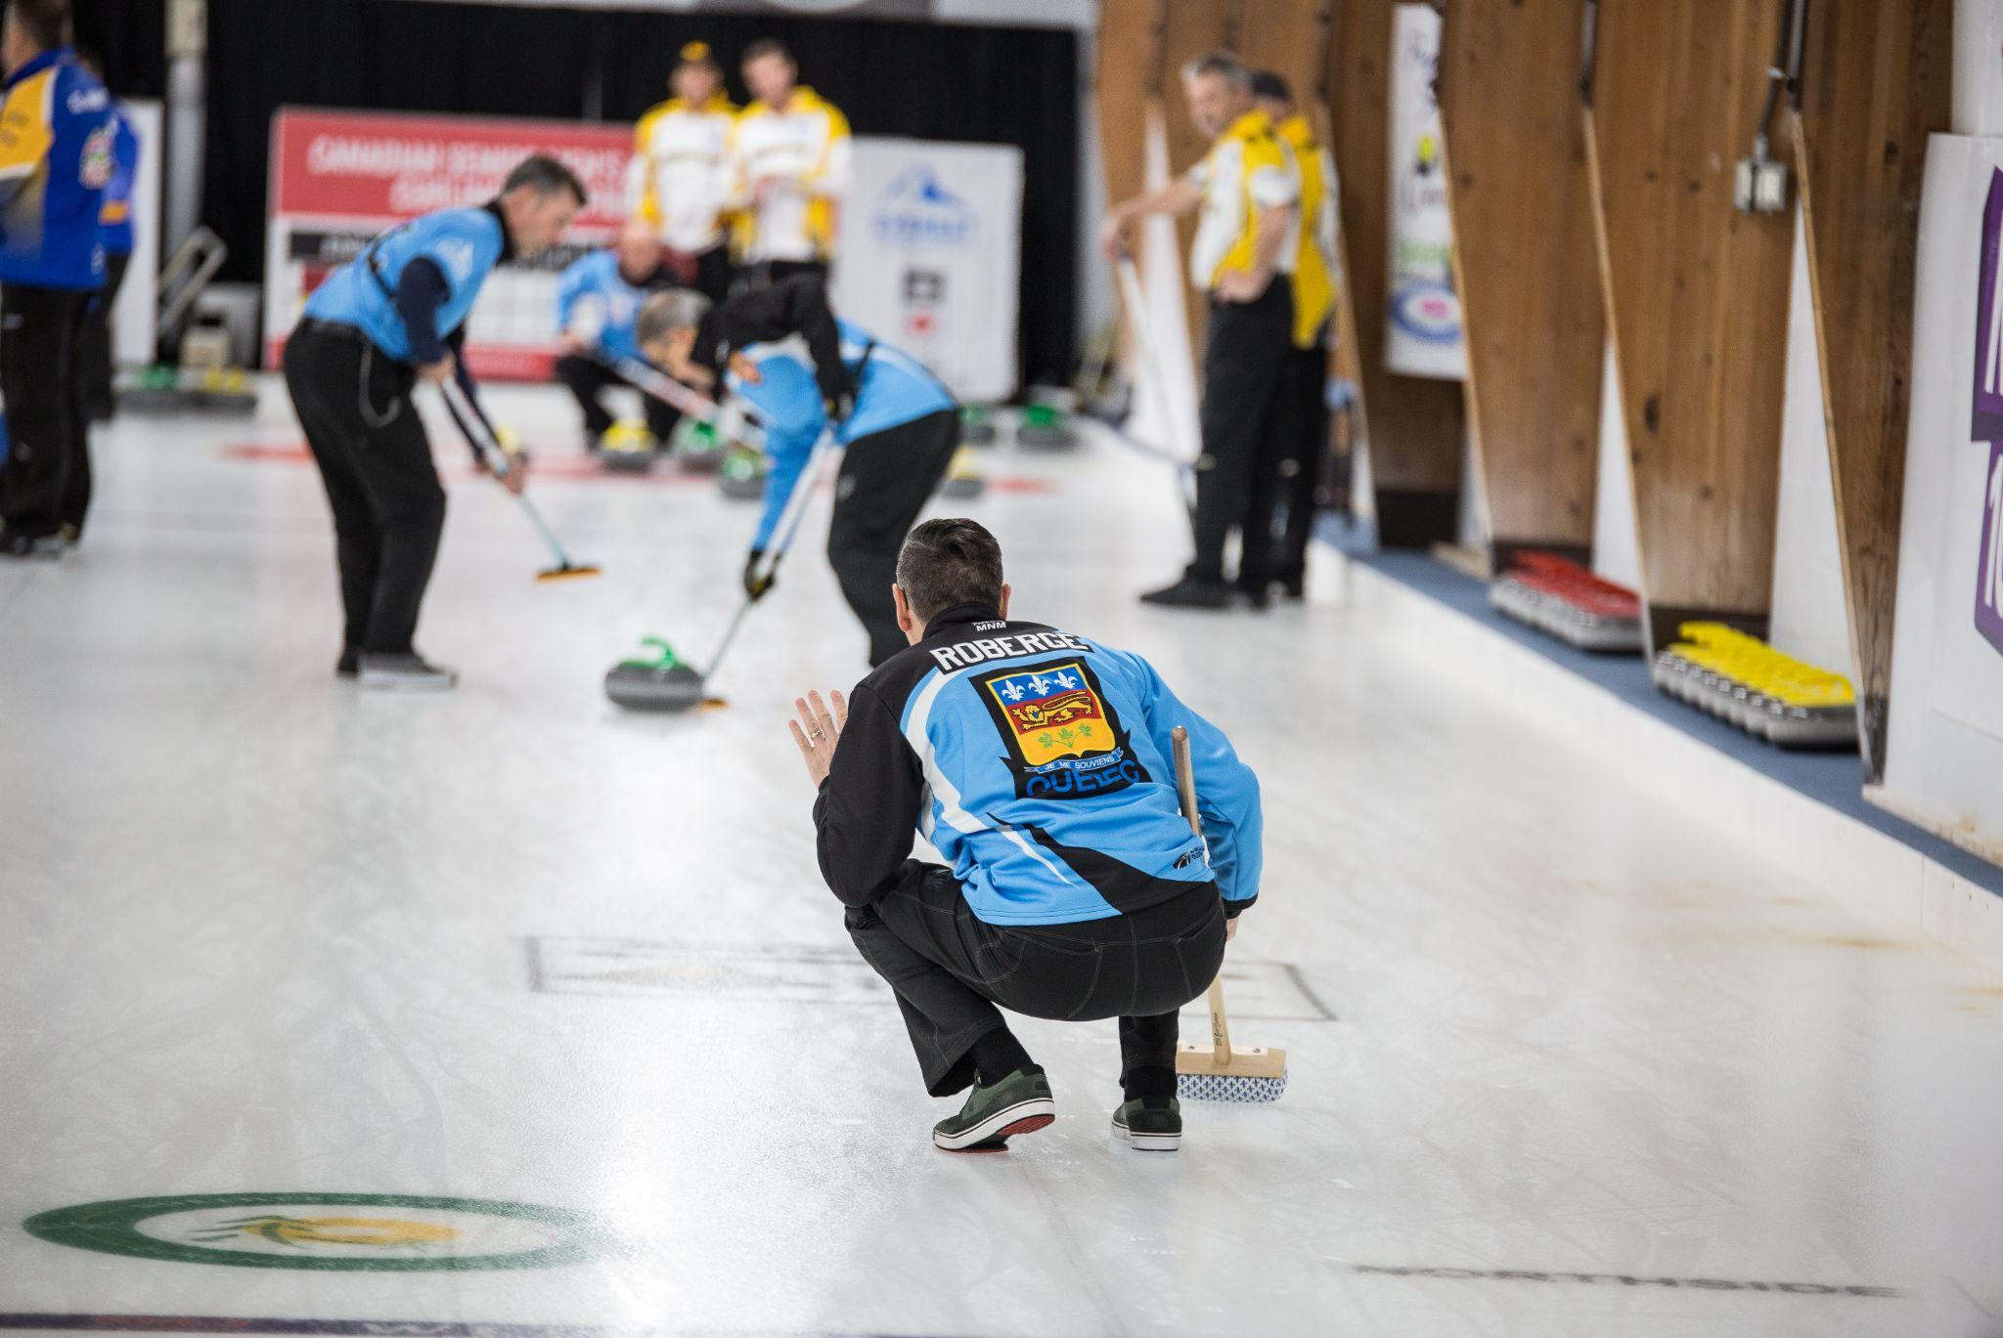
WEEK 1 - INTRODUCTION

Slide 3
Introduction
LEVEL 1 - WEEK 1
→ Introduction of the instructor(s)
→ Introduction of the participants
→ Presentation of the Program
🥌 4 levels of 10 sessions each
🥌 Beginner to Intermediate levels
🥌 Sessions of 120 minutes each
🥌 Divided in 3 segments: off-ice/on-ice/games

Slide 4
Objectives
LEVEL 1 - WEEK 1
Program objectives:
🥌 Learn basic curling techniques
🥌 Offer a positive experience
🥌 Offer a safe and supervised environment with instructors
🥌 Offer sessions specifically developed for recreational curlers
🥌 Provide an opportunity for participants to reach an advanced-Intermediate level of curling play by the end of Level 4

Slide 5
Themes
LEVEL 1 - WEEK 1
Subjects we’ll see in Level 1:
→ Safety and the components of the playing area
→ Ethics and game overview
→ Sliding position
→ Position in the hack
→ Steps involved in the slide
→ Holding the rock
→ Releasing the rock
→ Line of delivery
→ Open sweeping position
→ Introduction to judging rock speed
→ Basic notions of strategy
→ Introduction to the role of each player/communication

Slide 6
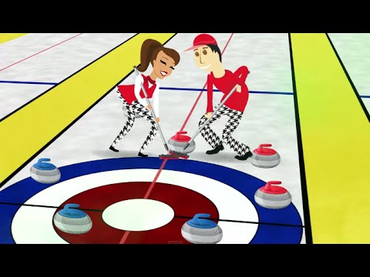
Security
LEVEL 1 - WEEK 1
⛑
Initiation to the sport of curling - Curling Canada Video
Different risk factors:
1- Equipment
→ Non-slip soles (gripper)
→ Sliders
→ Shoes
→ Brooms
→ Ice-making equipment
2- Environmental
→ The cold
→ Dehydration

Slide 7
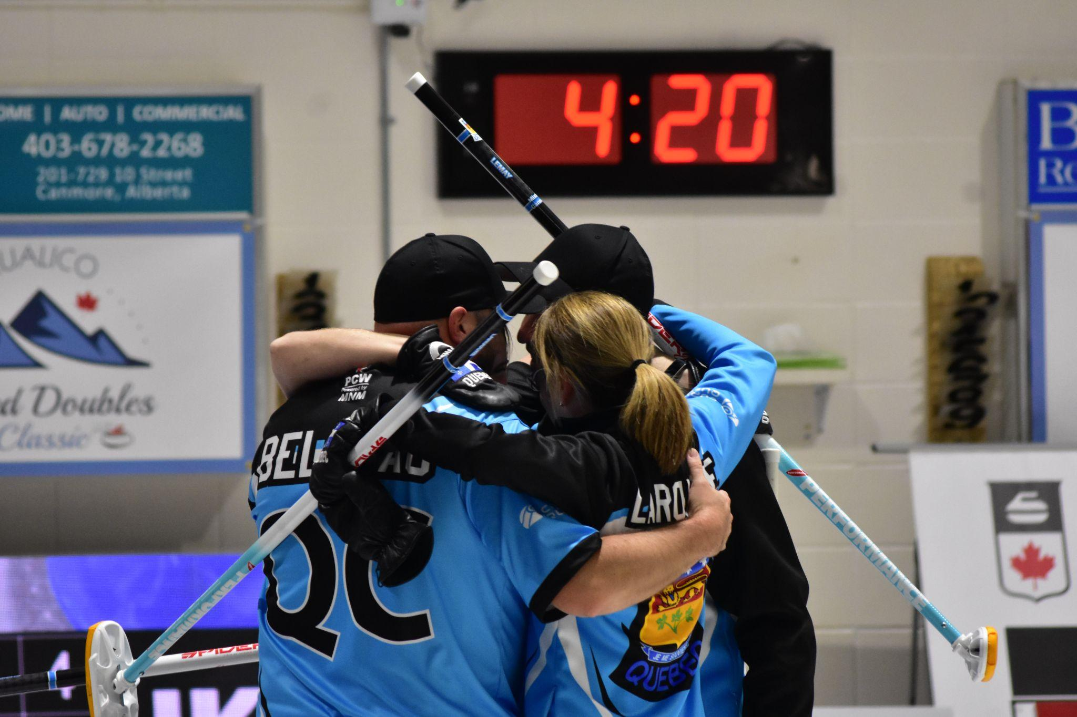
Security
LEVEL 1 - WEEK 1
⛑
Different risk factor (Cont’d) :
3- Human factors
→ The participants
→ The instructors
→ The officials
→ The coaches

Slide 8
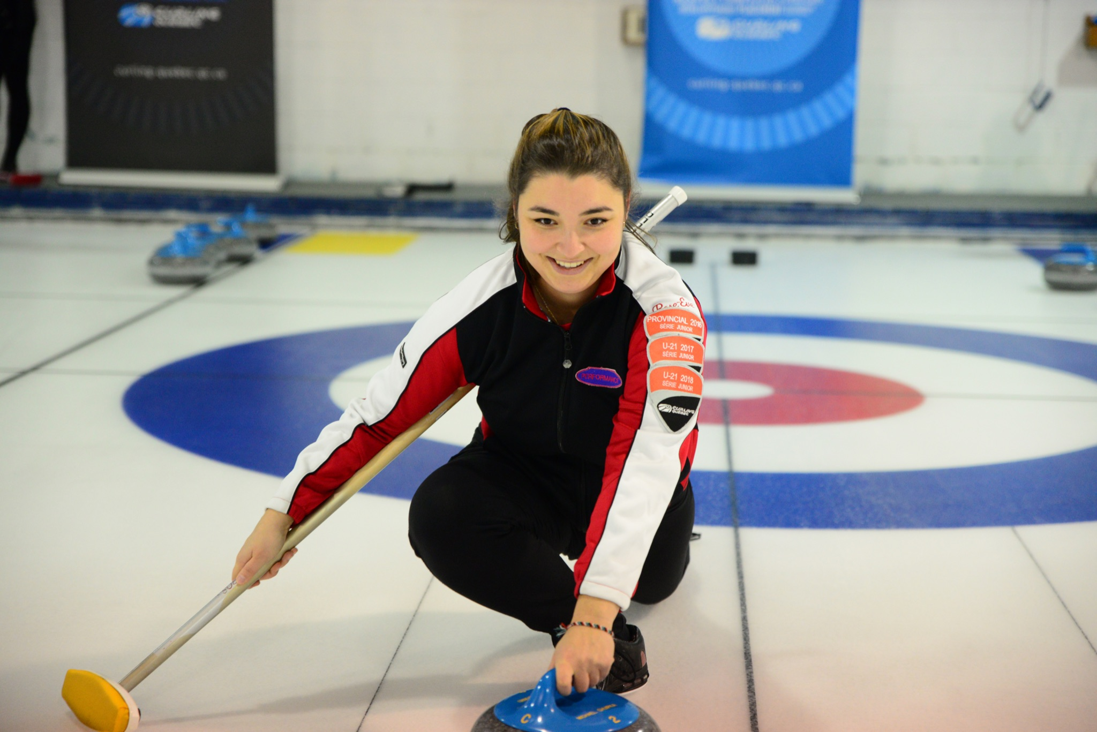
Equipment
LEVEL 1 - WEEK 1
Different types of curling equipment:
→ Shoes
→ Sliders
→ Grippers
→ Brooms
→ Stabilizer
→ Throwing stick (for reduced mobility)
→ Clothing

Slide 9
Prevention
LEVEL 1 - WEEK 1
Injury prevention:
→ Warm-up
→ Always step on the ice with the non-sliding shoe
→ Never run or walk backwards
→ A coach must always have an emergency action plan, to minimize risk
→ The instructors organize the activities according to the participants’ skill level
→ Always have the adequate equipment: grippers, clean broom head
→ Awareness of the emergency kit and the defibrillator location

Slide 10
Coach’s advice
LEVEL 1 - WEEK 1
All sports feature some level of risk. Each person has a responsibility to minimize risk.
Participants:
🥌 Maintain your equipment
🥌 Wash the head of your broom regularly with dishwashing soap and a brush. For the Hardline broom, use VIM. The head needs to be totally dry before being used again on the ice. (Allow 3 days)
🥌 Regularly clean your grippers

Slide 11
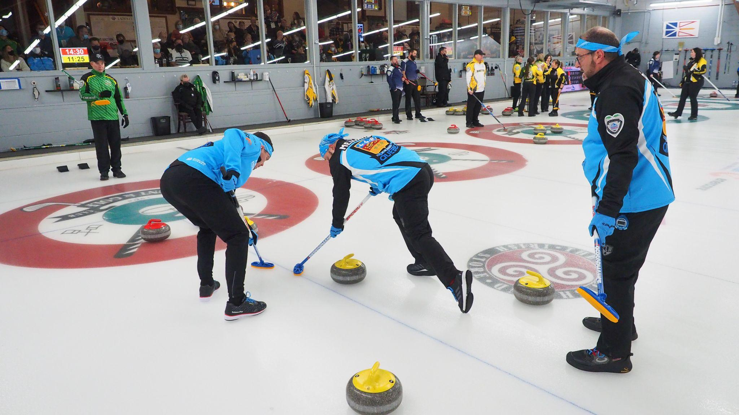
WEEK 2 - TERMINOLOGY

Slide 12
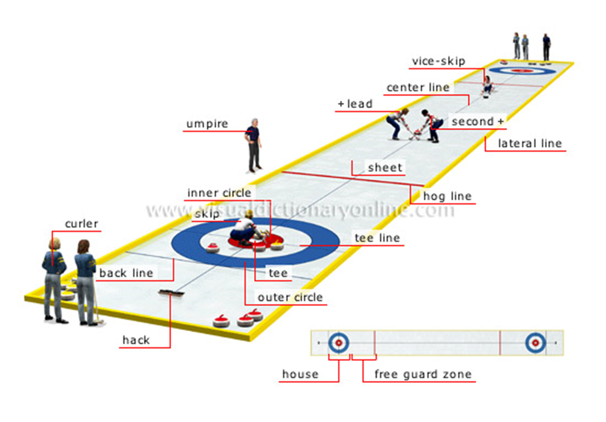
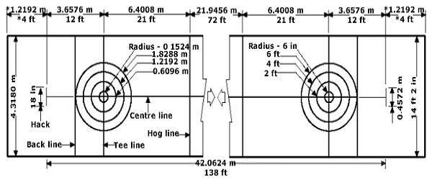
Terminology
LEVEL 1 - WEEK 2

Slide 13
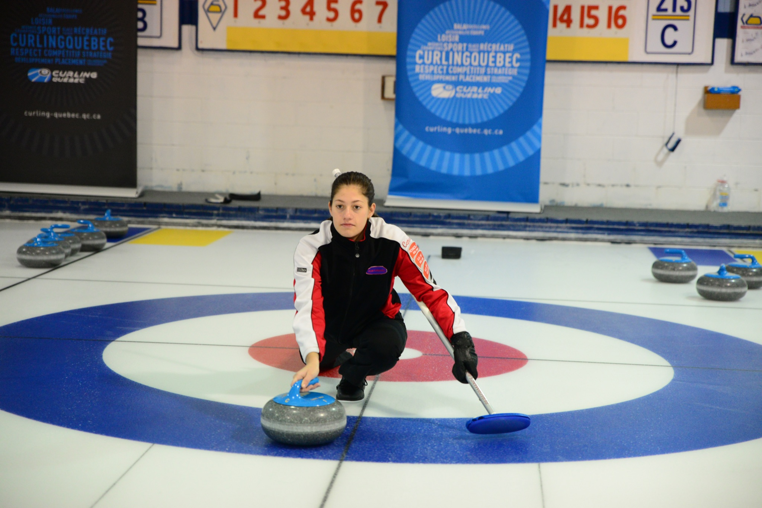
The slide
LEVEL 1 - WEEK 2
Key points of the basic slide position:
→ Shoulders are parallel to the ice and perpendicular to the line of delivery
→ Hips are perpendicular to the line of delivery (looking straight ahead)
→ The sliding foot is directly under the belly button (the body’s center of gravity)
→ The sliding foot is slightly turned outwards (the toes point outside the line of delivery)
→ The foot on the trailing leg (used as a rudder) should point either inside or straight

Slide 14
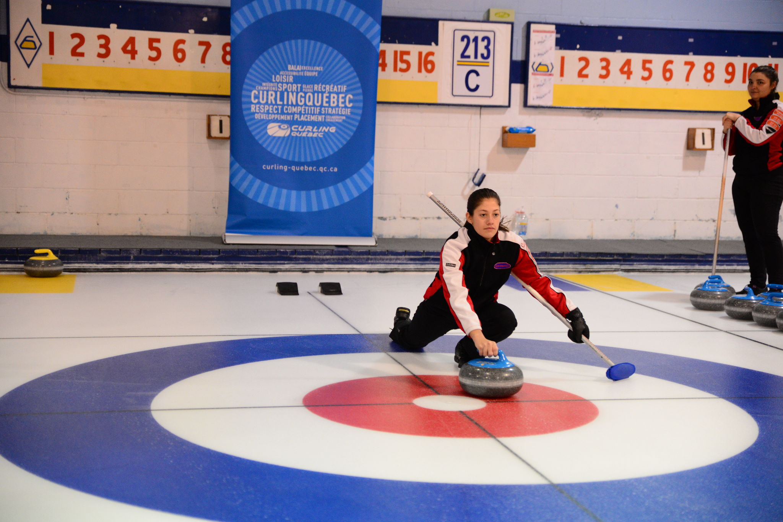
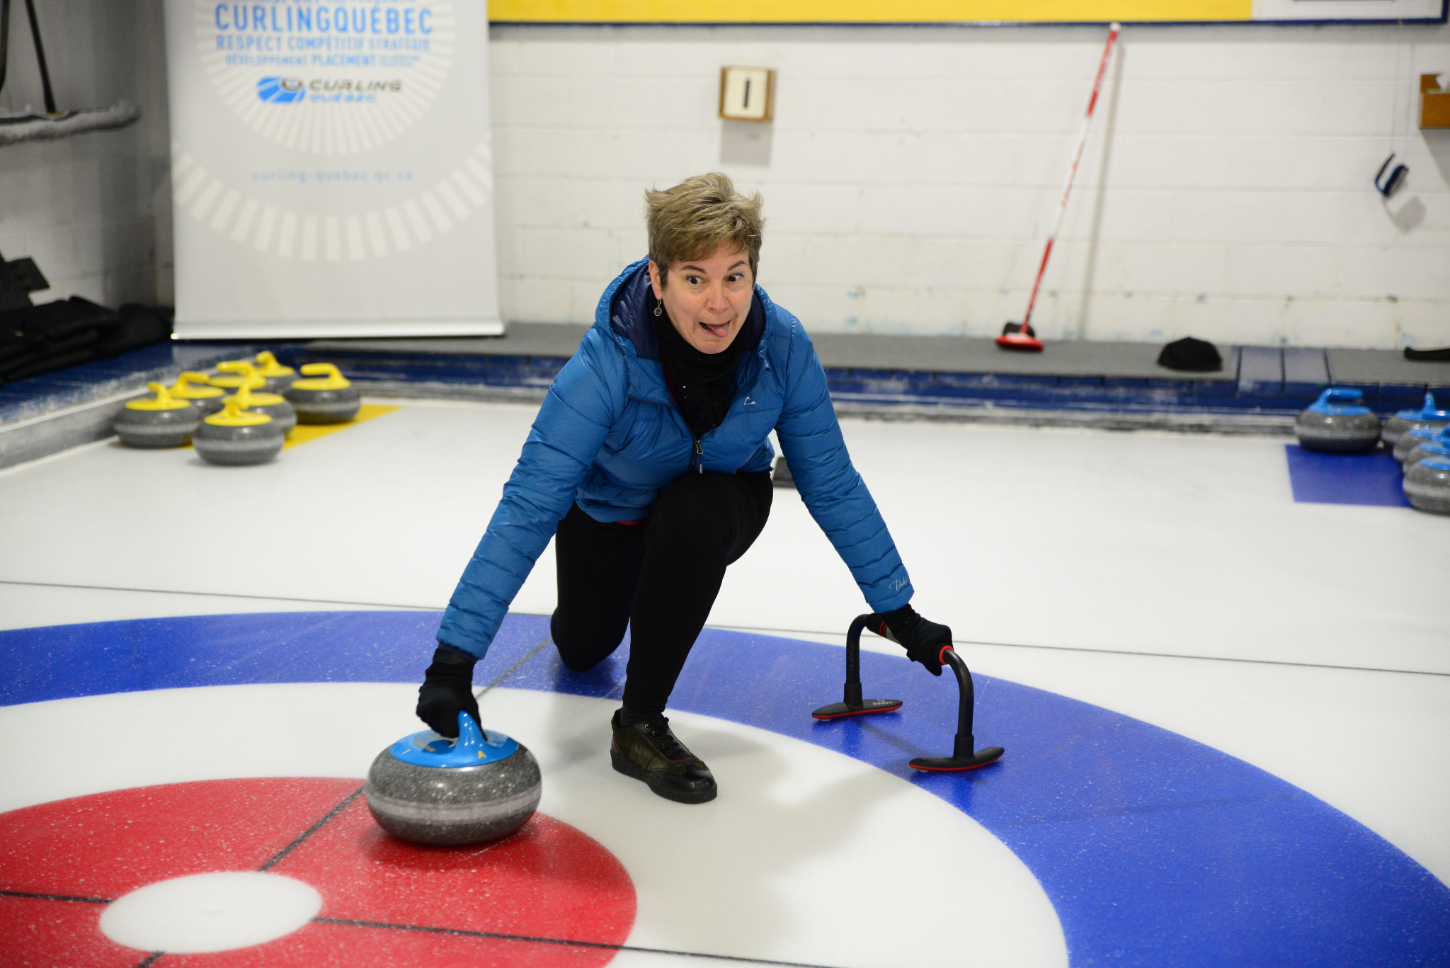
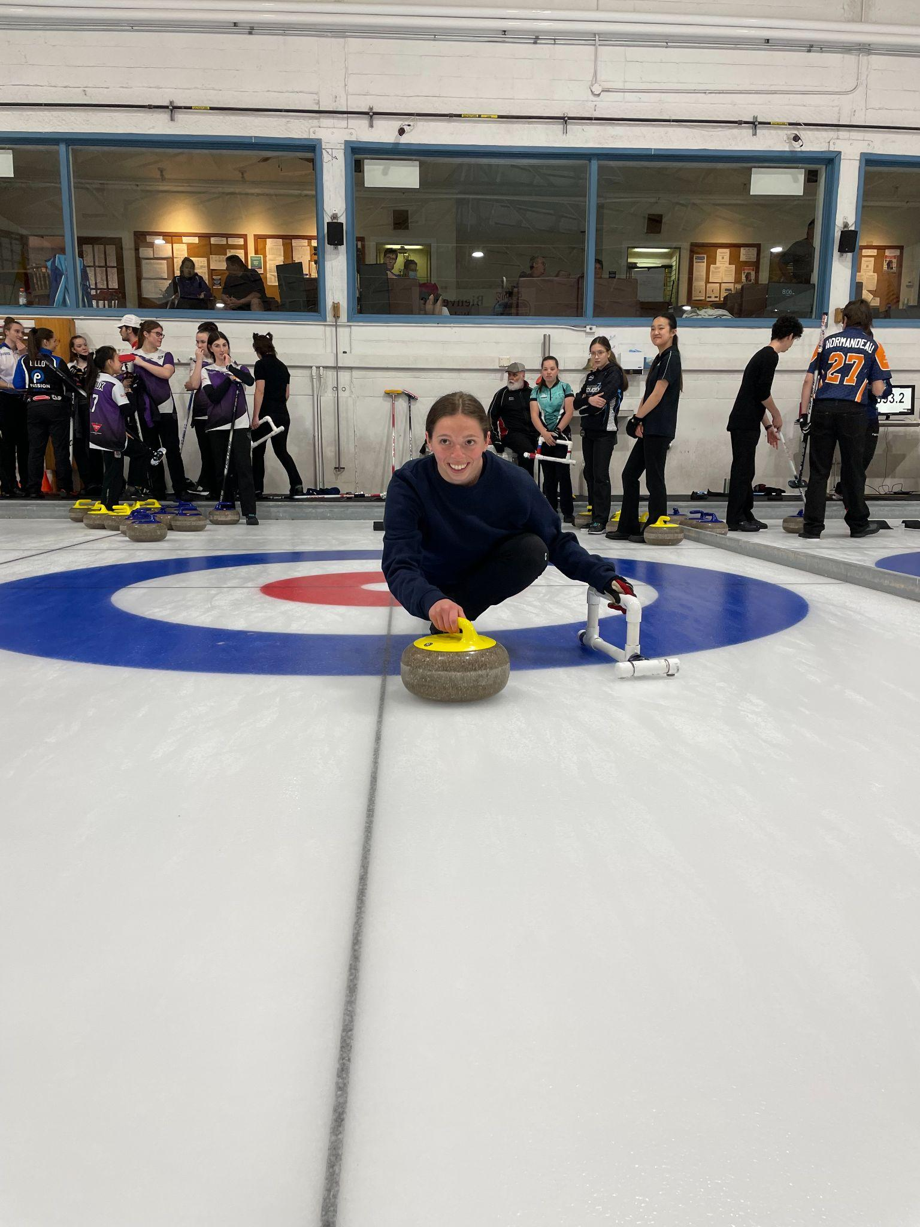
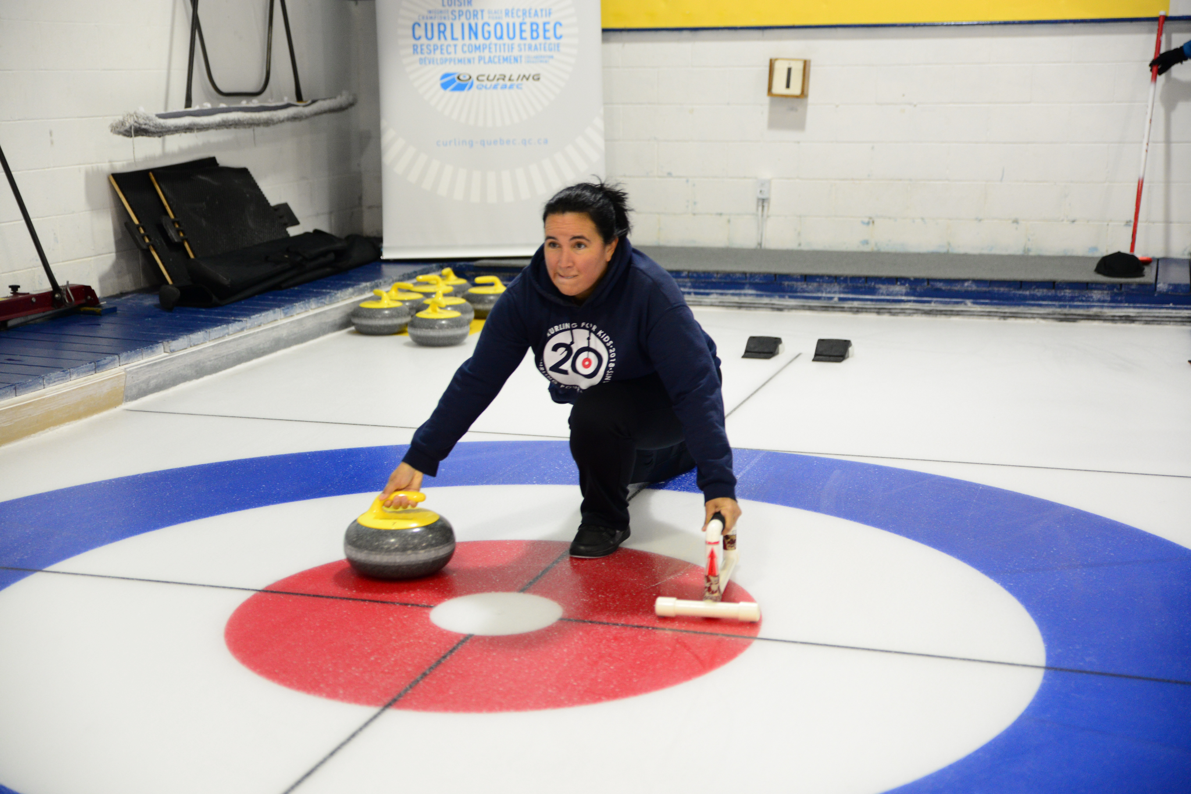
Sliding position
LEVEL 1 - WEEK 2
TO DO ✅
NOT TO DO ❌

Slide 15
Coach’s advice
LEVEL 1 - WEEK 2
→ Before playing any sport, it is important to learn the terminology related to that sport.
→ A proper understanding of the playing area allows you to better communicate while performing that sport.
→ The starting position in the hack is one of the key elements that will grant you better accuracy in your shots.
🥌 Will you have to strengthen some muscles?
🥌 Will you have to increase the stretching capacity of other muscles?
→ Throughout the program, we’ll be here to help you improve your sliding technique.

Slide 16
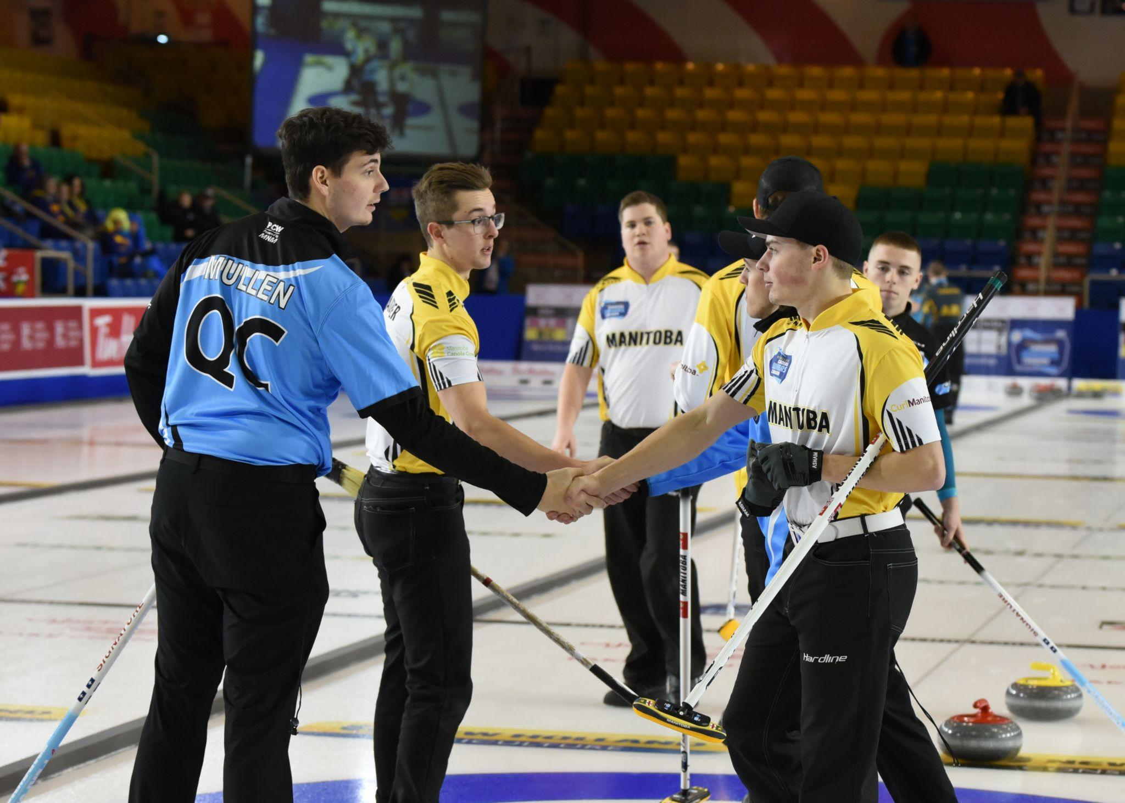
WEEK 3 - CURLING ETHICS

Slide 17
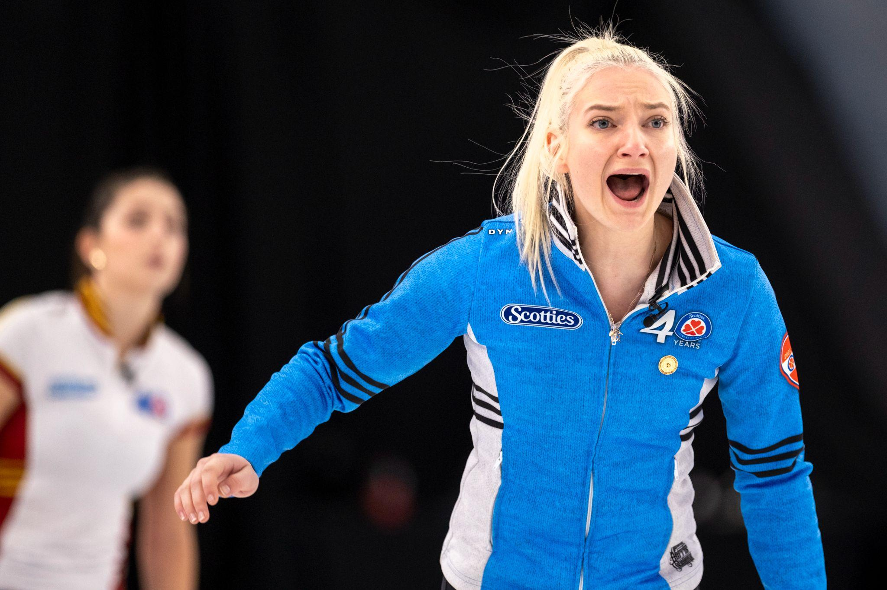
Curling ethics
LEVEL 1 - WEEK 3
Curling values:
→ Clean shoes adapted to the sport
→ Specific rules in each curling club
→ Food and beverages
→ Shaking hands pre- and post-game
→ The draw for the hammer
→ Positioning of the players on the active team
→ Positioning of the players on the inactive team
→ Avoid putting hands and knees on the ice at all times

Slide 18
Curling ethics
LEVEL 1 - WEEK 3
Basic rules of curling:
→ General information
→ The hammer
→ Different positions on a team
→ The hack, which side to use? (left or right)
→ A moving rock that is touched? (burned)
→ The five-rock guard rule
→ Sweeping behind the centerline of the house
Websites where you may find more information:
www.curling-quebec.qc.ca
www.curlingcanada.ca

Slide 19
General informations
LEVEL 1 - WEEK 3
Rocks/Ice/Pebble:
→ A rock weighs approximately 44 pounds
→ 16 rocks per sheet (8 of each colour)
→ Cost : 800$ to 1000$ per rock
→ The concave part under the rock: the crown
Equipment used:
→ Stabilizers or brooms
→ Curling stick (for reduced mobility)
→ Sliders and grippers
→ Stopwatch (reference tool)
🥌

Slide 20
Game orientation
LEVEL 1 - WEEK 3
Scoring:
→ The team with the most points after the last end wins the game
→ Only one team can score one or more points during each end
→ End = when both teams have thrown all eight rocks
→ Generally, a game lasts six to eight ends

Slide 21
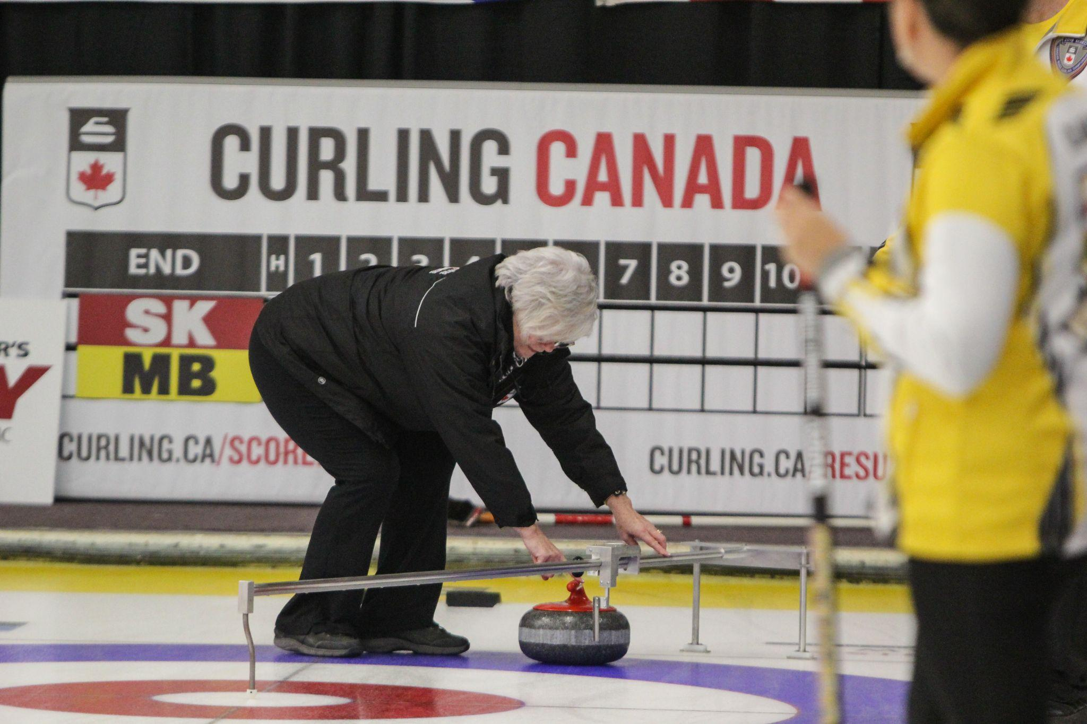
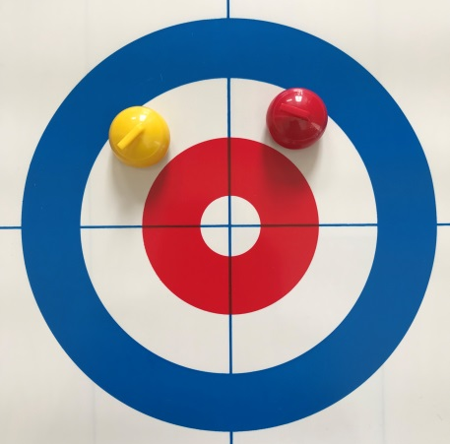
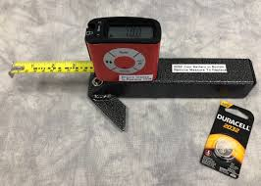
Game orientation
LEVEL 1 - WEEK 3
Measuring the rocks:
→ A specialized measuring device with a millimetric dial is used to measure two or more rocks which appear to be at equal distance from the button
→ The Laser Rock Measure is now used for measuring during championships

Slide 22
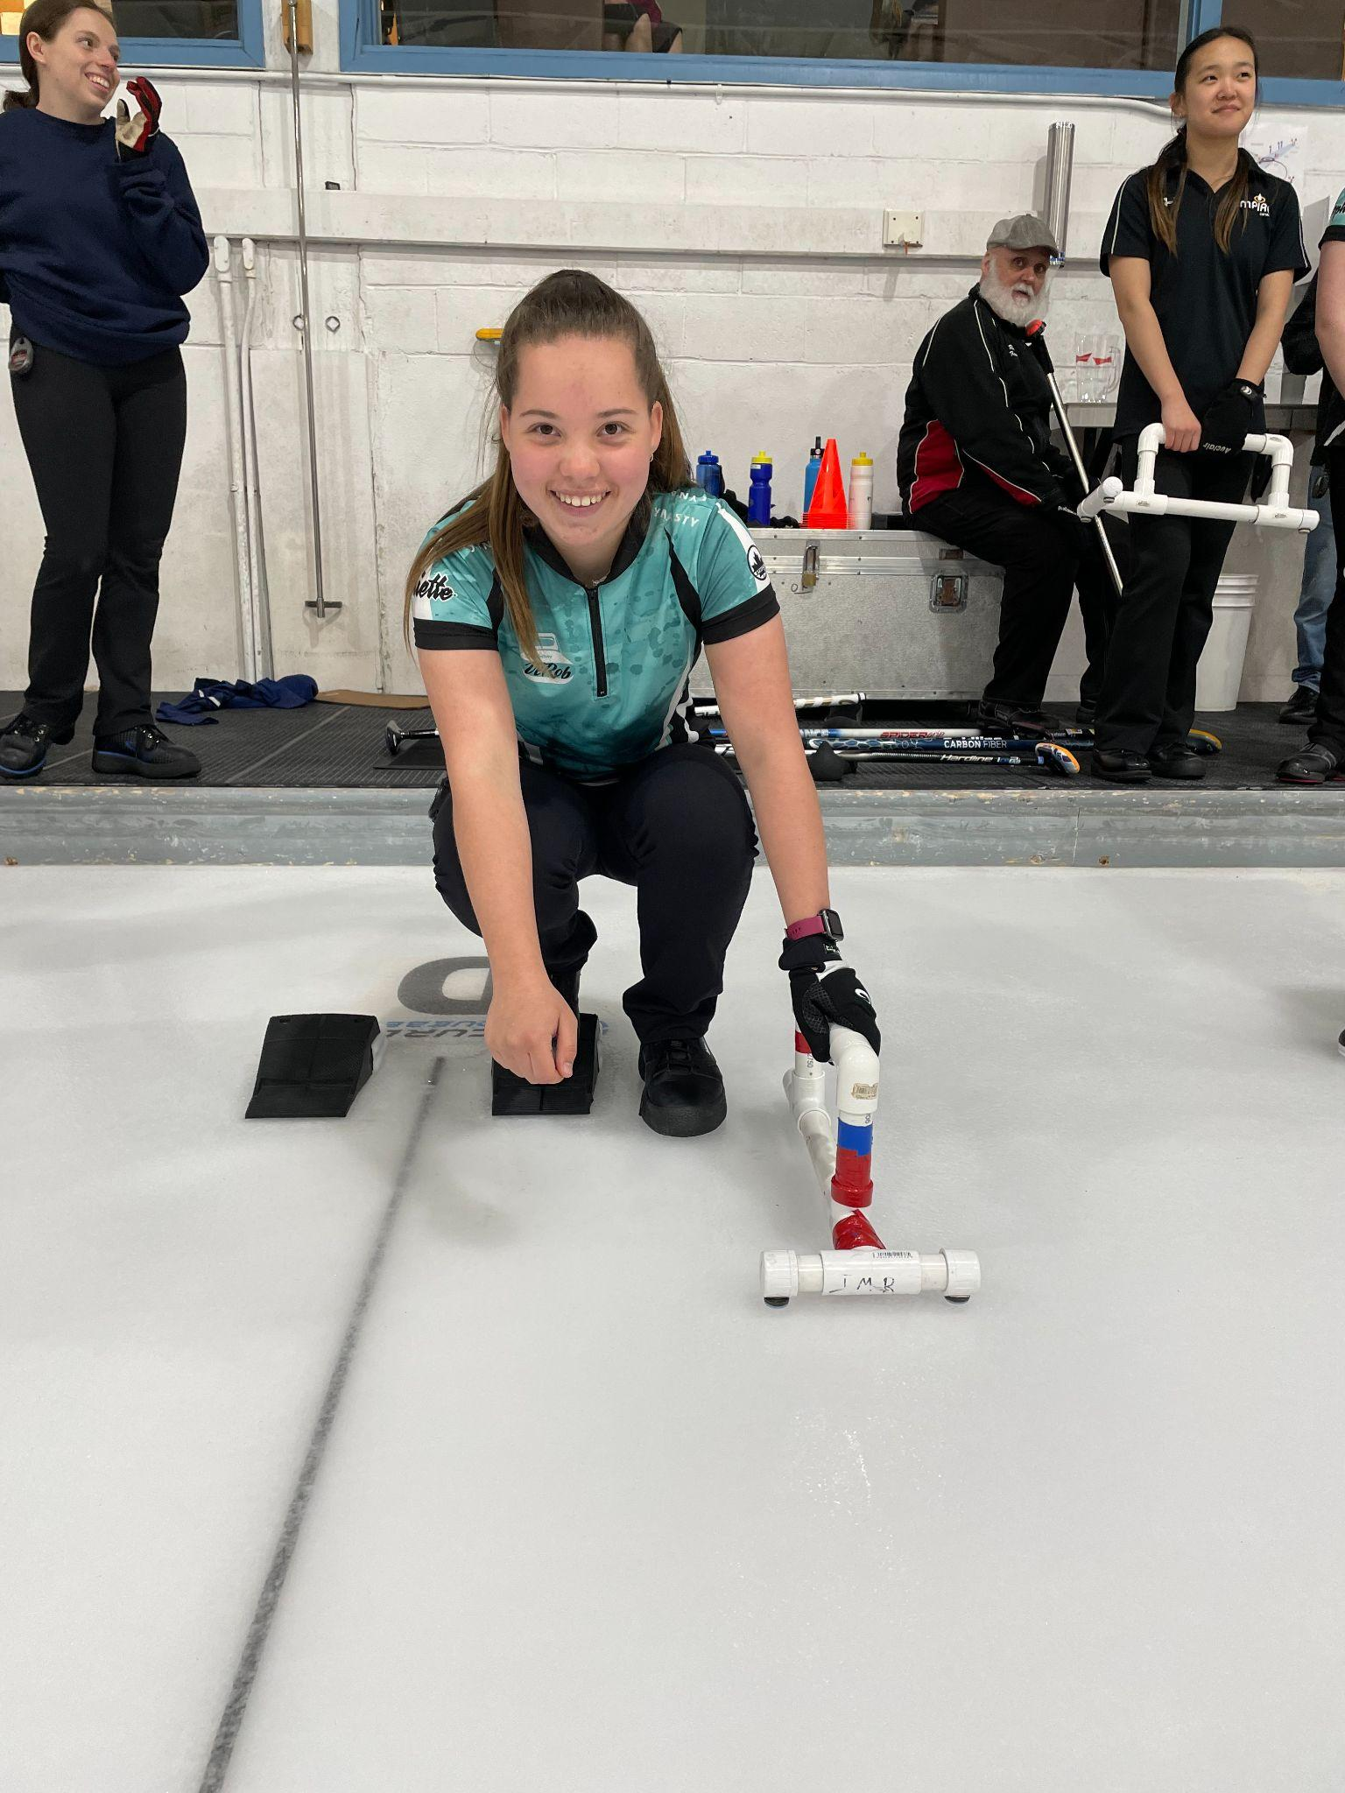
Position in the hack
LEVEL 1 - WEEK 3
Important components for a successful slide (example for a right-handed curler):
→ Stand straight behind the hack
→ Position the ball of right foot in the upper portion of the hack with the toes on the flat lower part of the hack
→ The big toe aims at the target
→ Position the sliding foot so that it is parallel to the foot in the hack
→ The heel of the sliding foot should be aligned with the toes of the right foot (heel to toes)
→ Lower yourself into a squat or half-squat position

Slide 23
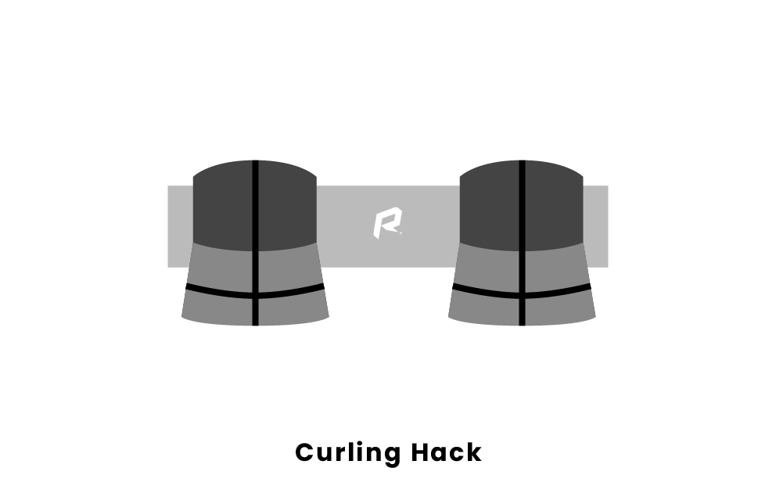
Position in the hack
LEVEL 1 - WEEK 3
→ Shoulders are parallel to the ice and perpendicular to the line of delivery
→ Hips are perpendicular to the line of delivery (the left and right hip bones are like our eyes, they must look toward the line of delivery)
→ The dominant eye is on the line of delivery*
→ The balancing arm is slightly bent
→ The throwing arm is firm but relaxed, the elbow is slightly bent
*The dominant eye will be discussed in Level 3

Slide 24
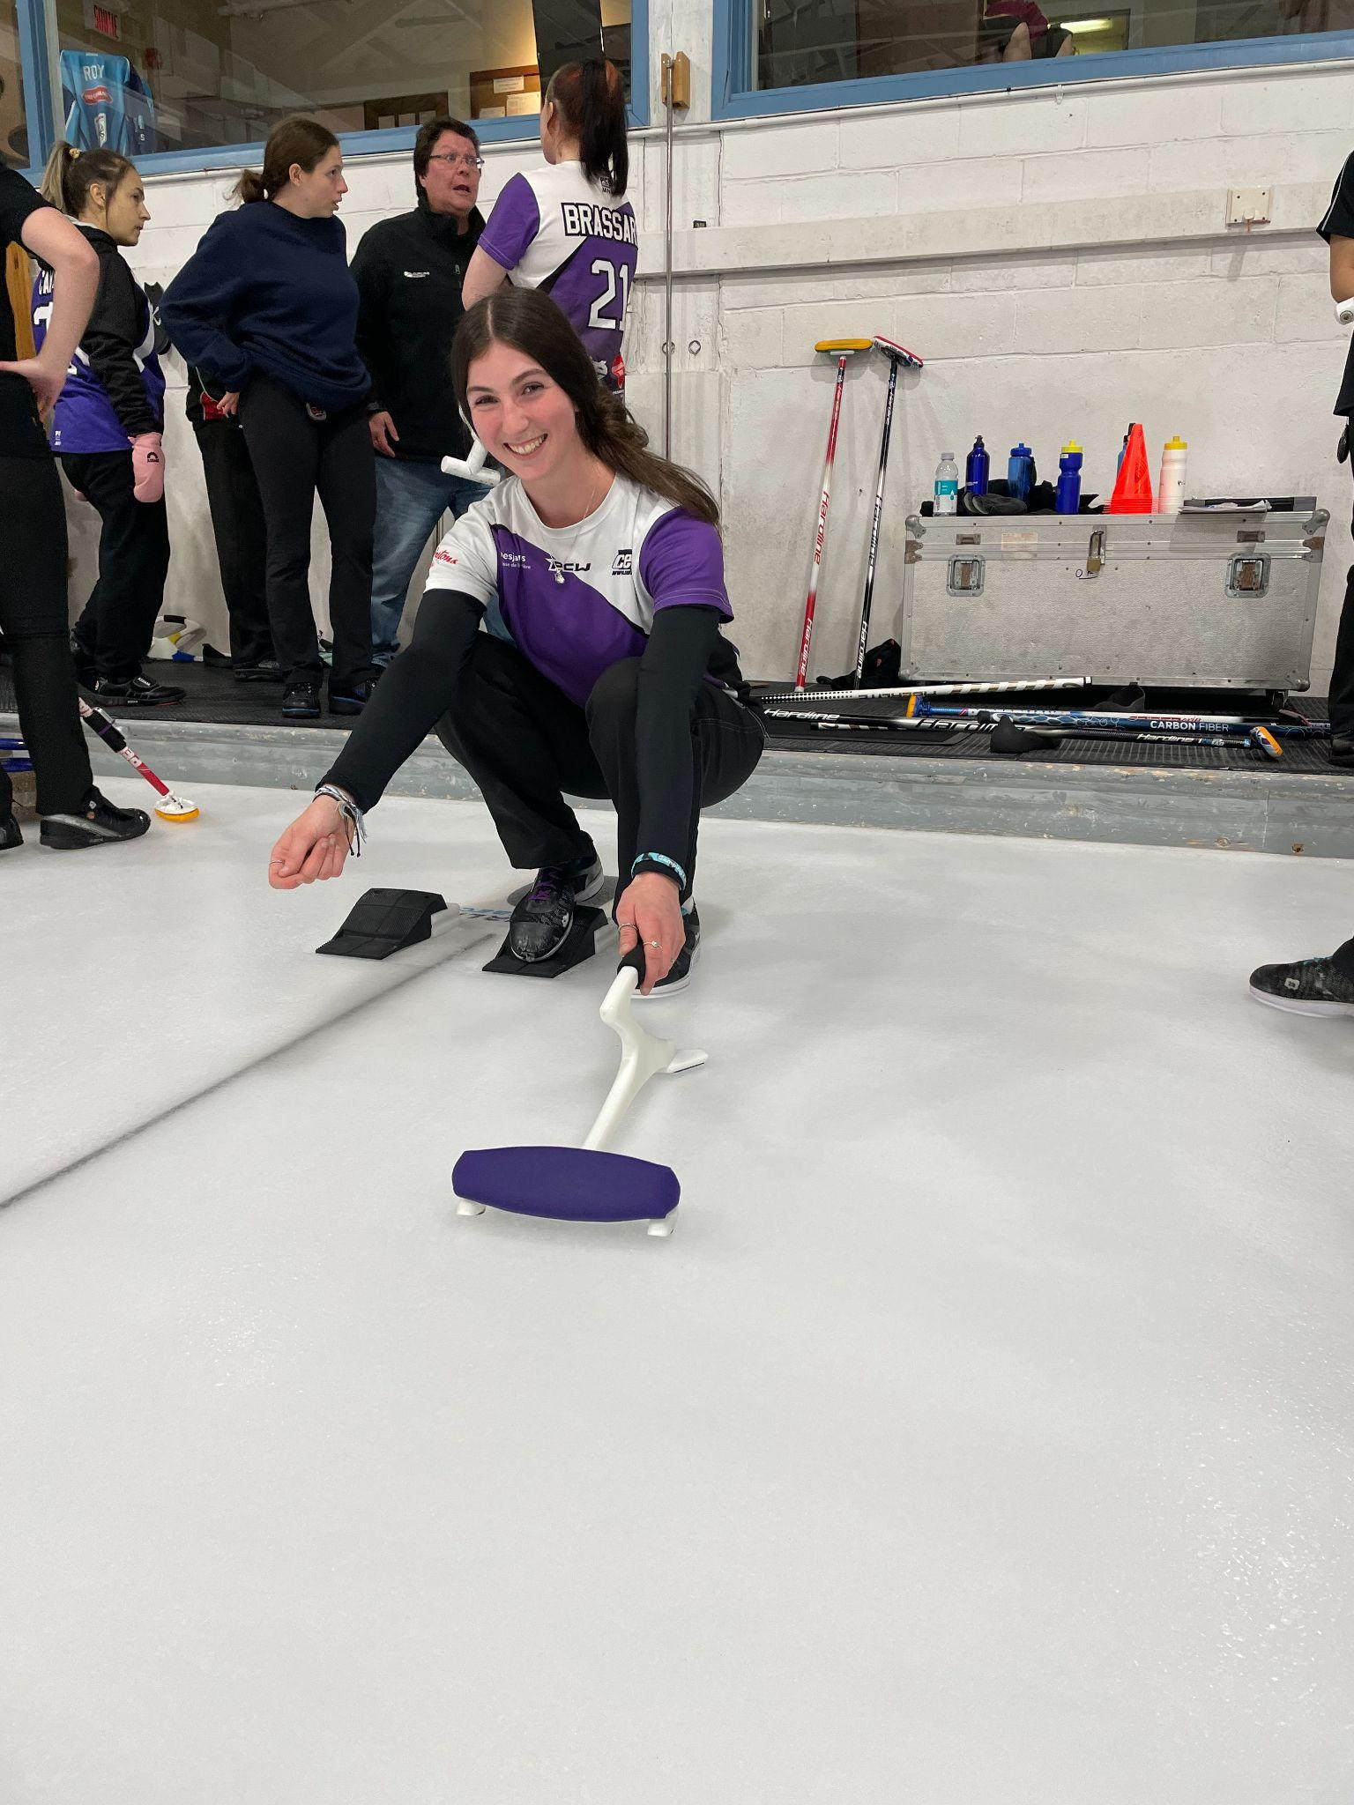
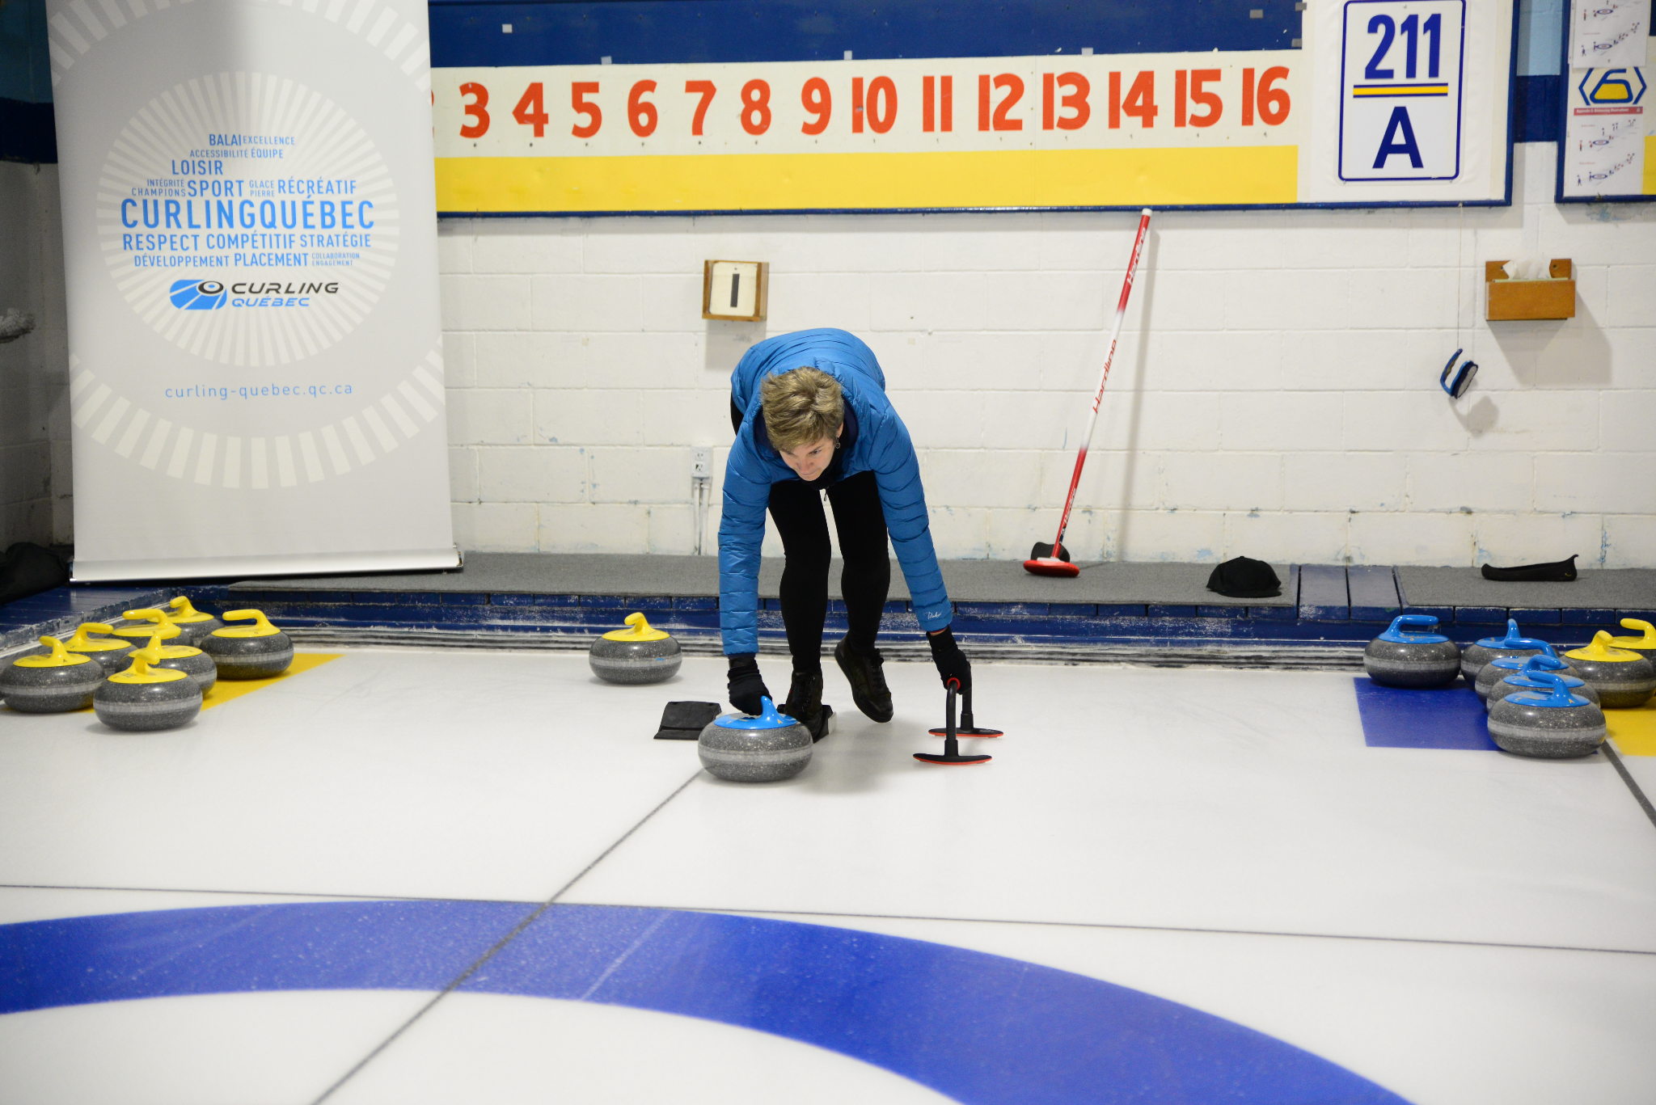
Position in the hack
LEVEL 1 - WEEK 3
TO DO ✅
NOT TO DO ❌

Slide 25
Coach’s advice
LEVEL 1 - WEEK 3
Everything begins in the HACK!!
→ You will be uncomfortable with the changes until it becomes natural.
→ Sliding is like archery, if your starting position is not aimed at the target, it will be impossible to hit it.
→ The secret: PRACTICE! If you have the opportunity to train with a coach, the coach will be able to film you and then you will understand the technical details to correct.
→ Film from the front, sides and the back to have a 360 degree view of the body.
→ It is important to become aware of your body positioning in order to understand what changes are needed.

Slide 26
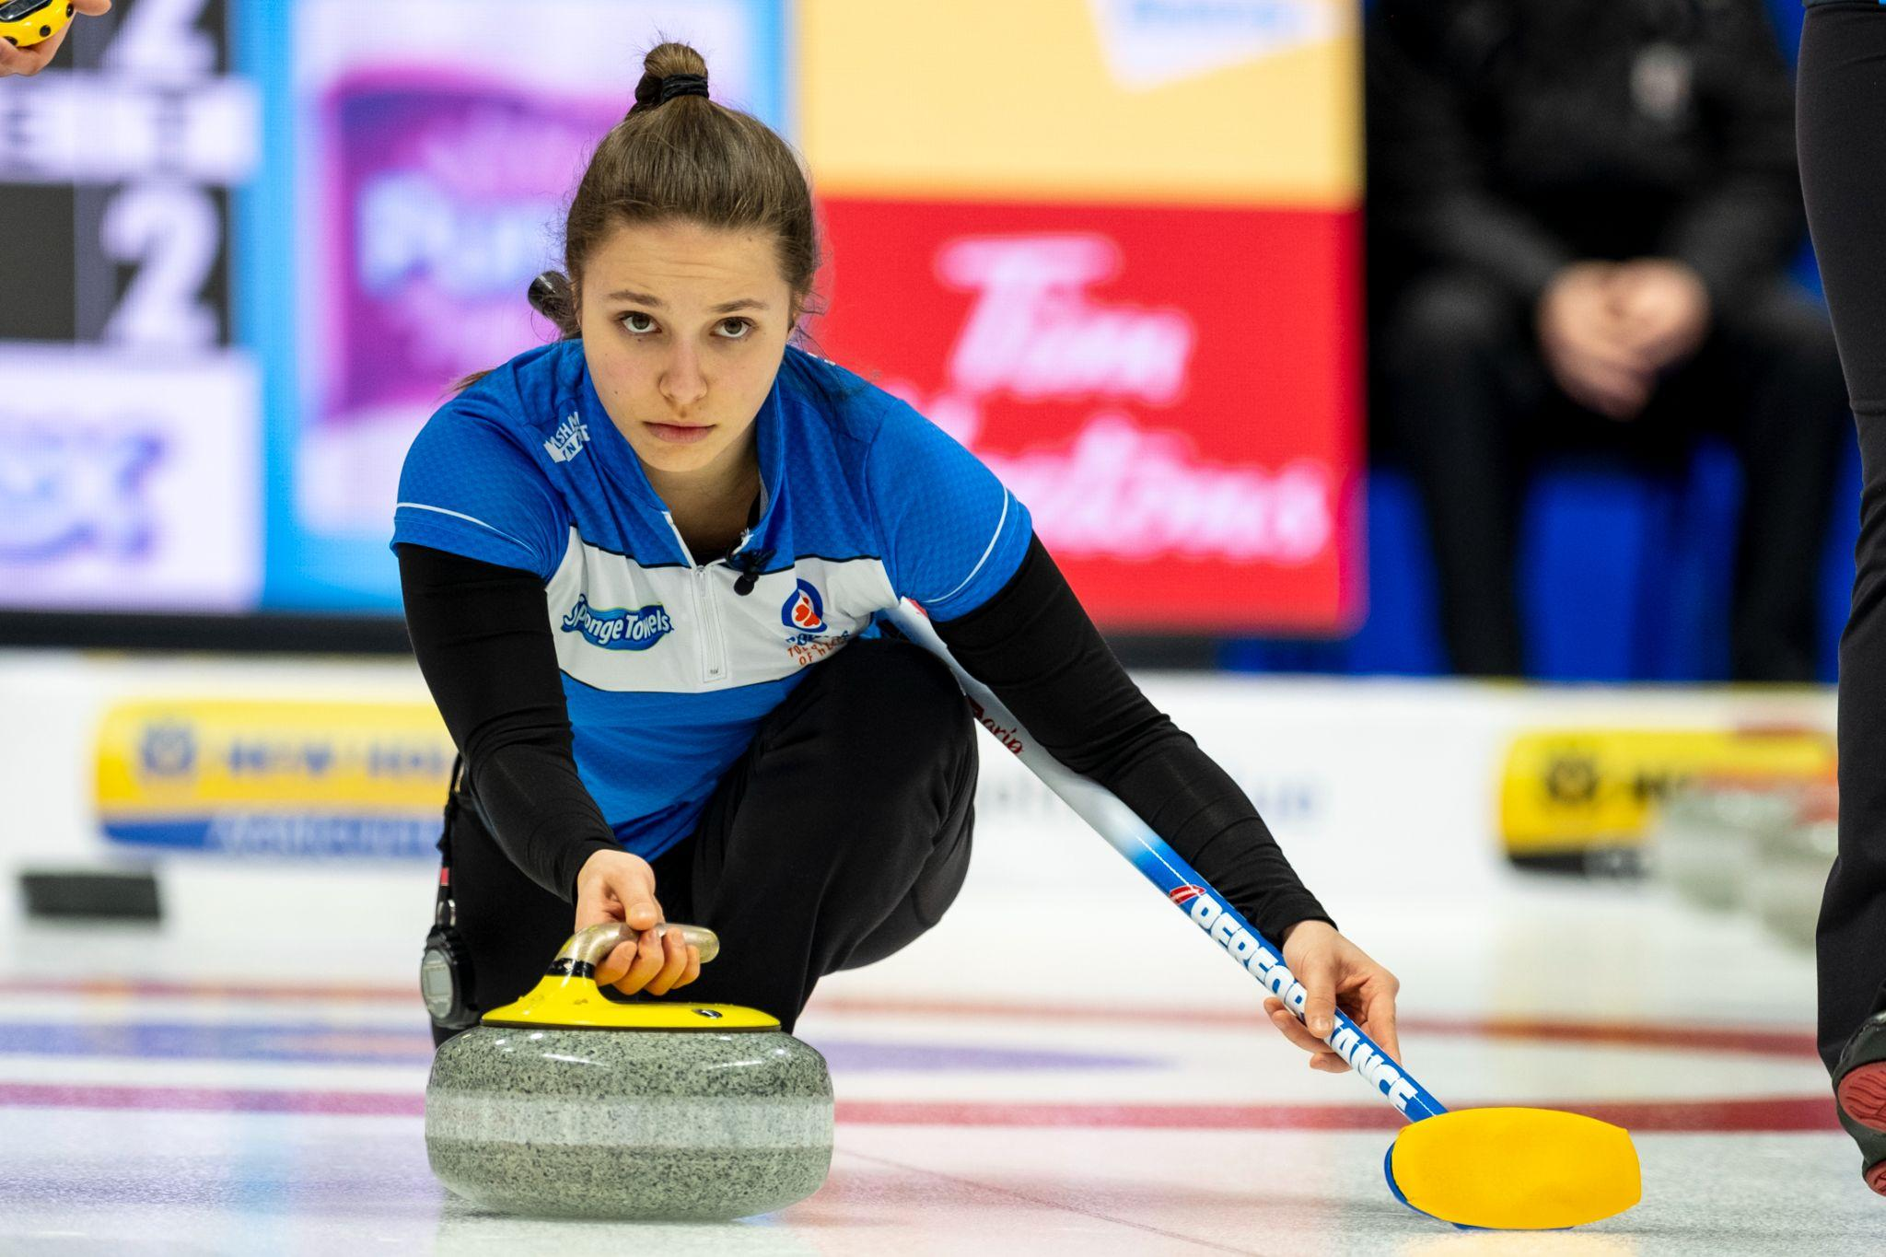
WEEK 4 - HOLDING THE ROCK

Slide 27
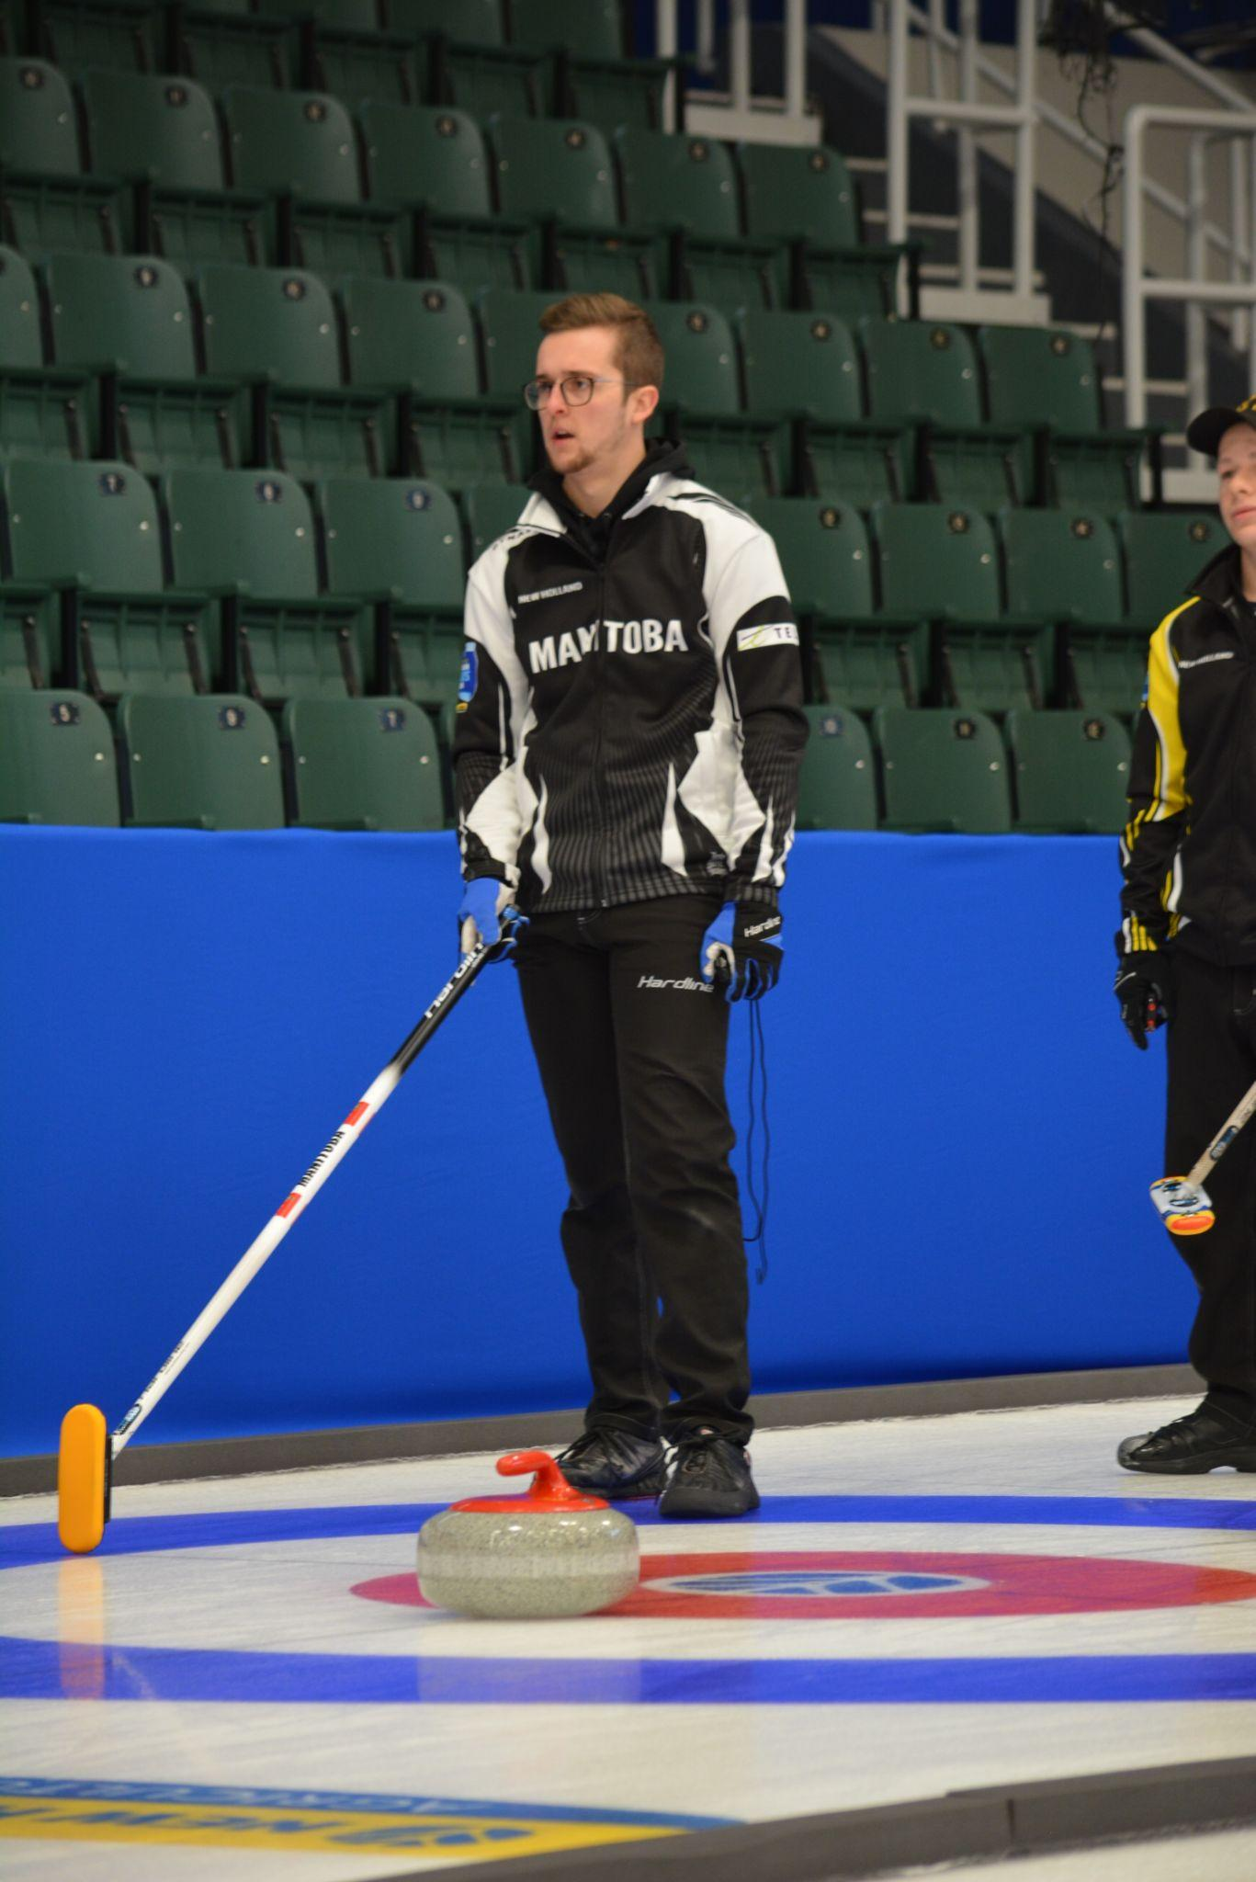
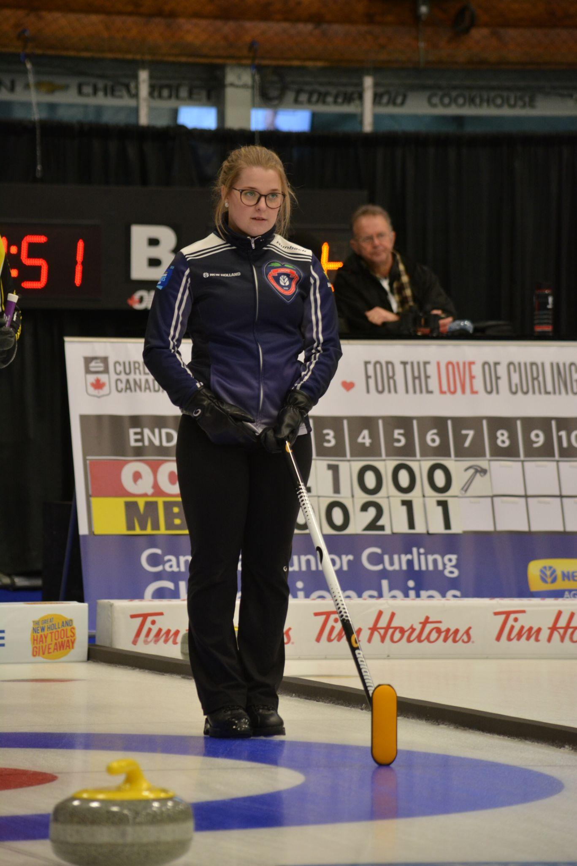
Captain’s signals
LEVEL 1 - WEEK 4
RIGHT POSITION

Slide 28
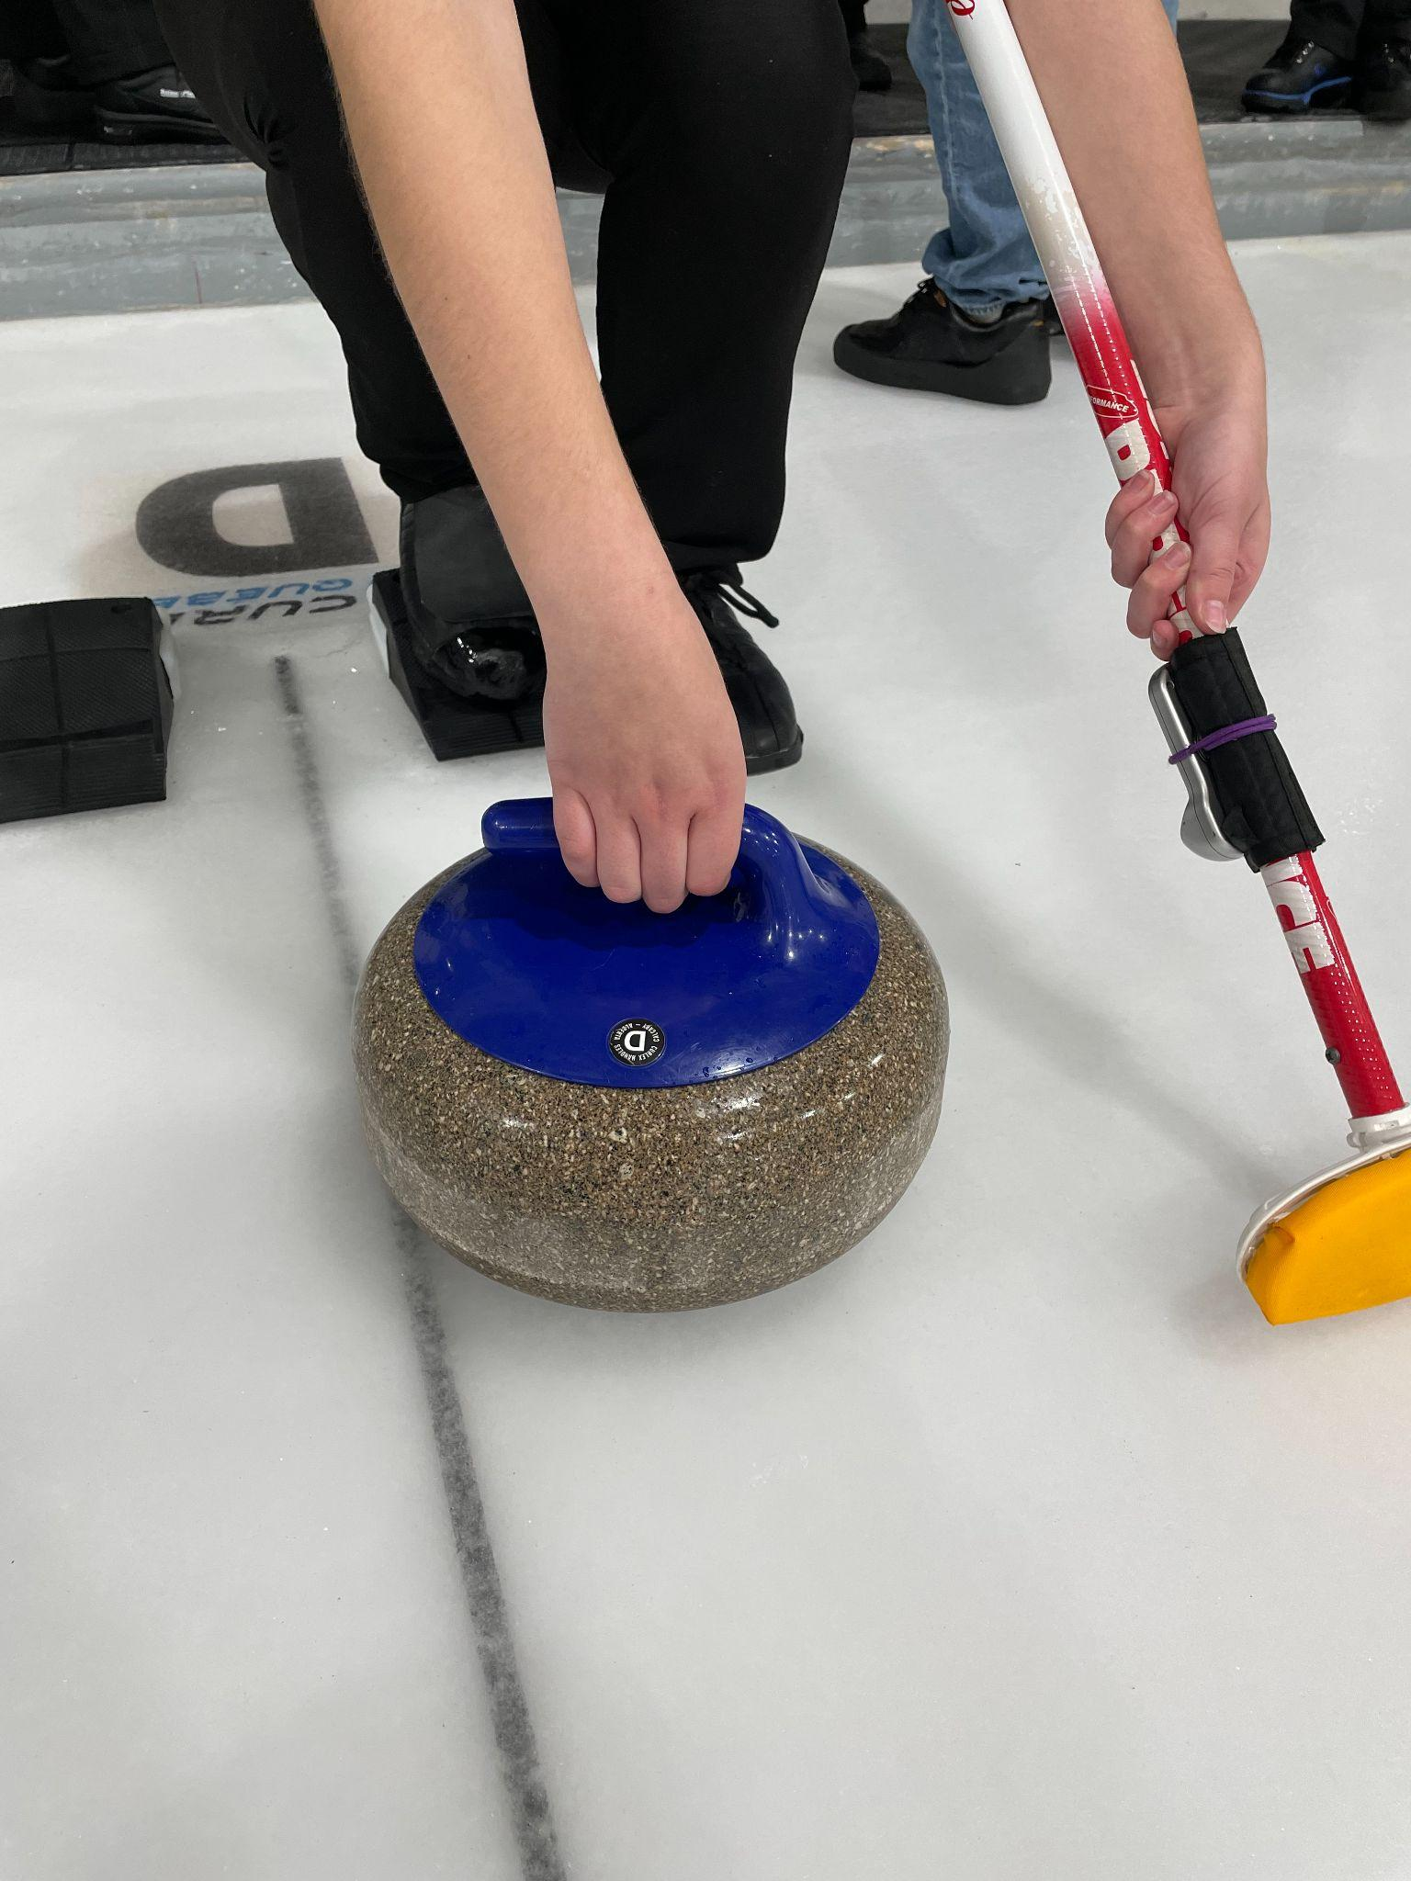
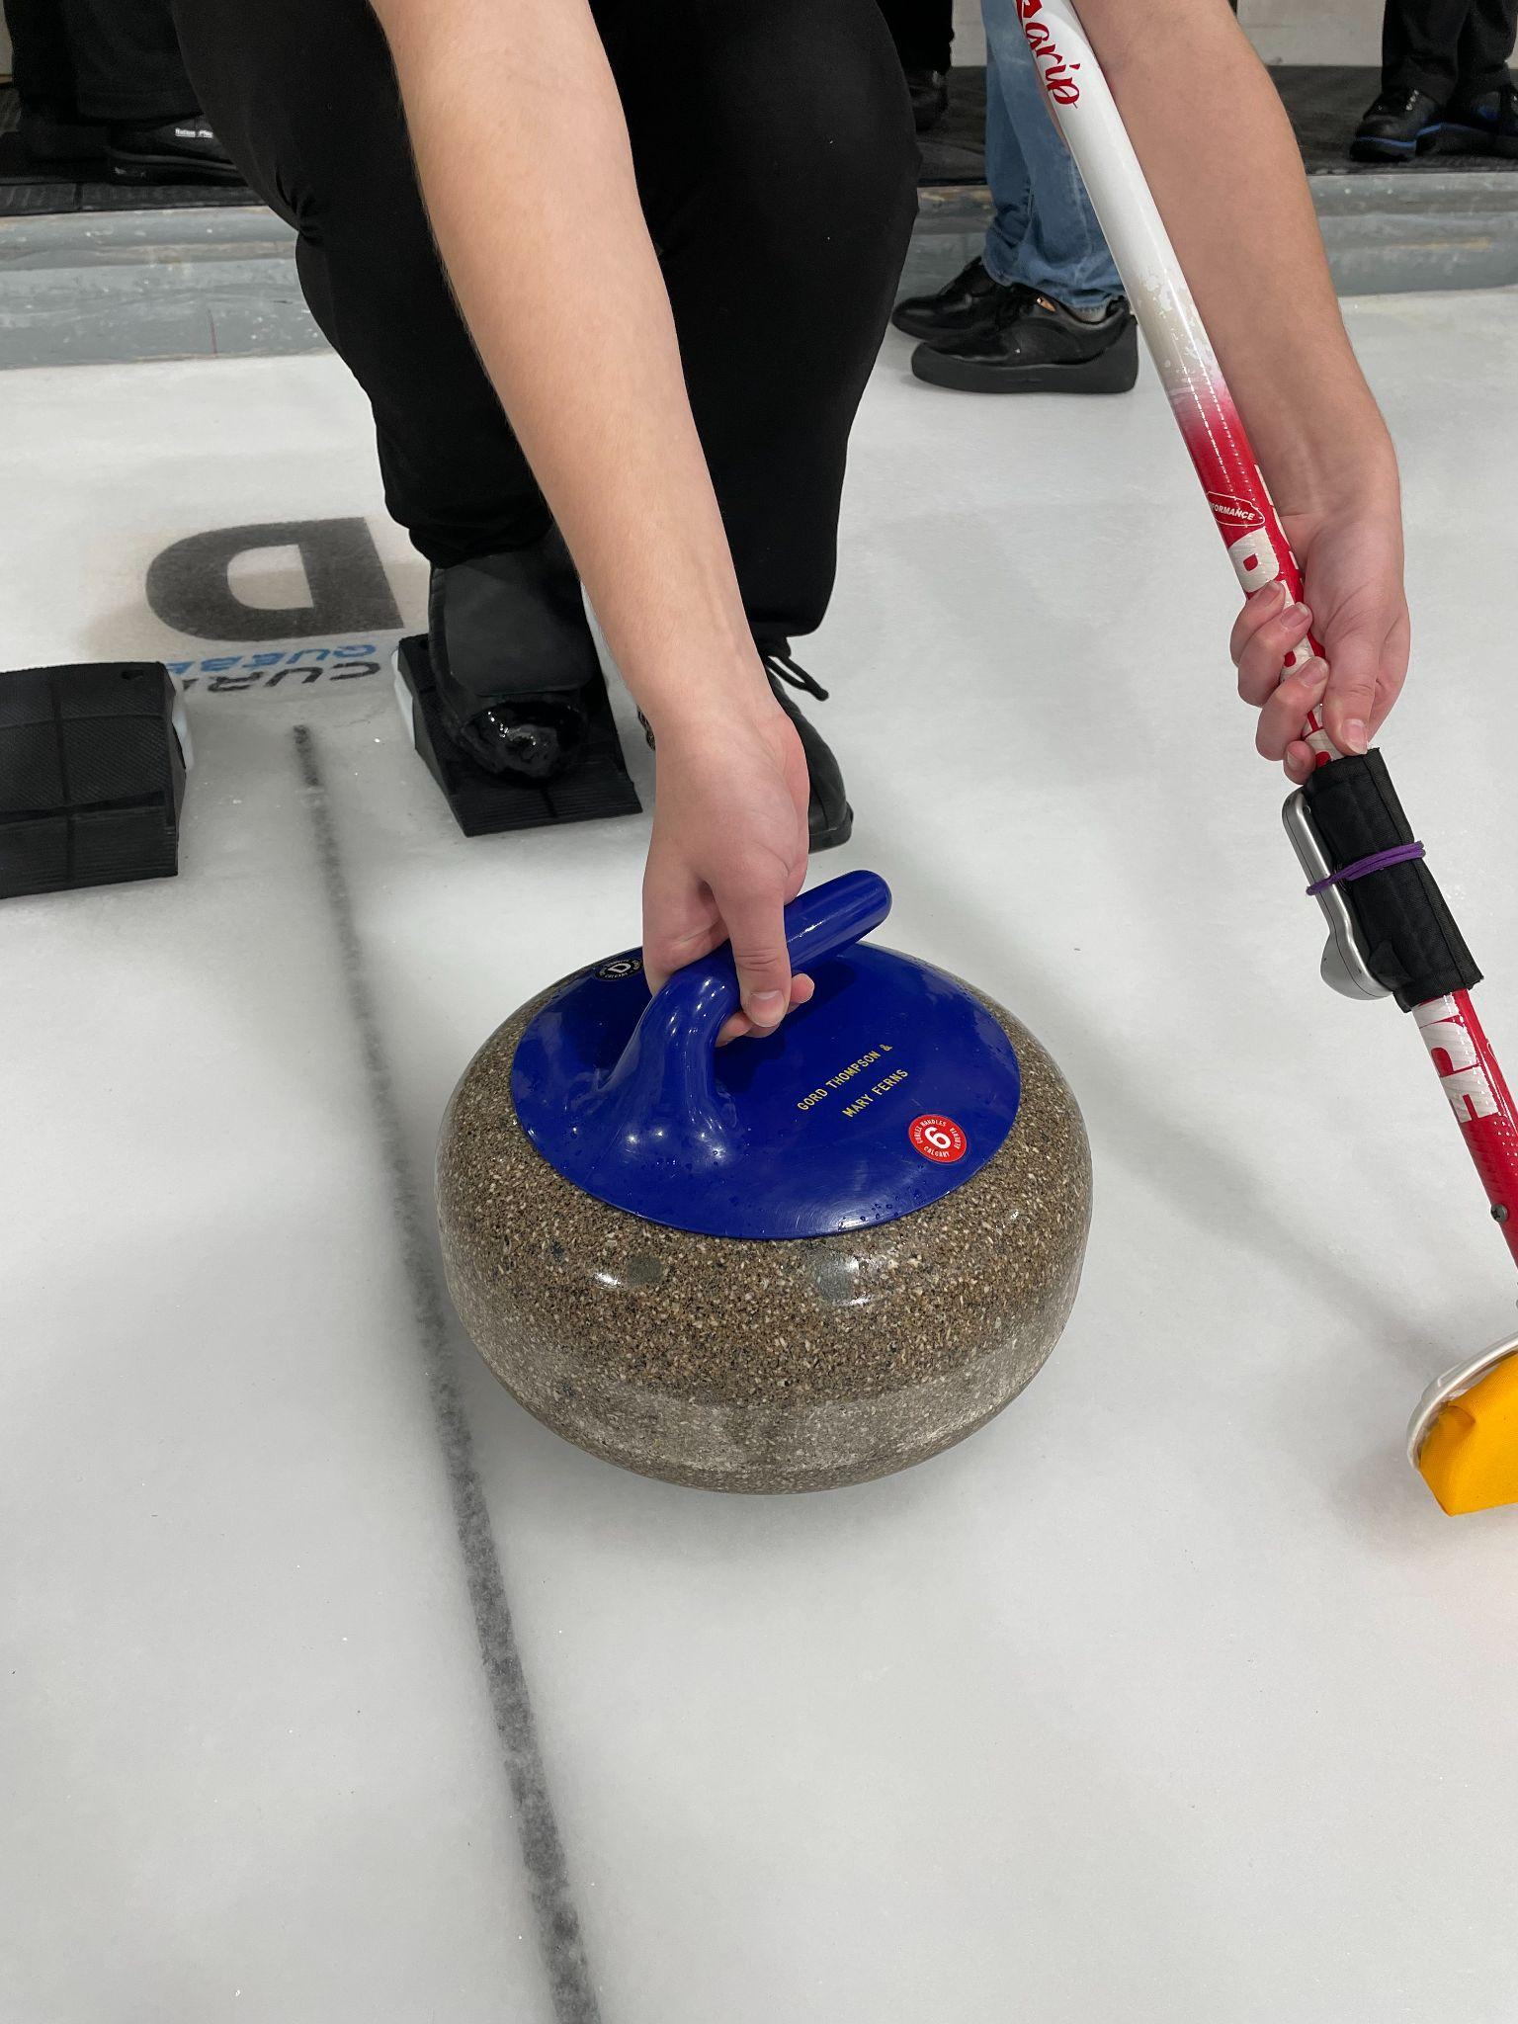
Holding the rock
LEVEL 1 - WEEK 4
Key components for properly holding the rock (description for a right-hander):
→ Place the stone so that the neck of the handle points to 12 o’clock
→ Keep the elbow slightly bent
→ Form a “U” with the fingers that will be under the handle
→ Position the thumb on the left side of the handle
→ Put the emphasis on the thumb, the index and the middle fingers
→ A “V” is then created with the thumb and index finger
→ For a clockwise rotation, position the stone (the neck of the handle) at 10 o’clock. The point of the ‘V’ will aim at your right shoulder
→ For a counter-clockwise rotation, position the stone (the neck of the handle) at 2 o’clock. The point of the ‘V’ will aim at your left shoulder

Slide 29
Rotation of the rock
LEVEL 1 - WEEK 4
→ A rock with lots of rotation stays straight for a longer time
→ A rock with less rotation will curl more
→ In general, a rock should have between 3.5 to 4.5 rotations for a draw
→ The ice surface, sweeping, and playing conditions can all impact the speed and curl of a rock
Fun facts
🥌

Slide 30
Coach’s advice
LEVEL 1 - WEEK 4
→ A solid grip on the rock will allow you to throw more consistently
→ The “V” position between the thumb and index finger confirms that your starting position is efficient
→ Do not forget that at first, holding the rock in the proper position might be uncomfortable, but the more you practice (repetition), the more natural it will become (automatism)
→ When you practice, count the number of rotations the rock completes on each shot
→ Always try to have the same number of rotations from one shot to the next (consistency)
Repetition = Automatism = Consistency

Slide 31
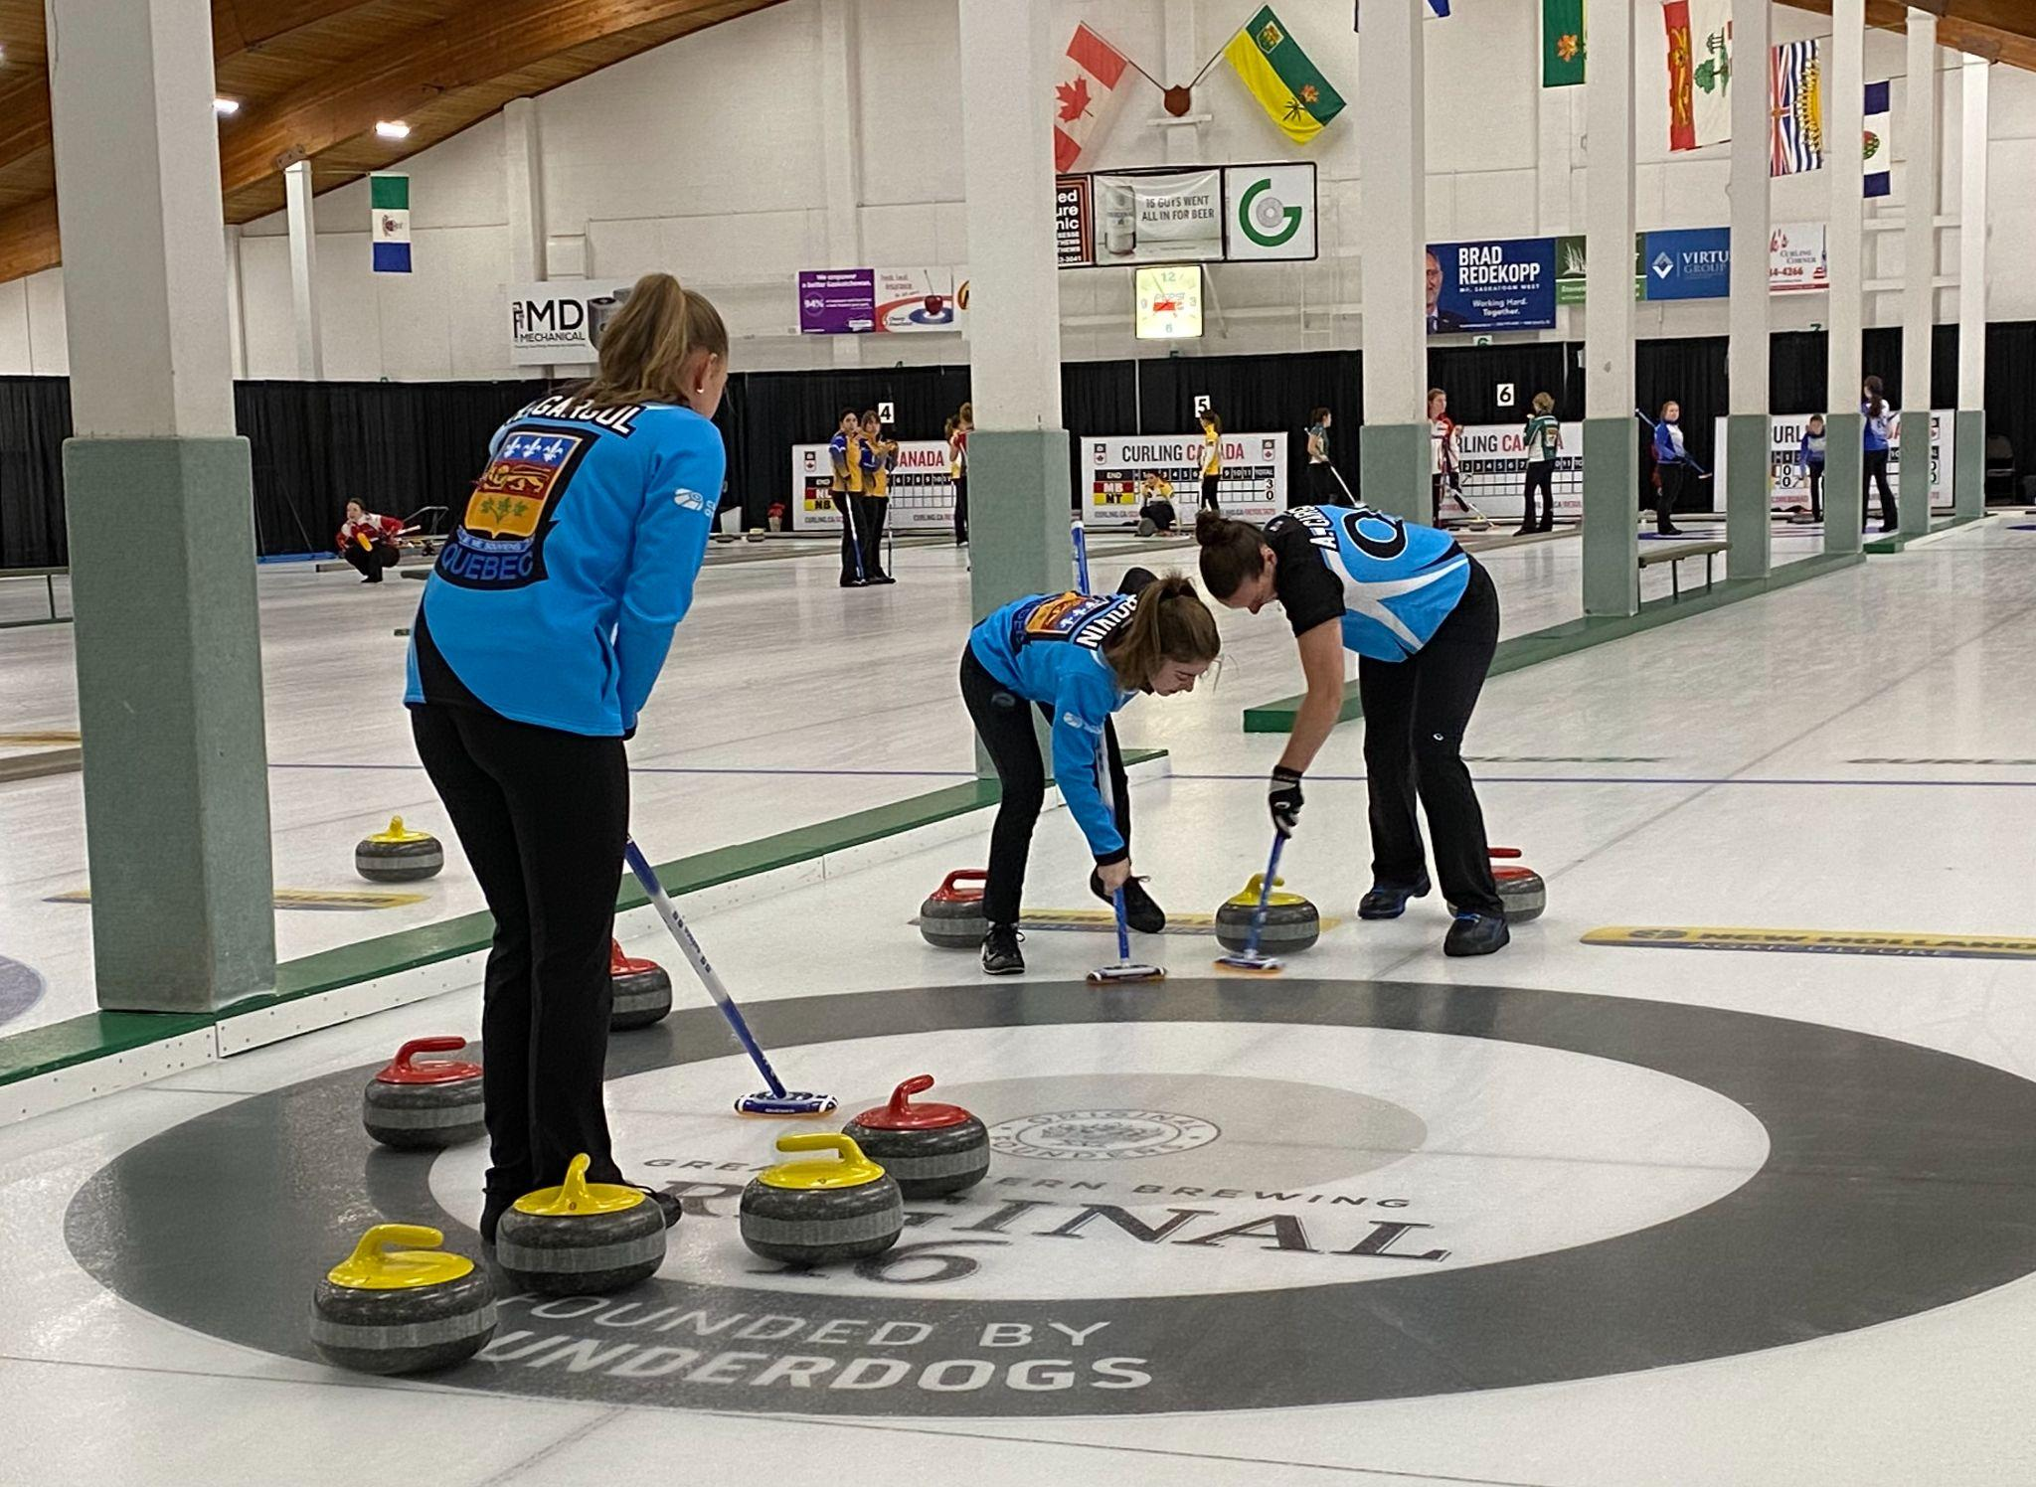
WEEK 5 - SWEEPING

Slide 32
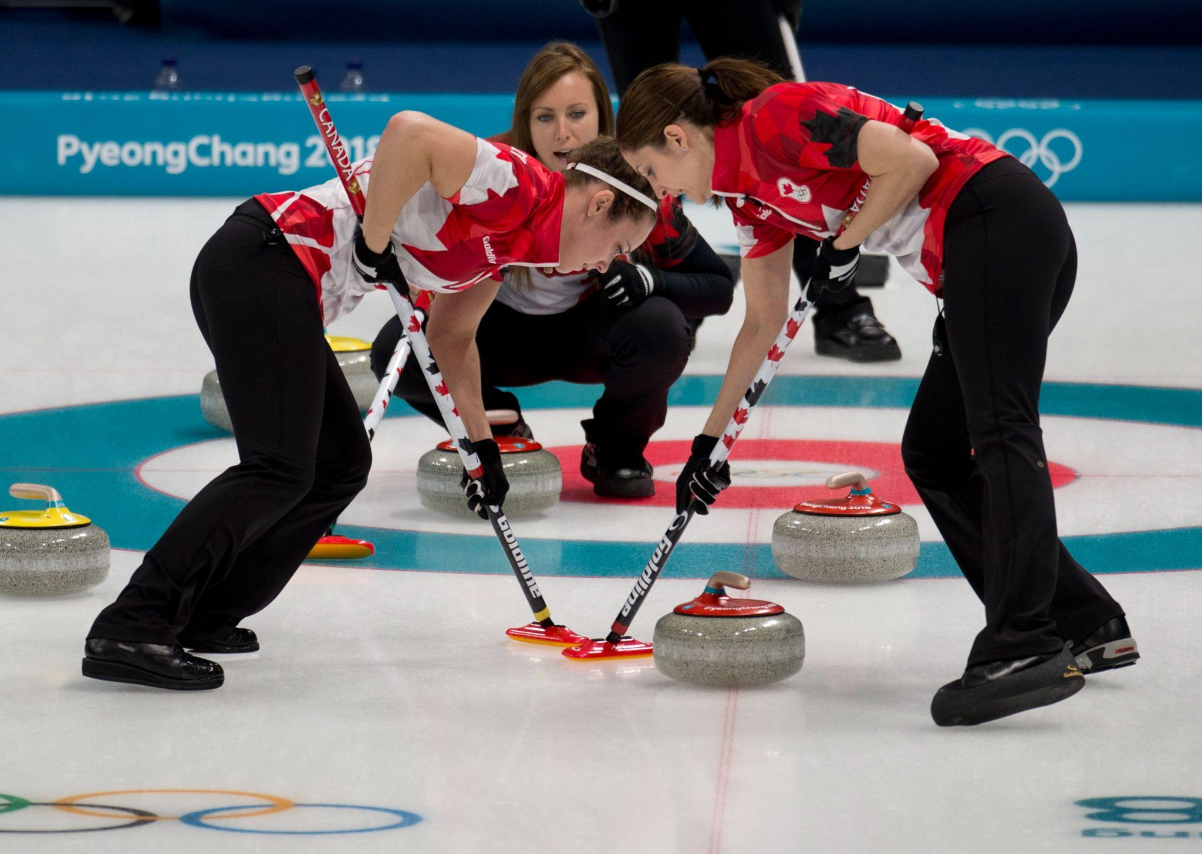
Sweeping - Basic effects
LEVEL 1 - WEEK 5
Basic effects of sweeping:
→ The friction of the broom’s fabric on the ice increases the sliding distance of a stone
→ Removes frost or debris found on the trajectory of the rock
→ Can slow down or increase the curling effect of the rock
🧹

Slide 33
Sweeping - Influencing factors
LEVEL 1 - WEEK 5
🧹
Factors that can influence the speed of a stone:
→ Temperature of the ice
→ Outdoor temperature
→ Sweeper efficiency
→ Surface of the ice (eg. Size of the pebble)
→ Debris, dirt, dust
→ The length of a game (eg. A team that is tight on time will play more take-outs)

Slide 34
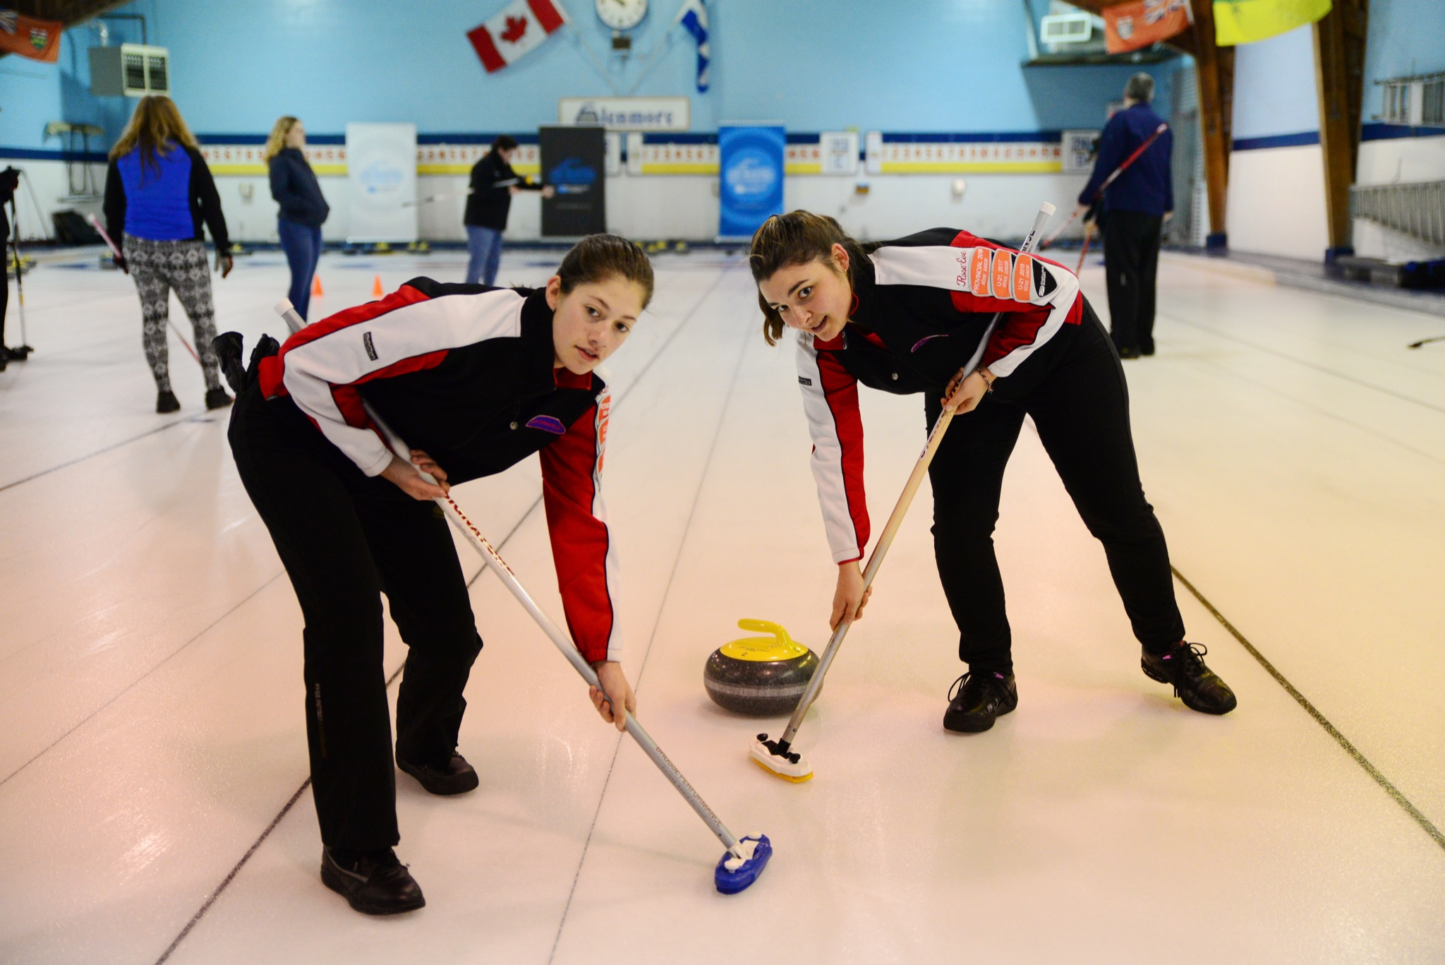
Sweeping - Basic position
LEVEL 1 - WEEK 5
🧹
Basic position for sweeping:
→ Mentally divide the broom into three equal parts
→ Position your body so that it faces the instructor/skip
→ The palm of the lower hand faces the skip, while the back of the upper hand faces the skip
Footwork:
→ Sidestepping

Slide 35
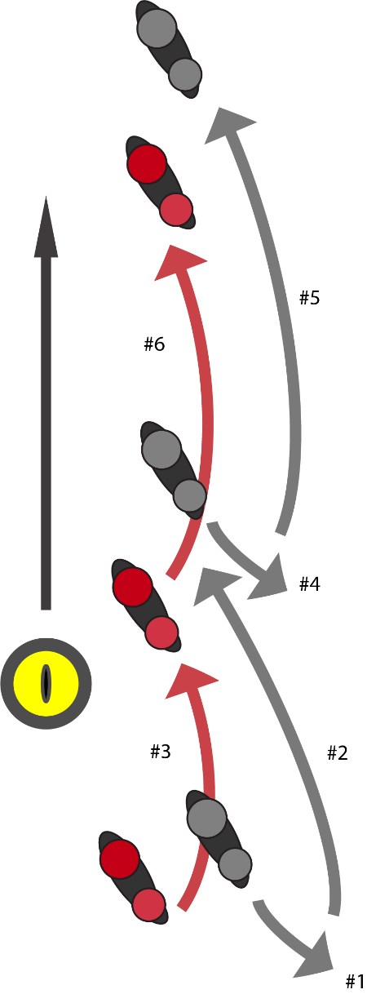
Sweeping - Footwork
LEVEL 1 - WEEK 5
Footwork:
→ The feet stride back and forth in a motion similar to cross-country skiing
*However, the movement is not identical to cross-country skiing

Slide 36
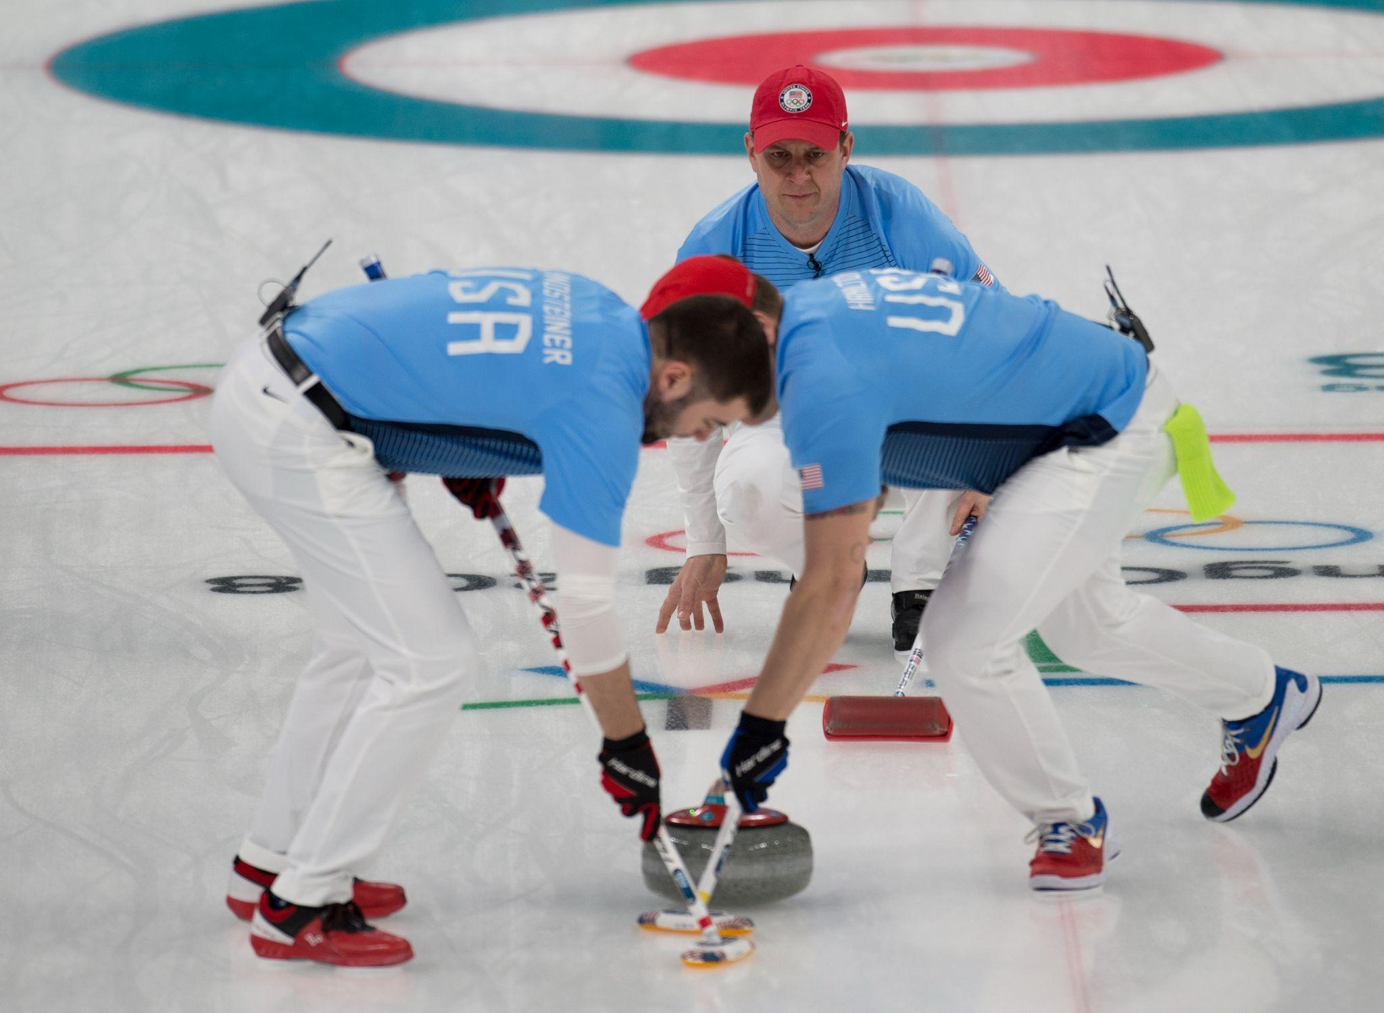
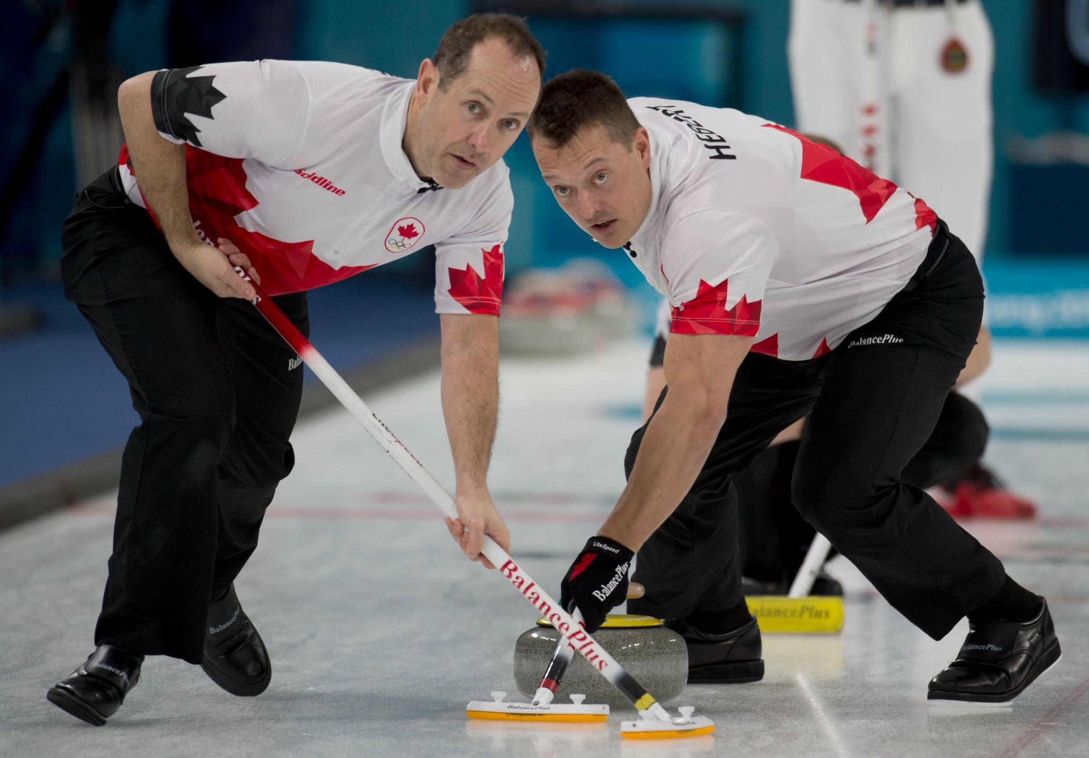
Sweeping - Open position
LEVEL 1 - WEEK 5
Brushing in the open position:
→ The body faces the skip
→ The palm of the lower hand faces the skip
→ The palm of the upper hand faces the sweeper
→ The feet stride back and forth
→The body weight is mostly on the balls of the feet
In these photos, which player is in the open position?

Slide 37
Sweeping
LEVEL 1 - WEEK 5
Did you know…
→ An elite player who sweeps with grippers on both shoes is 75-80% efficient
→ An elite player who sweeps with a slider is 15-20% efficient
*Study from 2010 de l’Université Western d’Ontario

Slide 38
Coach’s advice
LEVEL 1 - WEEK 5
→ Sweeping is an essential part of curling
→ Learning the proper basic technique in the open stance will allow for safer brushing, and make it easier to properly judge the speed of the rocks
→ Considering that one should work out their muscles as equally as possible, it is recommended that players change sides while adjusting their hands accordingly on the broom
🥌 This way, we can avoid injuries by not overusing the same muscles while always brushing on the same side

Slide 39
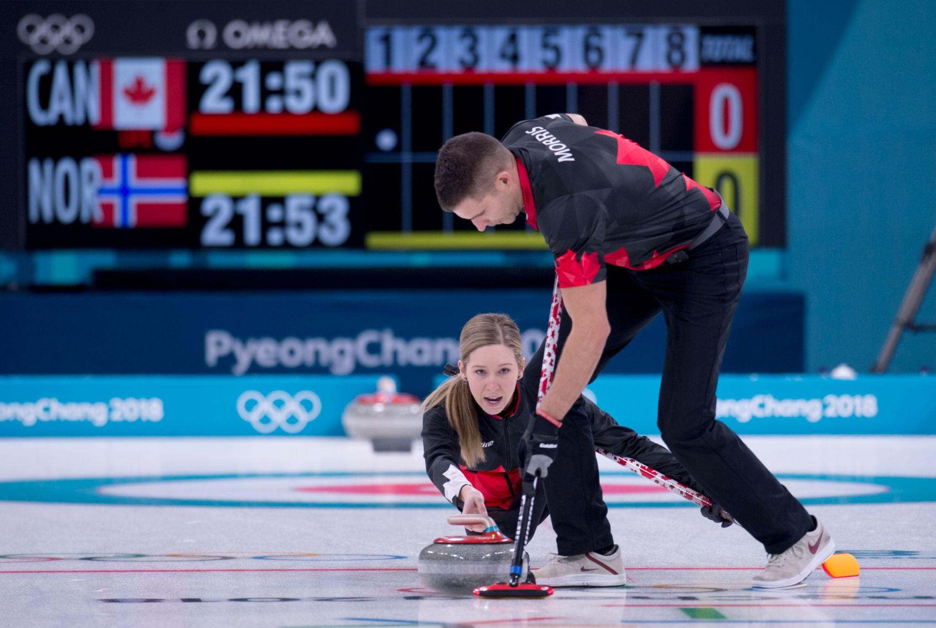
WEEK 6 - LINE OF DELIVERY

Slide 40
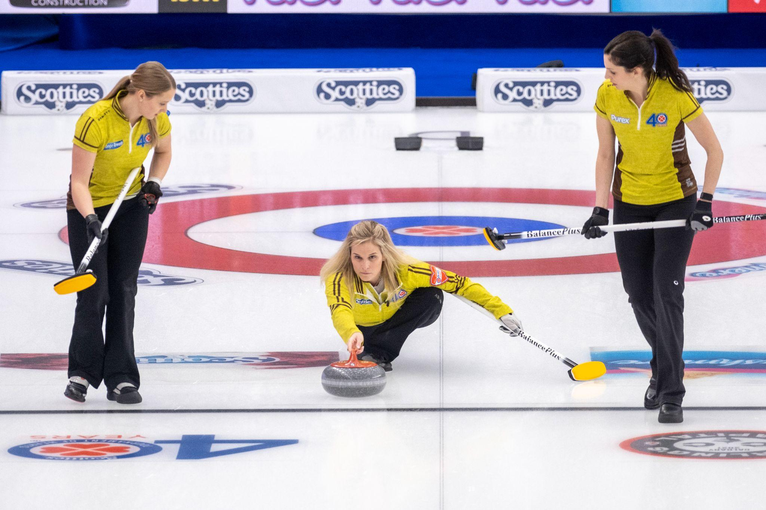
Line of delivery
LEVEL 1 - WEEK 6
Steps for a successful slide:
Position in the hack
Backswing
Weight transfer and forward motion
Pushing from the hack
Sliding position
The release

Slide 41
Coach’s advice
LEVEL 1 - WEEK 6
→ The line of delivery is crucial to have a successful shot
→ Do not forget that the entire shot begins with the proper position in the hack
→ Once your body is aligned with the target, one has to maintain this position for the entire weight transfer process
WARNING:
🥌 The body should never rotate, it should maintain the parallel line ‘FORWARD-BACKWARD’
🥌 Do not bring the sliding foot too far back in the backswing
🥌 The sliding foot should be under the body’s center of gravity (the belly button) when sliding

Slide 42
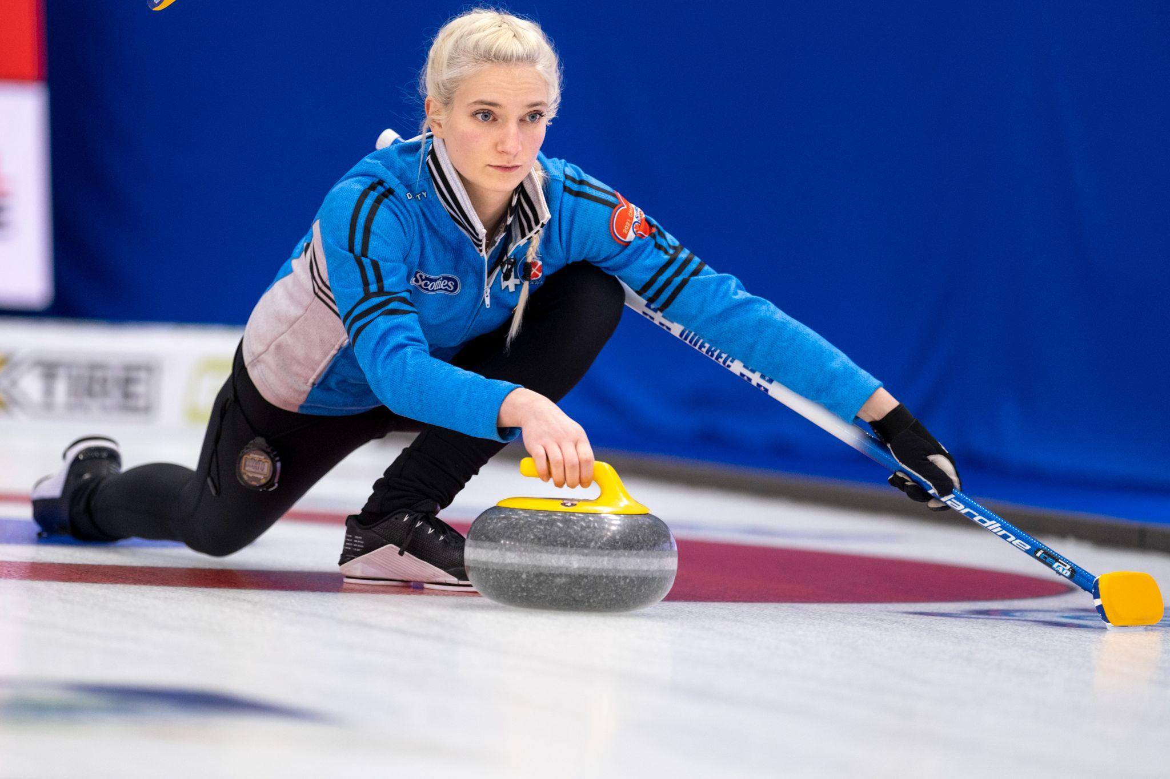
WEEK 7 - TYPES OF SHOTS

Slide 43
Types of shots
LEVEL 1 - WEEK 7
Guard
→ Stone that stops between the hog line and the house
→ It protects one or many rocks in the house
Draw
→ Rock that stops in the house
→ Any rock that touches the house may count as a point
Take-out
→ Action of removing a competitor’s rock from play by hitting it with another stone

Slide 44
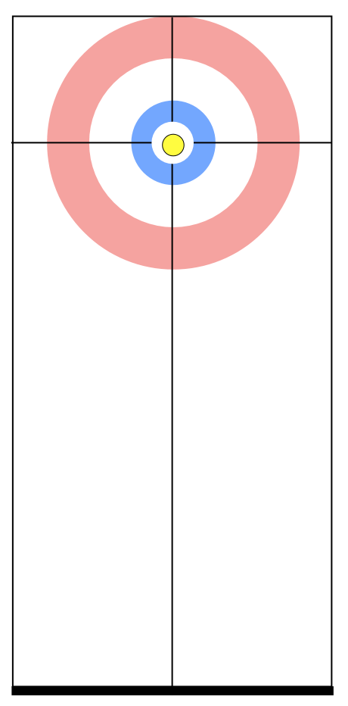
Play area in zones
LEVEL 1 - WEEK 7
Zone 1
Zone 2
Zone 3
Zone 4
Zone 5
Hog Line
Board

Slide 45
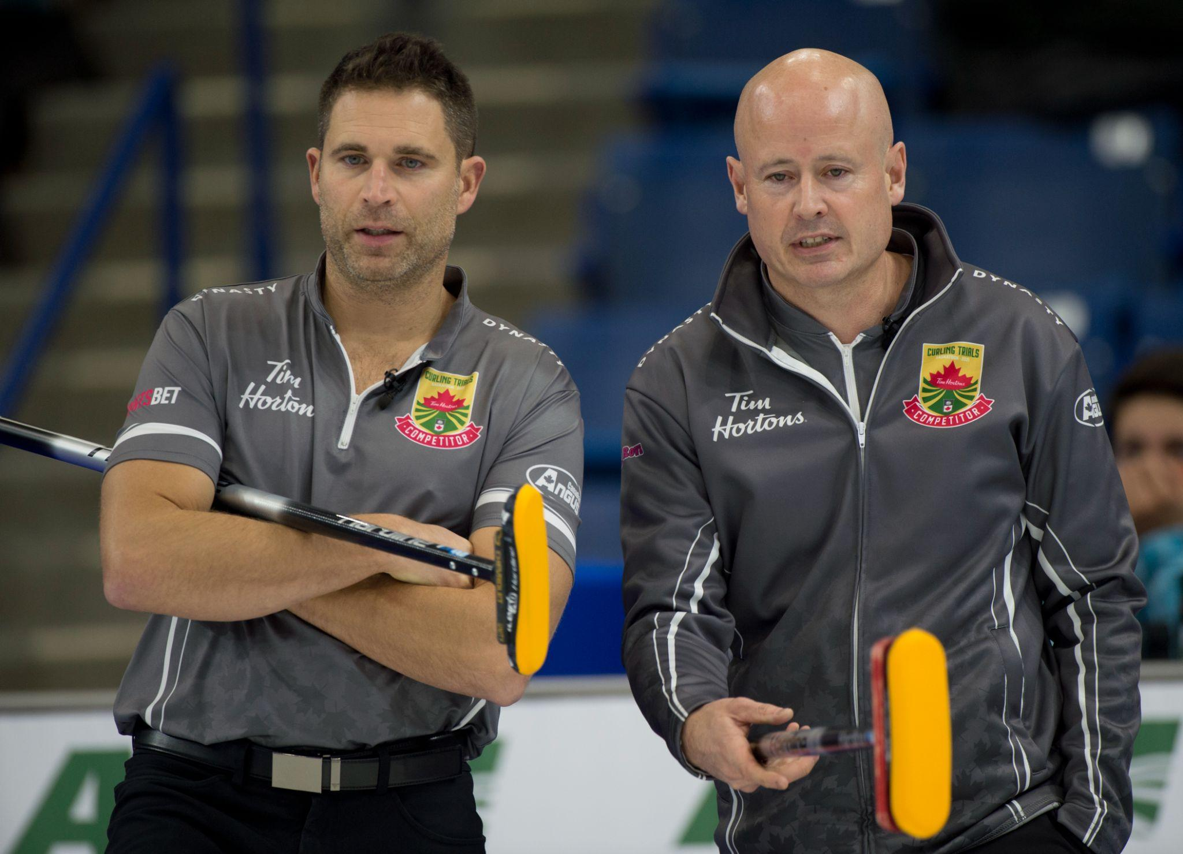
Communication
LEVEL 1 - WEEK 7
Successful basic communication elements:
→ Consistency
→ Clarity for all players
→ Focuses on being positive and constructive
→ Is fast and efficient (in order to respect allotted game time)
→ Takes place before, during and after the throw
→ Varies according to different factors (playing conditions, ice condition, strategy, etc.)
🗣

Slide 46
Coach’s advice
LEVEL 1 - WEEK 7
→ There are three types of shots in curling. In order to properly develop your technique, it is important to master all three basic shots.
→ You must adjust your push strength from the hack according to the requested shot.
→ Just as in everyday life, COMMUNICATION plays a key role in curling.
Practice = Improvement = Confidence = Consistency

Slide 47
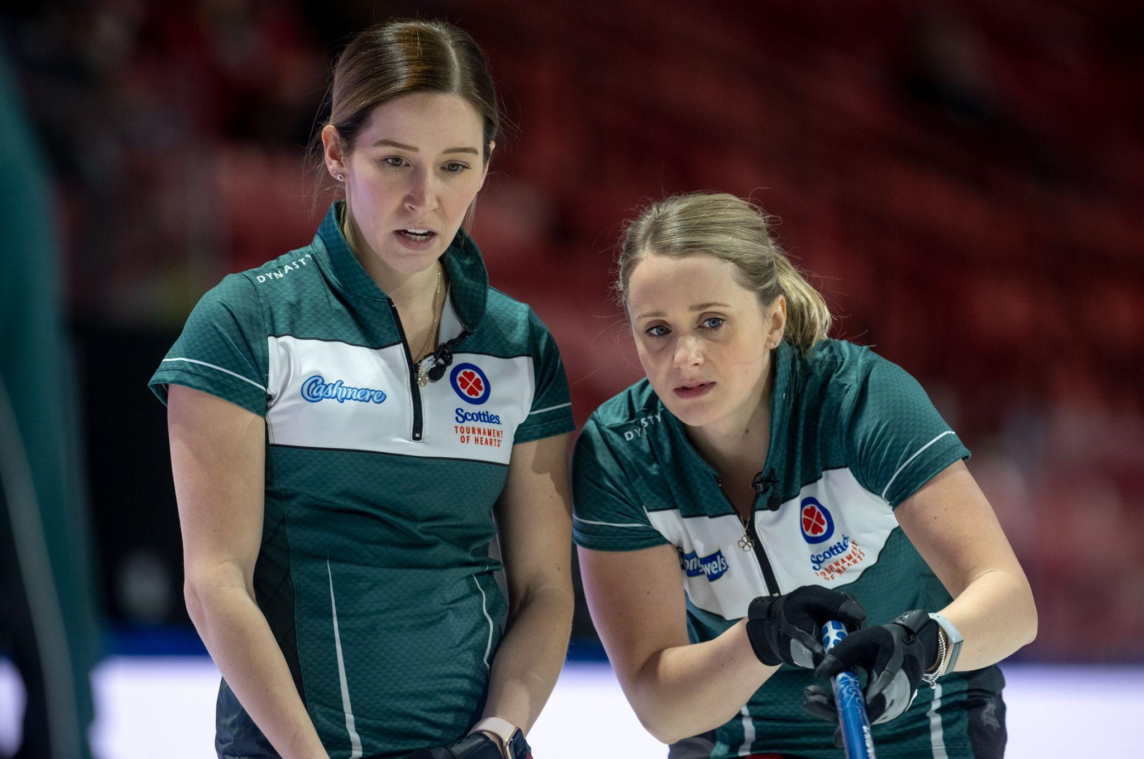
WEEK 8 - STRATEGY

Slide 48
Strategy - Definitions
LEVEL 1 - WEEK 8
Definitions:
→ Strategy
Strategy is the plan that leads to an objective.
🥌 It is the basic means of achieving an intended outcome in a specific game situation, and provides general guidance as to the types of shots that you should select (example: for the first end, the plan is to blank the end to learn the ice condition and to keep the advantage of the hammer for the second end).
→ Tactics
Tactics are the specific shots that you play to help implement ‘’the plan’’
🥌 Tactics are also the various team skills and systems that help you execute shots successfully (example : The choice of shots, where the stones should be positioned, etc.).
*It is important for the tactics to be aligned with the strategy!

Slide 49
Strategy - Influential factors
LEVEL 1 - WEEK 8
Factors that can influence your choice of strategy:
→ Do you have the hammer?
→ Are we at the beginning, middle or end of the game?
→ Which player is throwing?
→ What are the strengths or weaknesses of our team? What are the opponents’ strengths/weaknesses?
→ What is the current score?
→ What is our objective (take 2, blank, give up 1 point, etc.)?
→ How many ends are left?
→ What are the ice conditions now?

Slide 50
Strategy
LEVEL 1 - WEEK 8
The basic strategy to adopt:
With the hammer
→ Last rock advantage
→ Control of the sides of the house and corner guards
→ Objective = Take 2 or more
Without the hammer
→ First rock of the end
→ Control the center of the sheet and center guard
→ Objective = Give 1 or steal
It is important that all the players know the strategy every end!
🔨

Slide 51
Coach’s advice
LEVEL 1 - WEEK 8
→ Strategy is a very broad subject.
→ Just like the different techniques, one must learn and master the basic strategy.
→ The game of curling will be more enjoyable and enriching if we understand the strategy.
→ Curling is a lot like chess: we have to think ahead, planning our next shot while considering our opponent’s shots.
→ Many factors will influence your choice of shots (tactics) but what is most important: discuss it with your teammates!

Slide 52
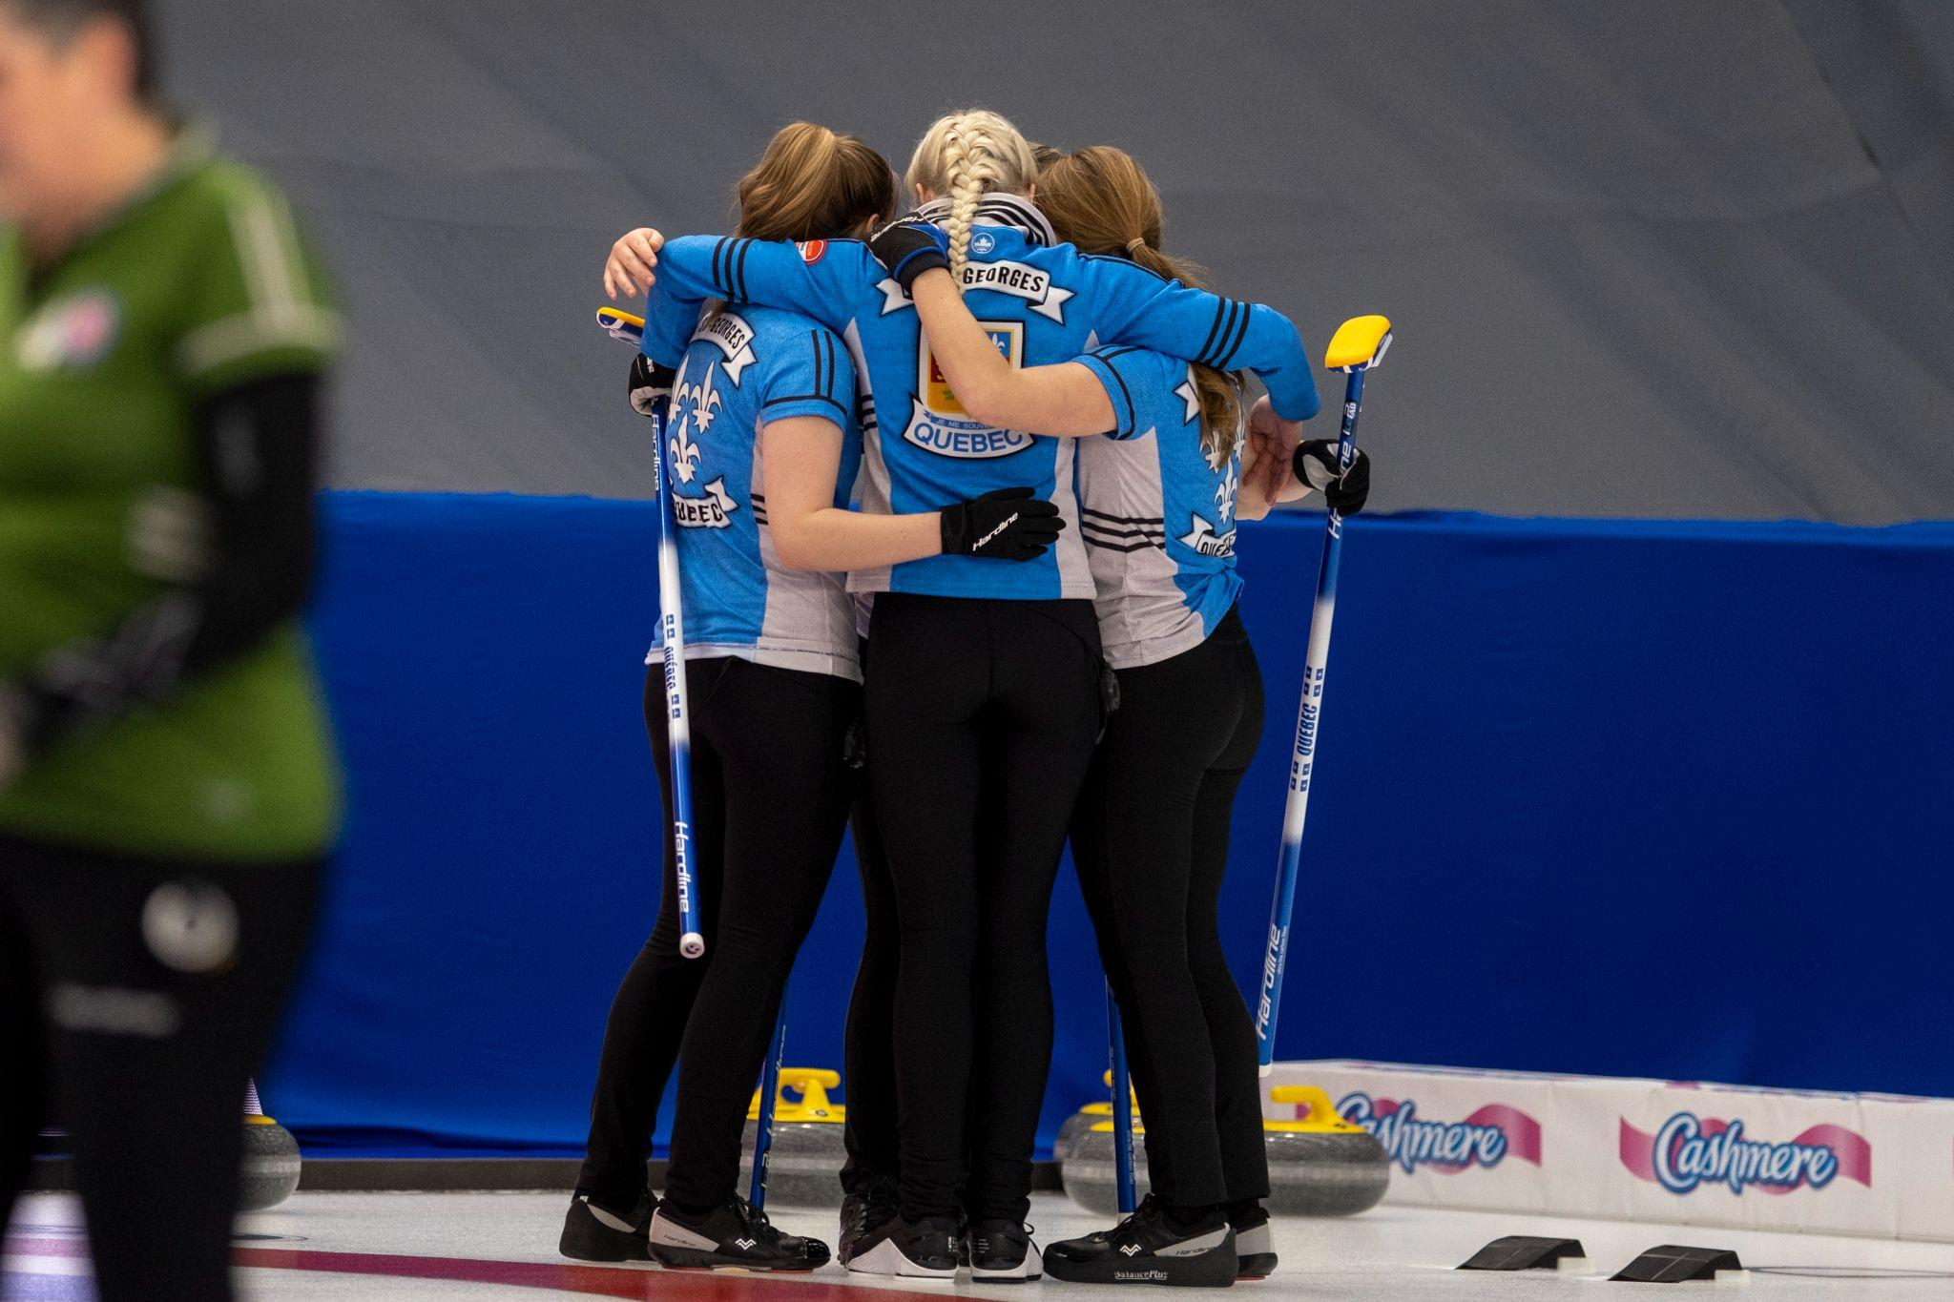
WEEK 9 - ROLE OF PLAYERS

Slide 53
Role of players - Lead
LEVEL 1 - WEEK 9
Lead:
→ Key player to start the end
→ Is excellent with guards and draws
→ Studies the play and ice condition (speed, opponents)
→ Judges the rock’s speed and communicates it to the team
→ Cleans the zone around the hack
→ Prepares the third’s and the skip’s stones
→ Should not be in the house

Slide 54
Role of players - Second
LEVEL 1 - WEEK 9
Second:
→ Is excellent with all types of shots
→ Studies the play and ice condition (speed, opponents)
→ Judges the rocks’ speed and communicates it to the team
→ Helps in putting away the stones after each end
→ Cleans the ice around the line of delivery for the next shot from the back line to the hog line
→ May go to the edge of the active house if the skip and the third ask for advice.
→ Should not be in the house during an end

Slide 55
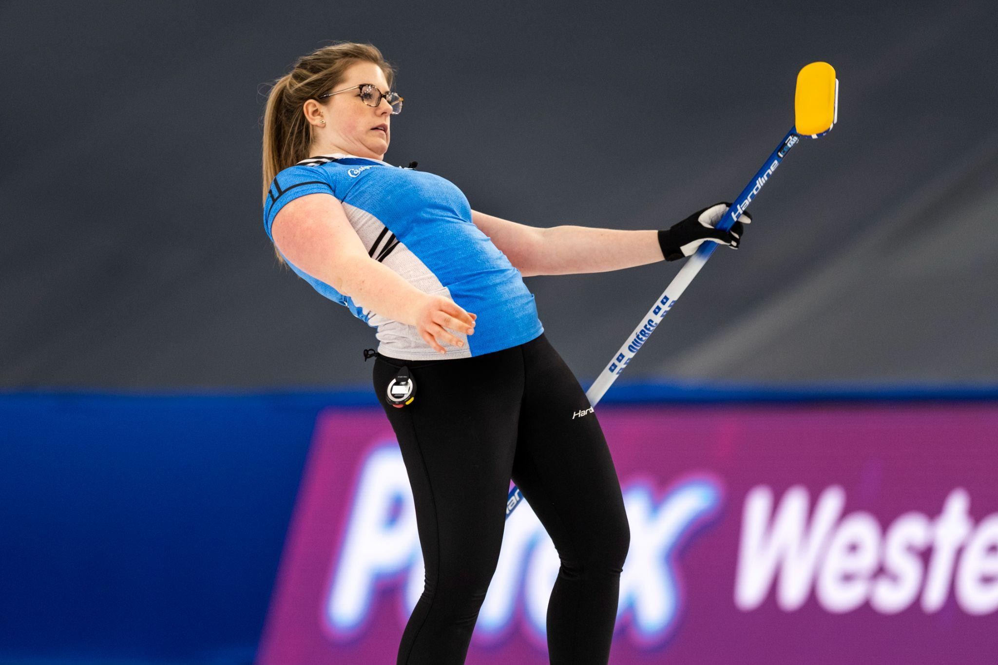
Role of players - Vice skip
LEVEL 1 - WEEK 9
Third (vice-skip):
→ Is excellent with all types of shots
→ Is the link between the skip and the front end
→ Reinforces the skip’s decisions
→ Manages the game time
→ Reads the ice and is alert to the changing ice conditions
→ Replaces the skip in the house when they throw their stones
→ Communicates with teammates clearly and efficiently
→ Does the measuring, agrees to the score with opposing third, and puts up the score

Slide 56
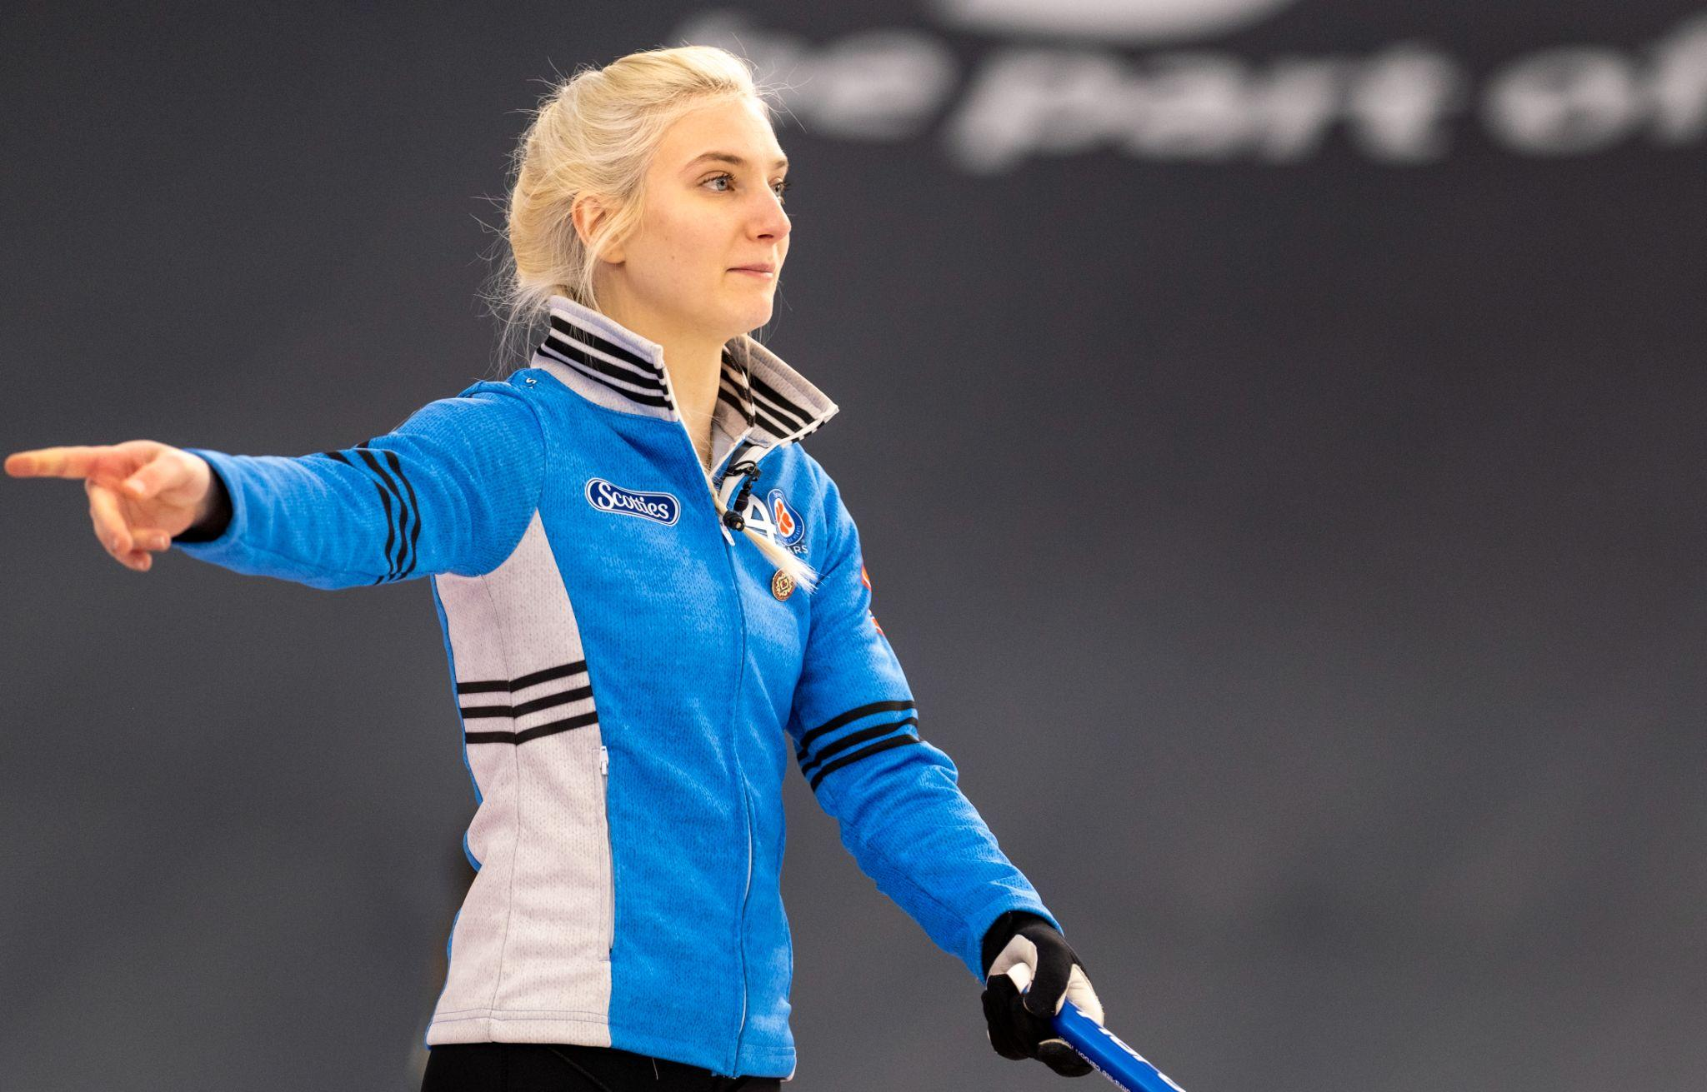
Role of players - Skip
LEVEL 1 - WEEK 9
Captain (Skip):
→ Is the ‘leader’ of the team
→ Sets the strategy
→ Communicates the shot to be played clearly and efficiently
→ Communicates with teammates during the game (ice conditions, strategy, feedback on shots, etc.)
→ Reads the ice
→ Adjusts the strategy according to the strengths and weaknesses of the team and the opponents
→ Excels with draws and shots under pressure

Slide 57
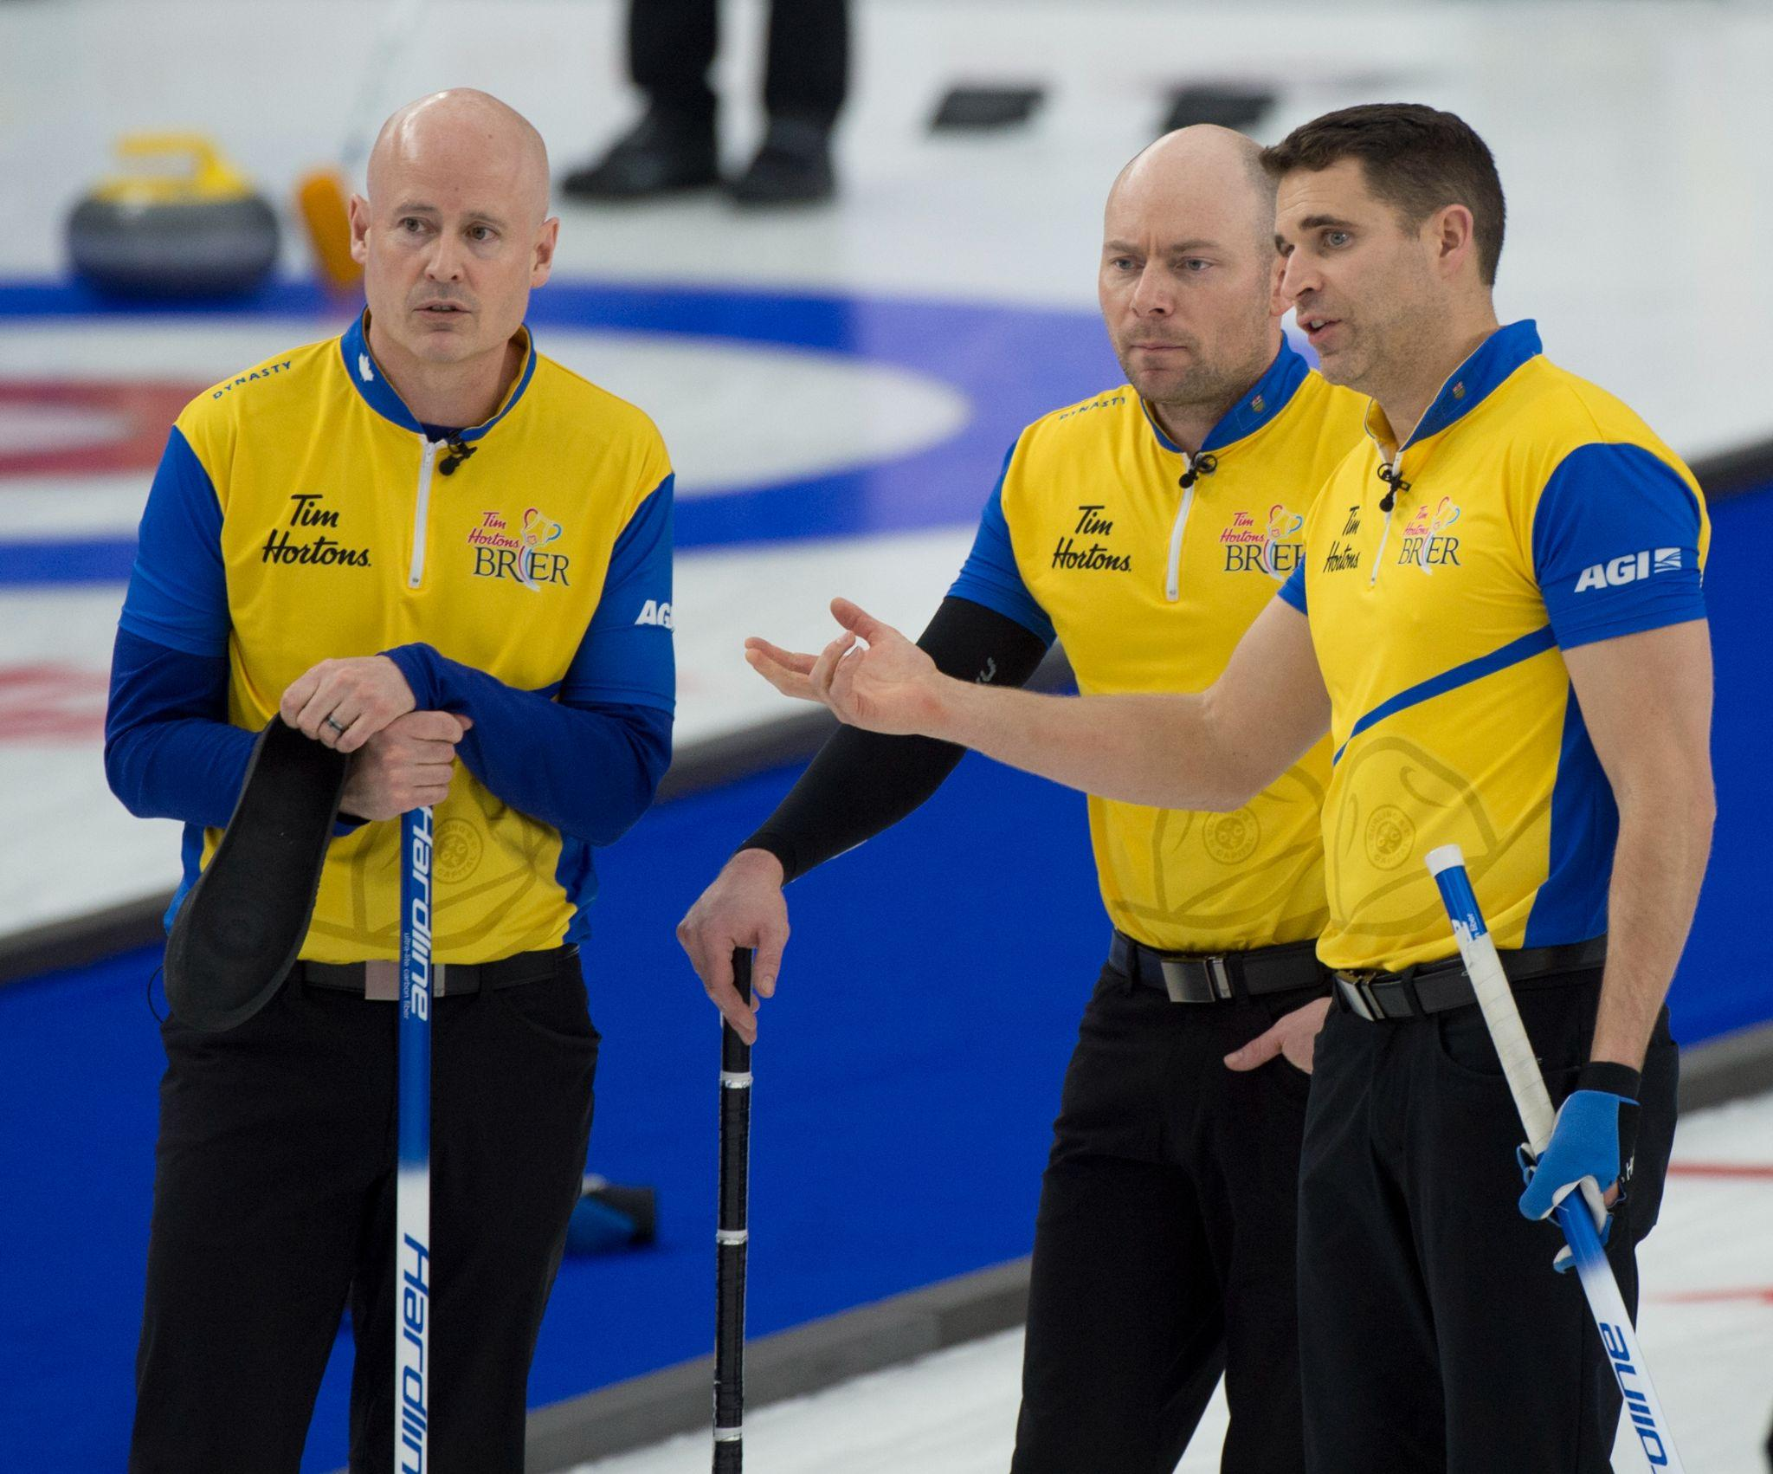
Role of players - Communication
LEVEL 1 - WEEK 9
Communication between the players during a game:
→ Must be consistent
→ Must be clear for all the players on the team
→ Must be positive and constructive
→ Must be done before, during and after the shot
→ Must be quick and efficient in order to respect the clock
→ Must be adapted to the different factors (sheet conditions, ice speed, strategy, etc.)
🗣

Slide 58
Role of players - What to say and not to say
LEVEL 1 - WEEK 9
What to say and what not to say:
✅
→ Encourage teammates
→ Stay positive
→ Give constructive feedback
→ Validate ice speed or sheet condition
→ Communicate at all times
❌
→ Be negative with the teammates
→ Give negative comments on shots or sweeping
→ Stop communicating if a shot is missed
→ Bang their broom on the ice
→ Swear

Slide 59
Coach’s advice
LEVEL 1 - WEEK 9
Every role is important!!
→ The more you curl, the more at ease you will become with the skills of communication.
→ Each player has a key role within the team.
→ If one player tries to do too much or tries to take over the role of another player, gaps and problems will occur.
→ It is the duty of each player to know and understand their role.
Efficient Communication = Positive energy = Fun

Slide 60
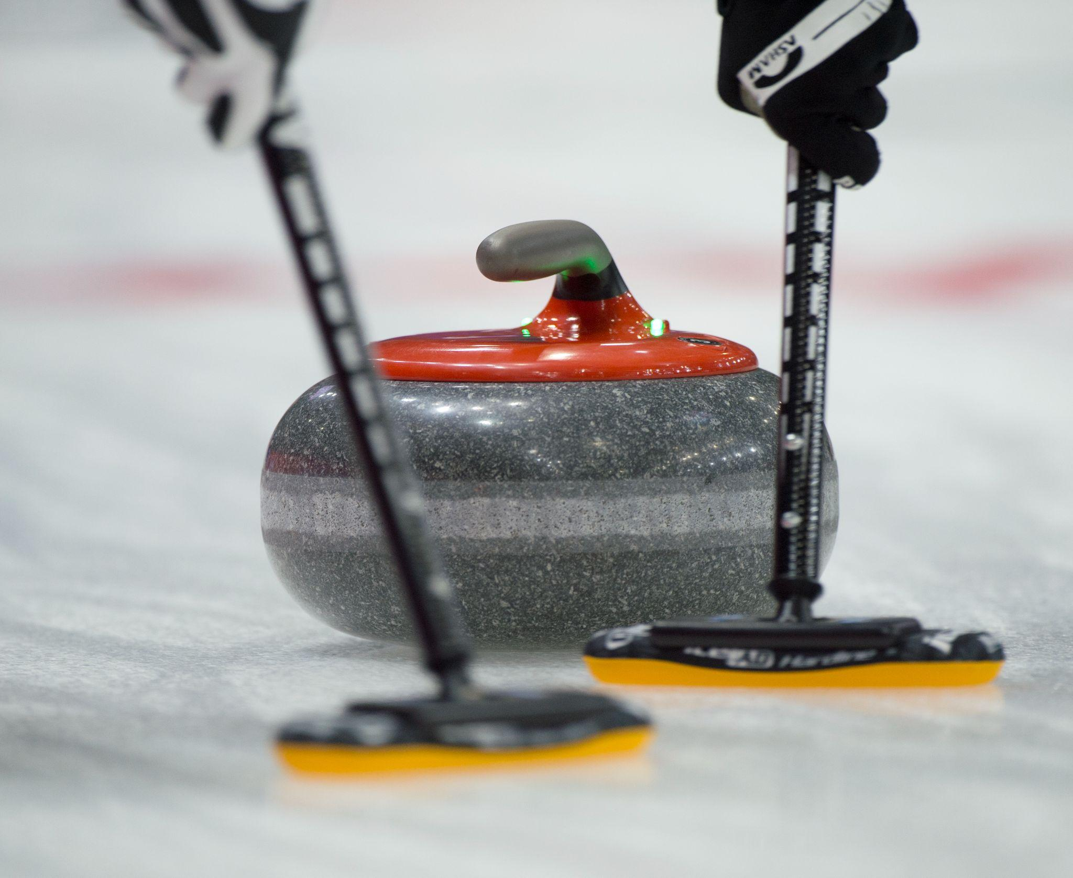
WEEK 10 - SUMMARY

Slide 61
Level 1 - What you have learned
LEVEL 1 - WEEK 10
→ Safety related to curling
→ Basic terminology of curling
→ Ethics and basic rules
→ Positioning in the hack
→ The steps to making a shot
→ Sliding with a stabiliser
→ Sweeping in the open position and the effects of sweeping
→ Different types of shots
→ Communication and the role of each player
→ Basic strategy
💡

Slide 62
Level 1 - What you learned
LEVEL 1 - WEEK 10
Congratulations on completing the first level of the
ASCENSION PROGRAM!
Join us for Level 2 to keep improving the basic techniques!

Slide 63
Level 1 - What level 2 has in store for you
LEVEL 1 - WEEK 10
What to expect for Level 2:
→ More detailed techniques on the position in the hack, weight transfer and using the brush when sliding
→ Improving holding the stone and introduction to the release zone
→ Improving the open sweeping position and introduction to the 4 key points to efficient brushing
→ Team dynamics
→ Learning techniques for better weight control
→ Familiarization with curling terminology
→ Developing a basic strategy and introduction to the term: tolerance
→ More game-time to improve your skills!

